Slide 1

Moments in Time:
Photographs from the Jay Family Collection

Slide 2
Life on the Jay estate

Slide 3
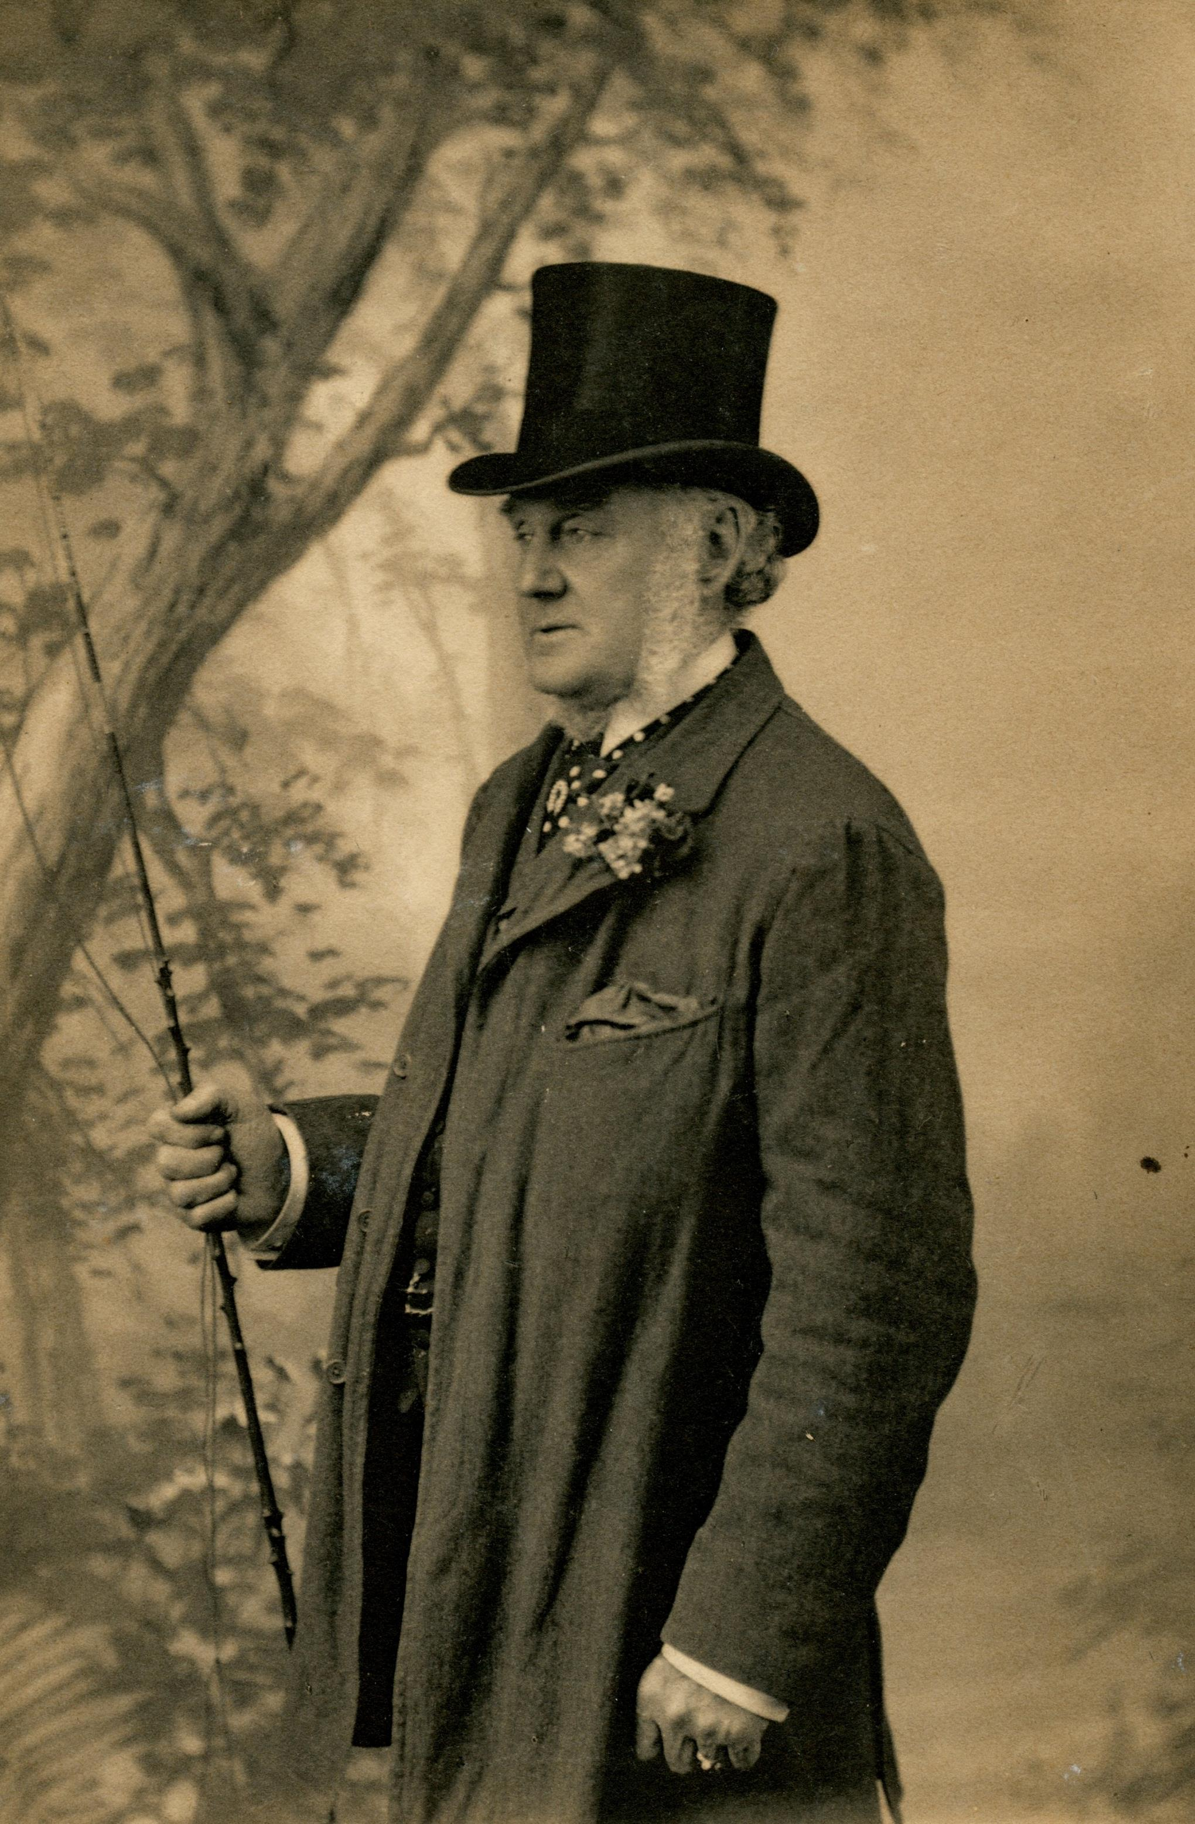
Edwin Forones a groom at Bedford house
Place unknown (photographer Ball at 17 Regent St. SW)
c. 1900
JJ.2015.15

Slide 4
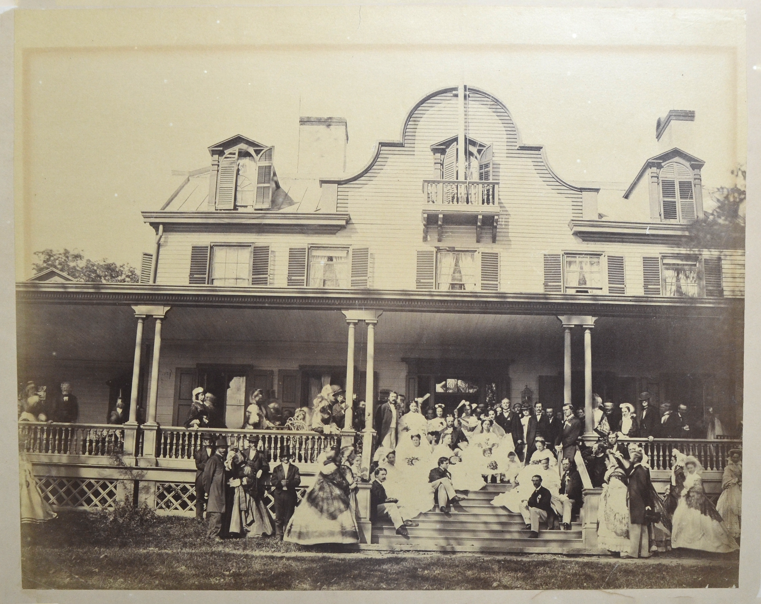
Mary Jay and William schieffelin wedding
Matthew brady
Front porch, Bedford house
1863
jj.1975.10

Slide 5
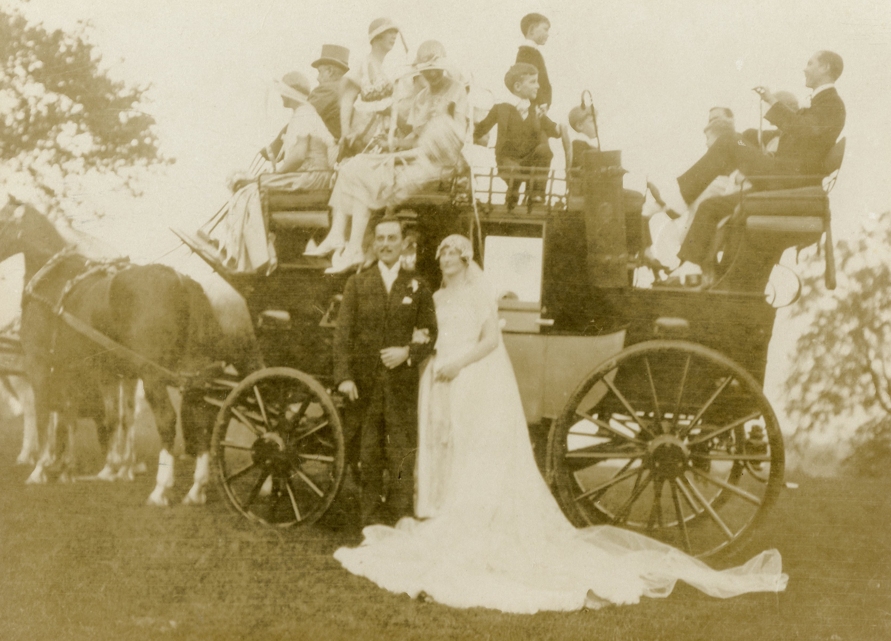
Dorothy Iselin and guy Sherman pascHal with wedding coach
Bedford house
1926
jj.2015.31

Slide 6
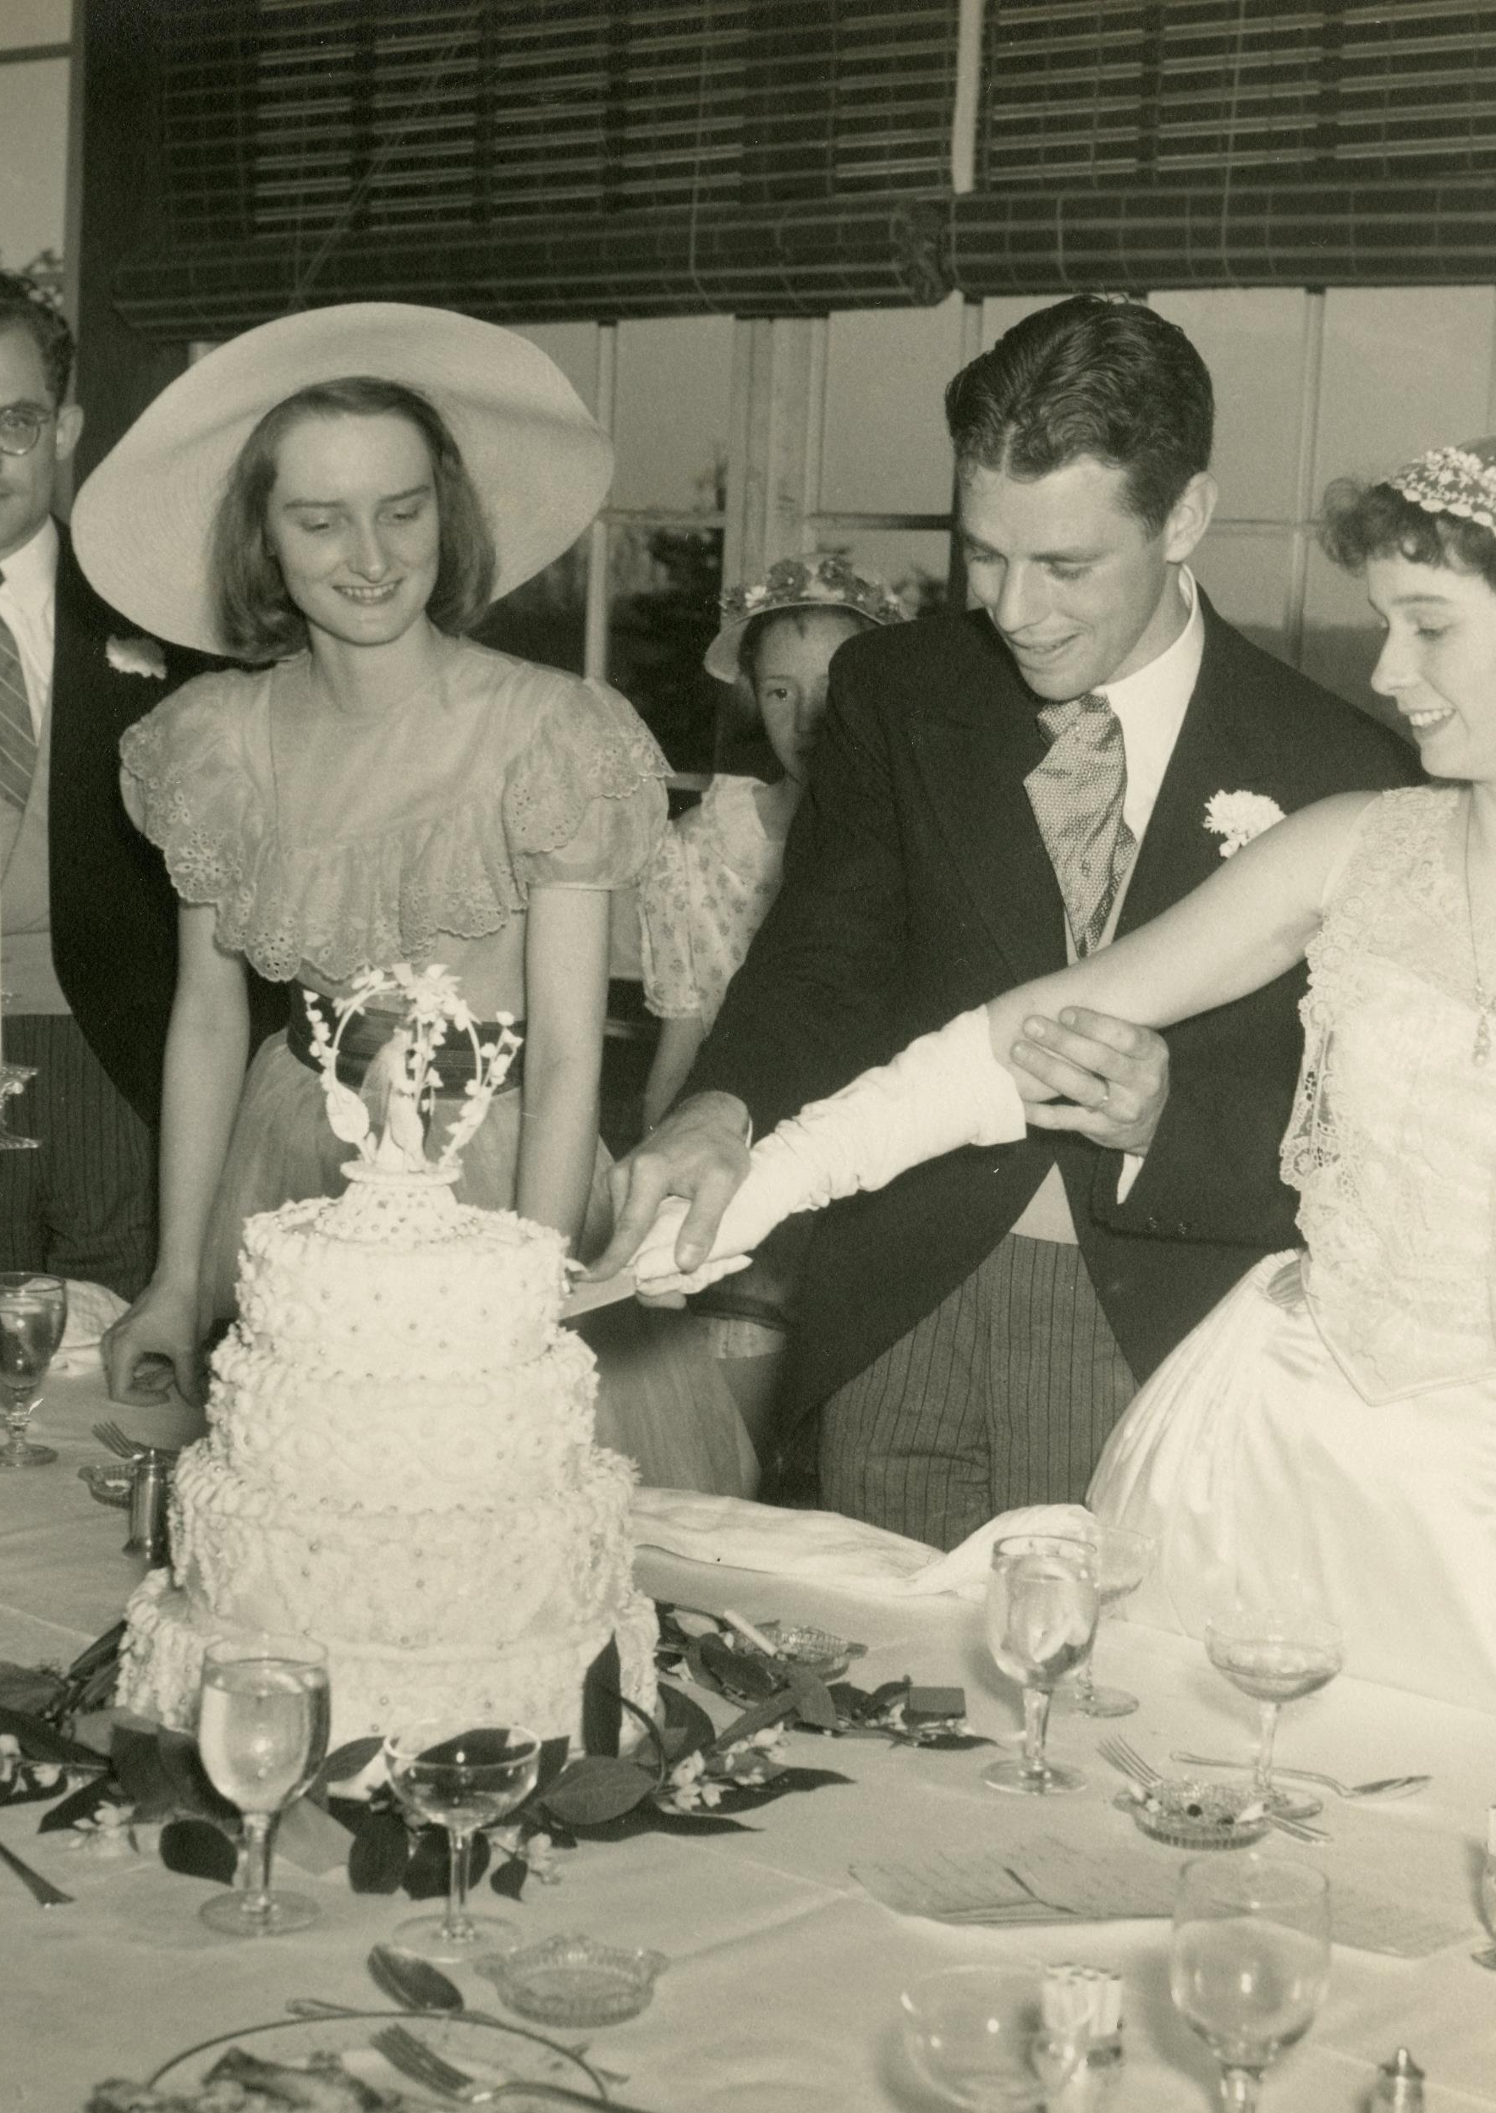
Barbara pascHal and Richard Dominick cutting wedding cake
Glass porch, Bedford house
1948
jj.2015.25

Slide 7
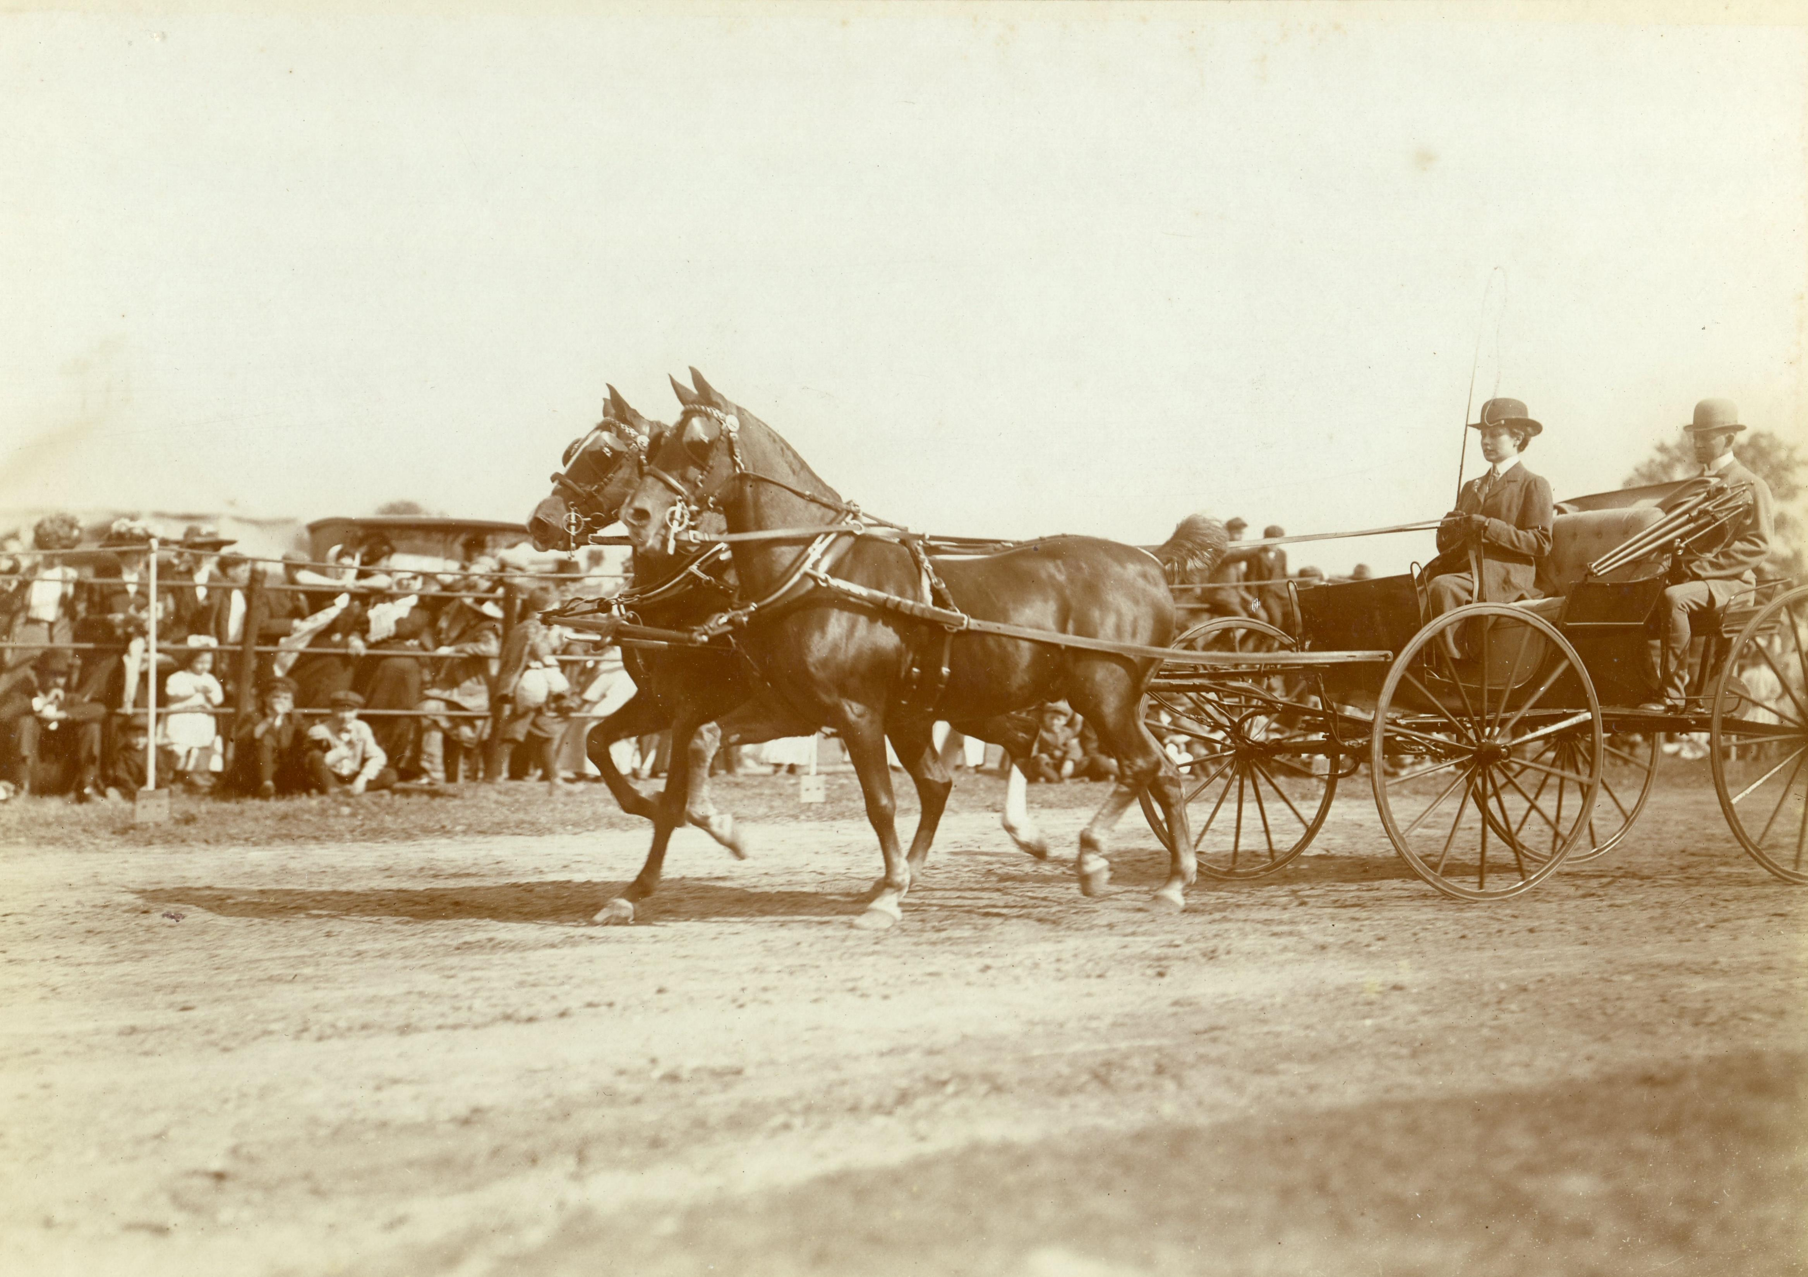
Eleanor Iselin driving a coach
Place unknown
c. 1905
jj.2015.29

Slide 8
portraiture

Slide 9
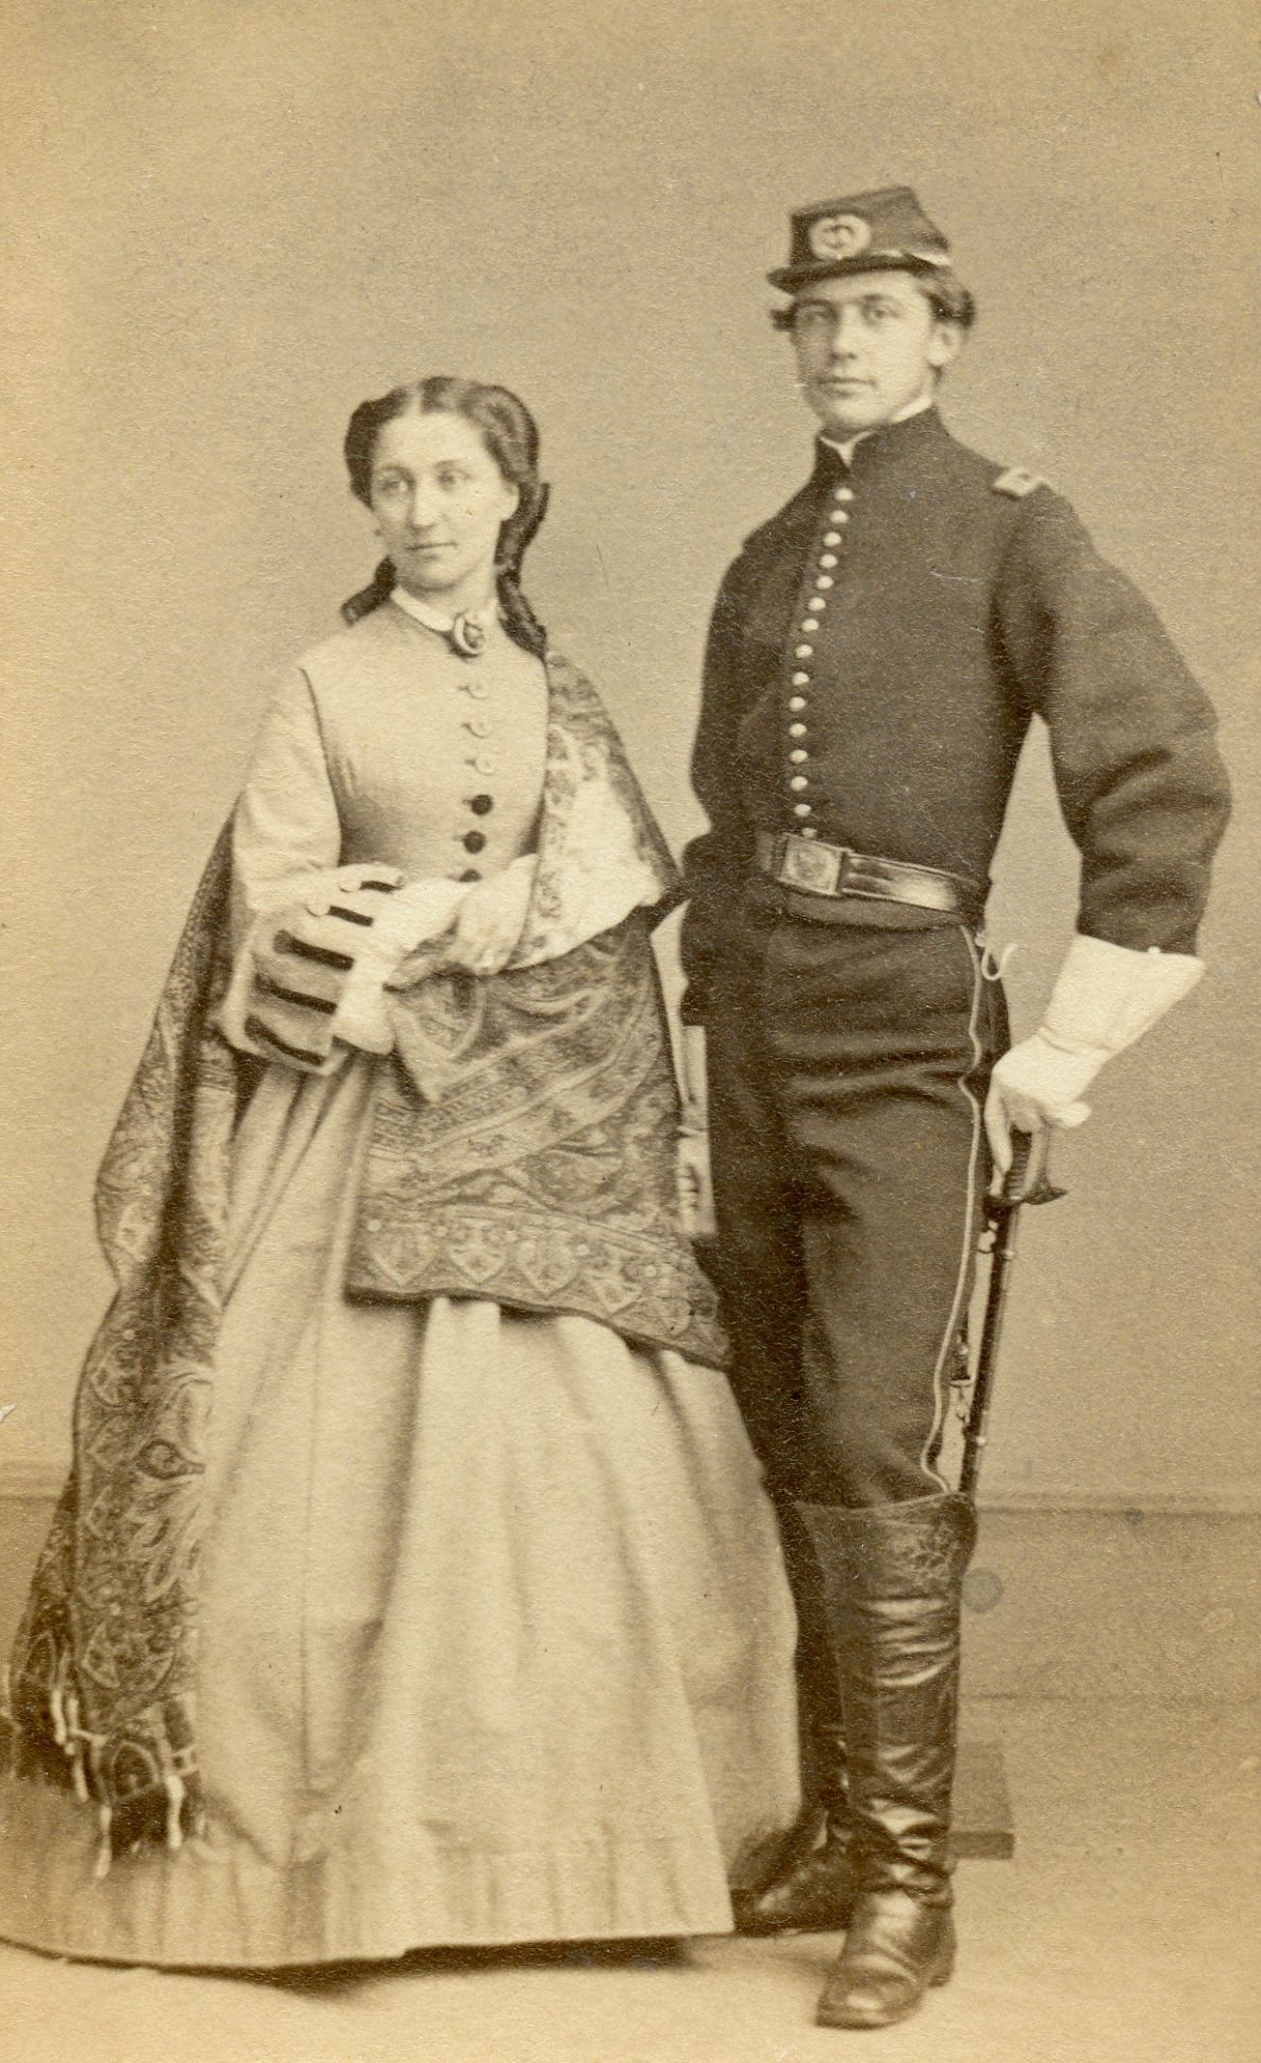
Col. William Jay with sister
Eleanor chapman
Charles Frederick Studio, 587 Broadway, New York, NY
C. 1865
JJ.1984.117

Slide 10
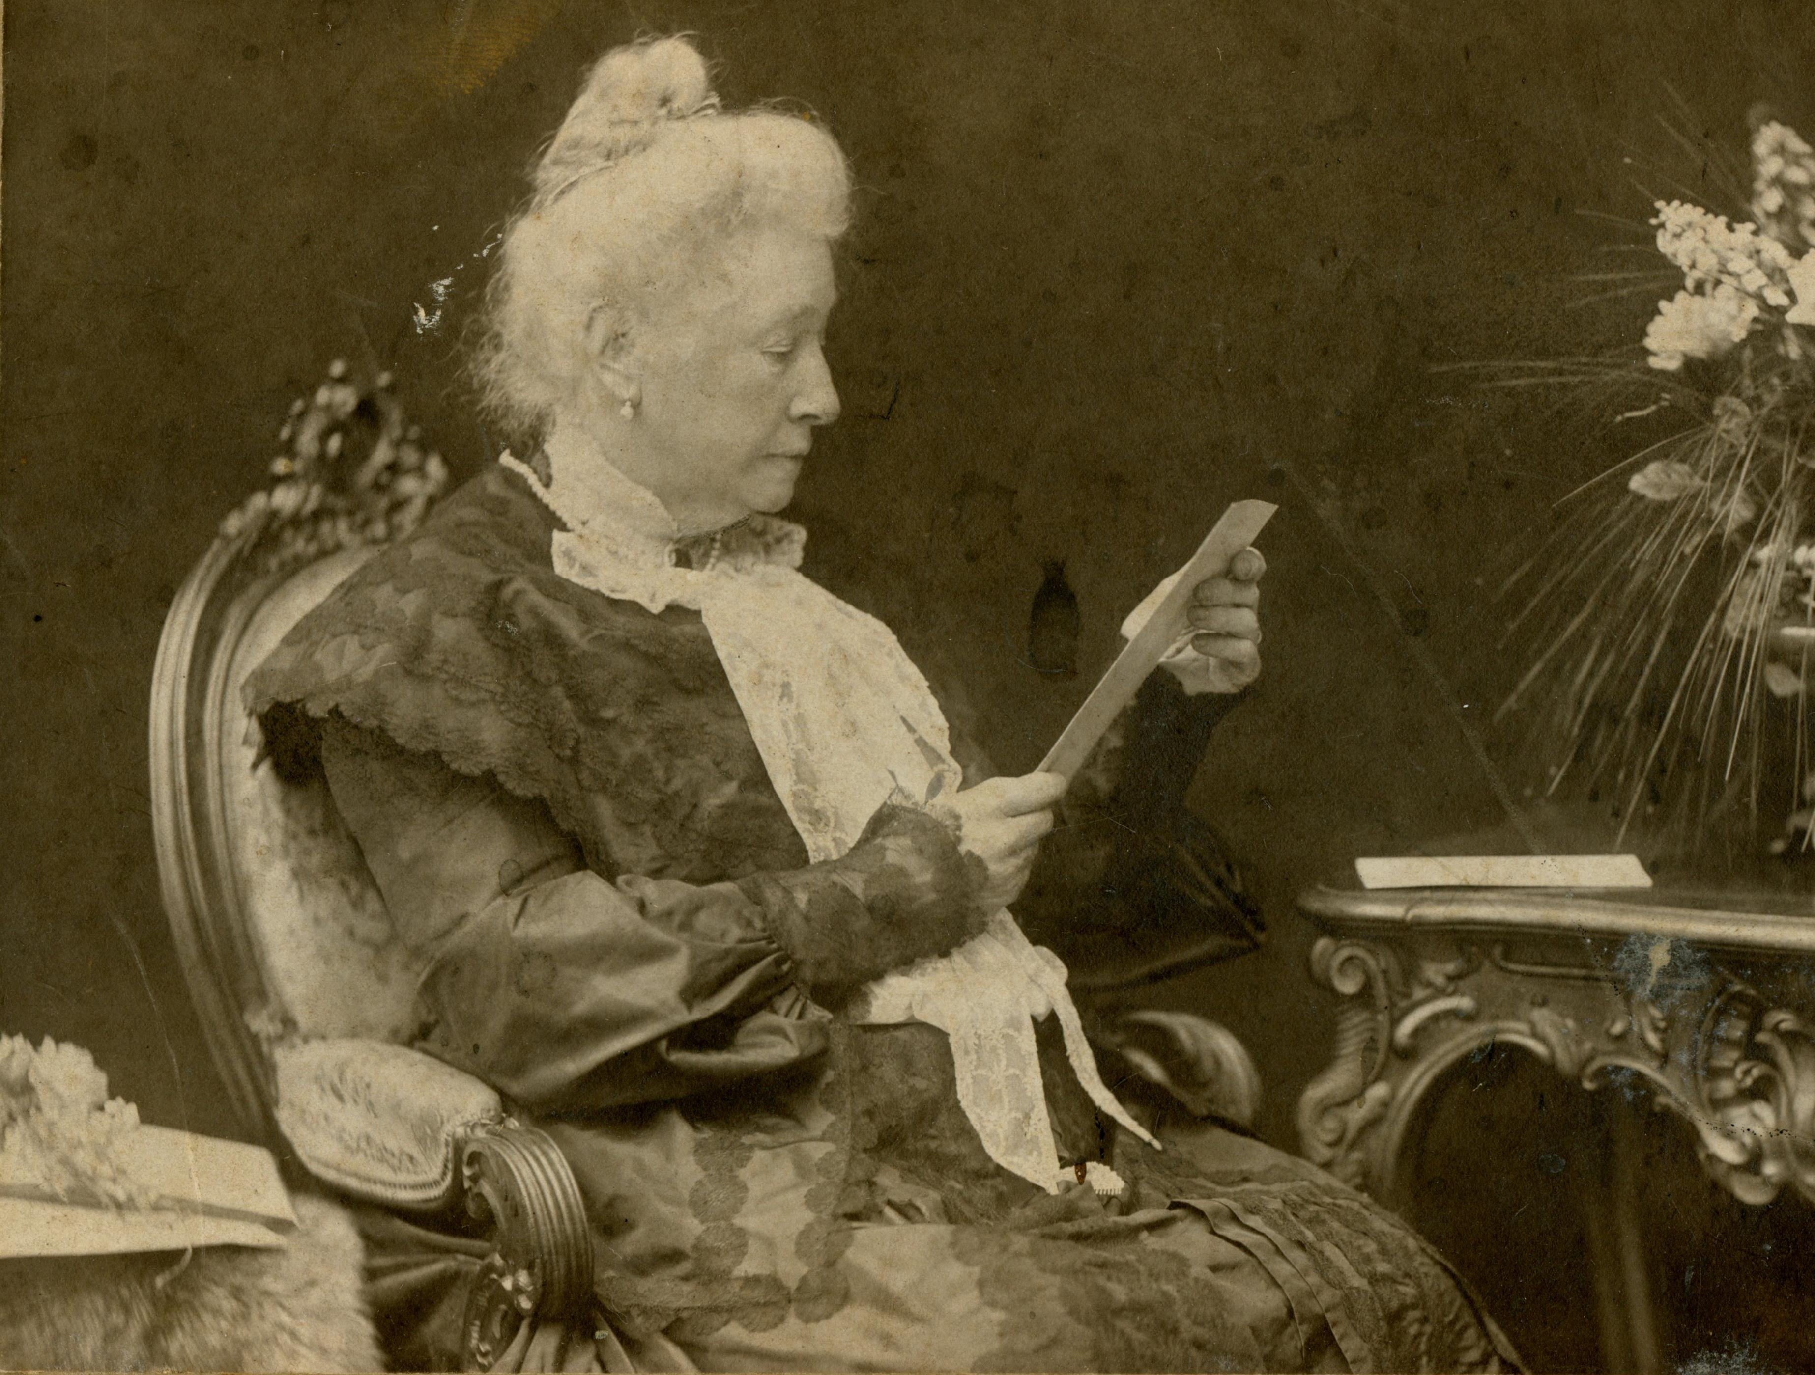
Anna jay von schweinitz
von Bosch Studio, Wiesbaden, Hesse, Germany
c. 1915
JJ.1984.118

Slide 11
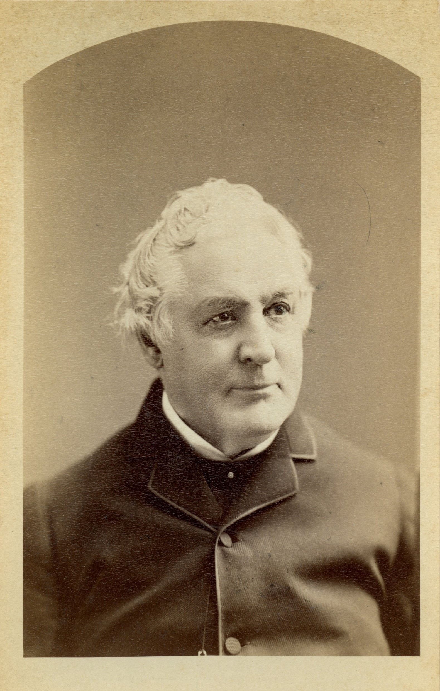
John Jay II
Bogardus Studio, New York, NY
C. 1880
JJ.2015.14

Slide 12
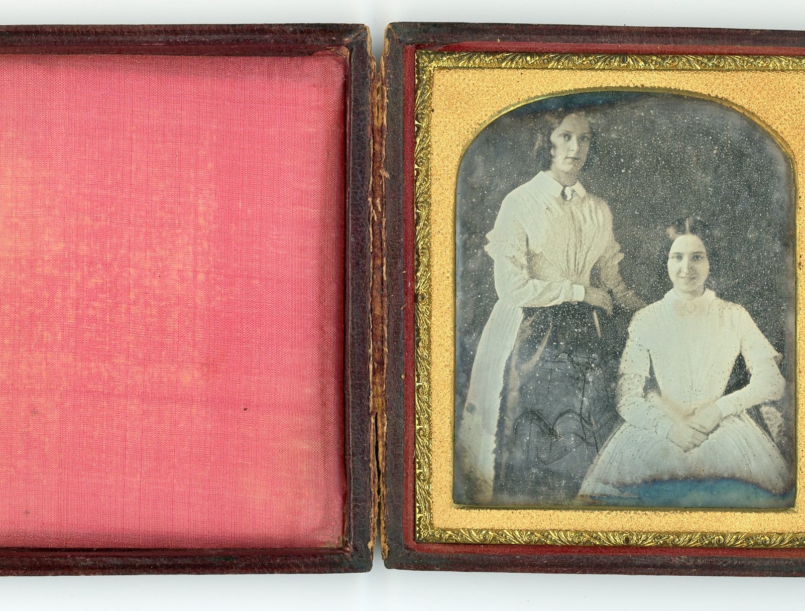
Susan matilda jay and friend
Isabella morris
Daguerreotype
Place unknown
1848
JJ.1982.70

Slide 13
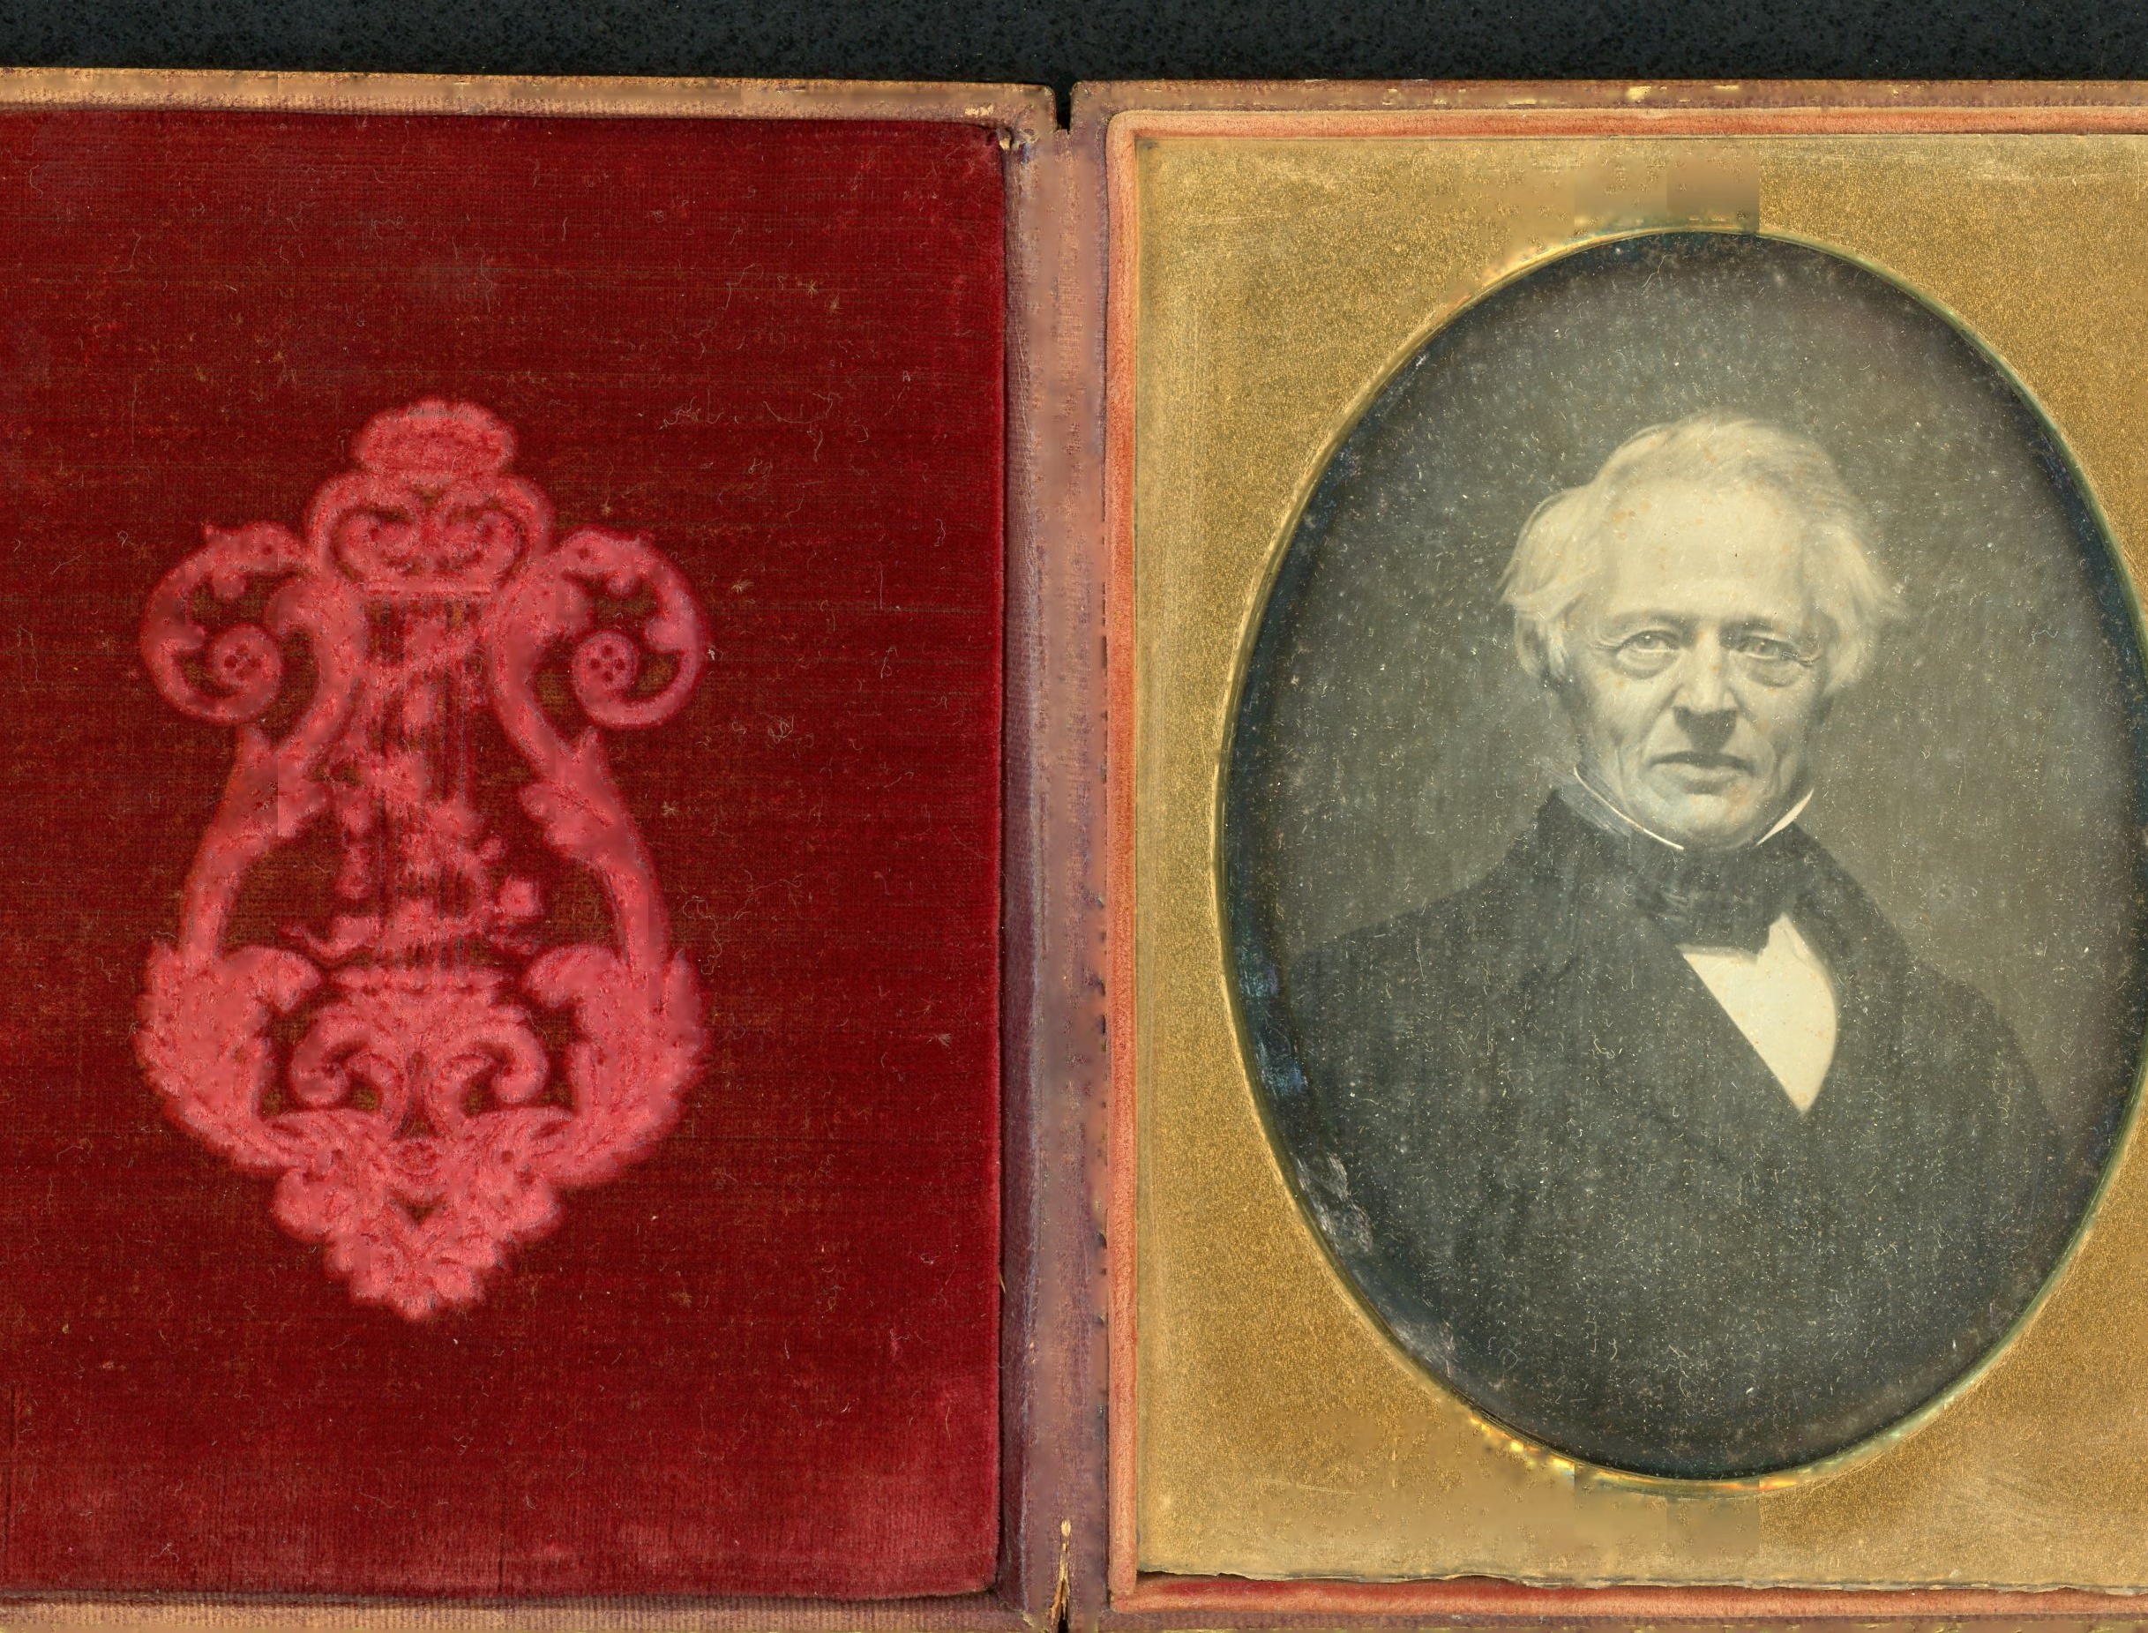
William Jay
Daguerreotype of Henry Antonio Wenzler’s Portrait
1850
JJ.1974.86

Slide 14
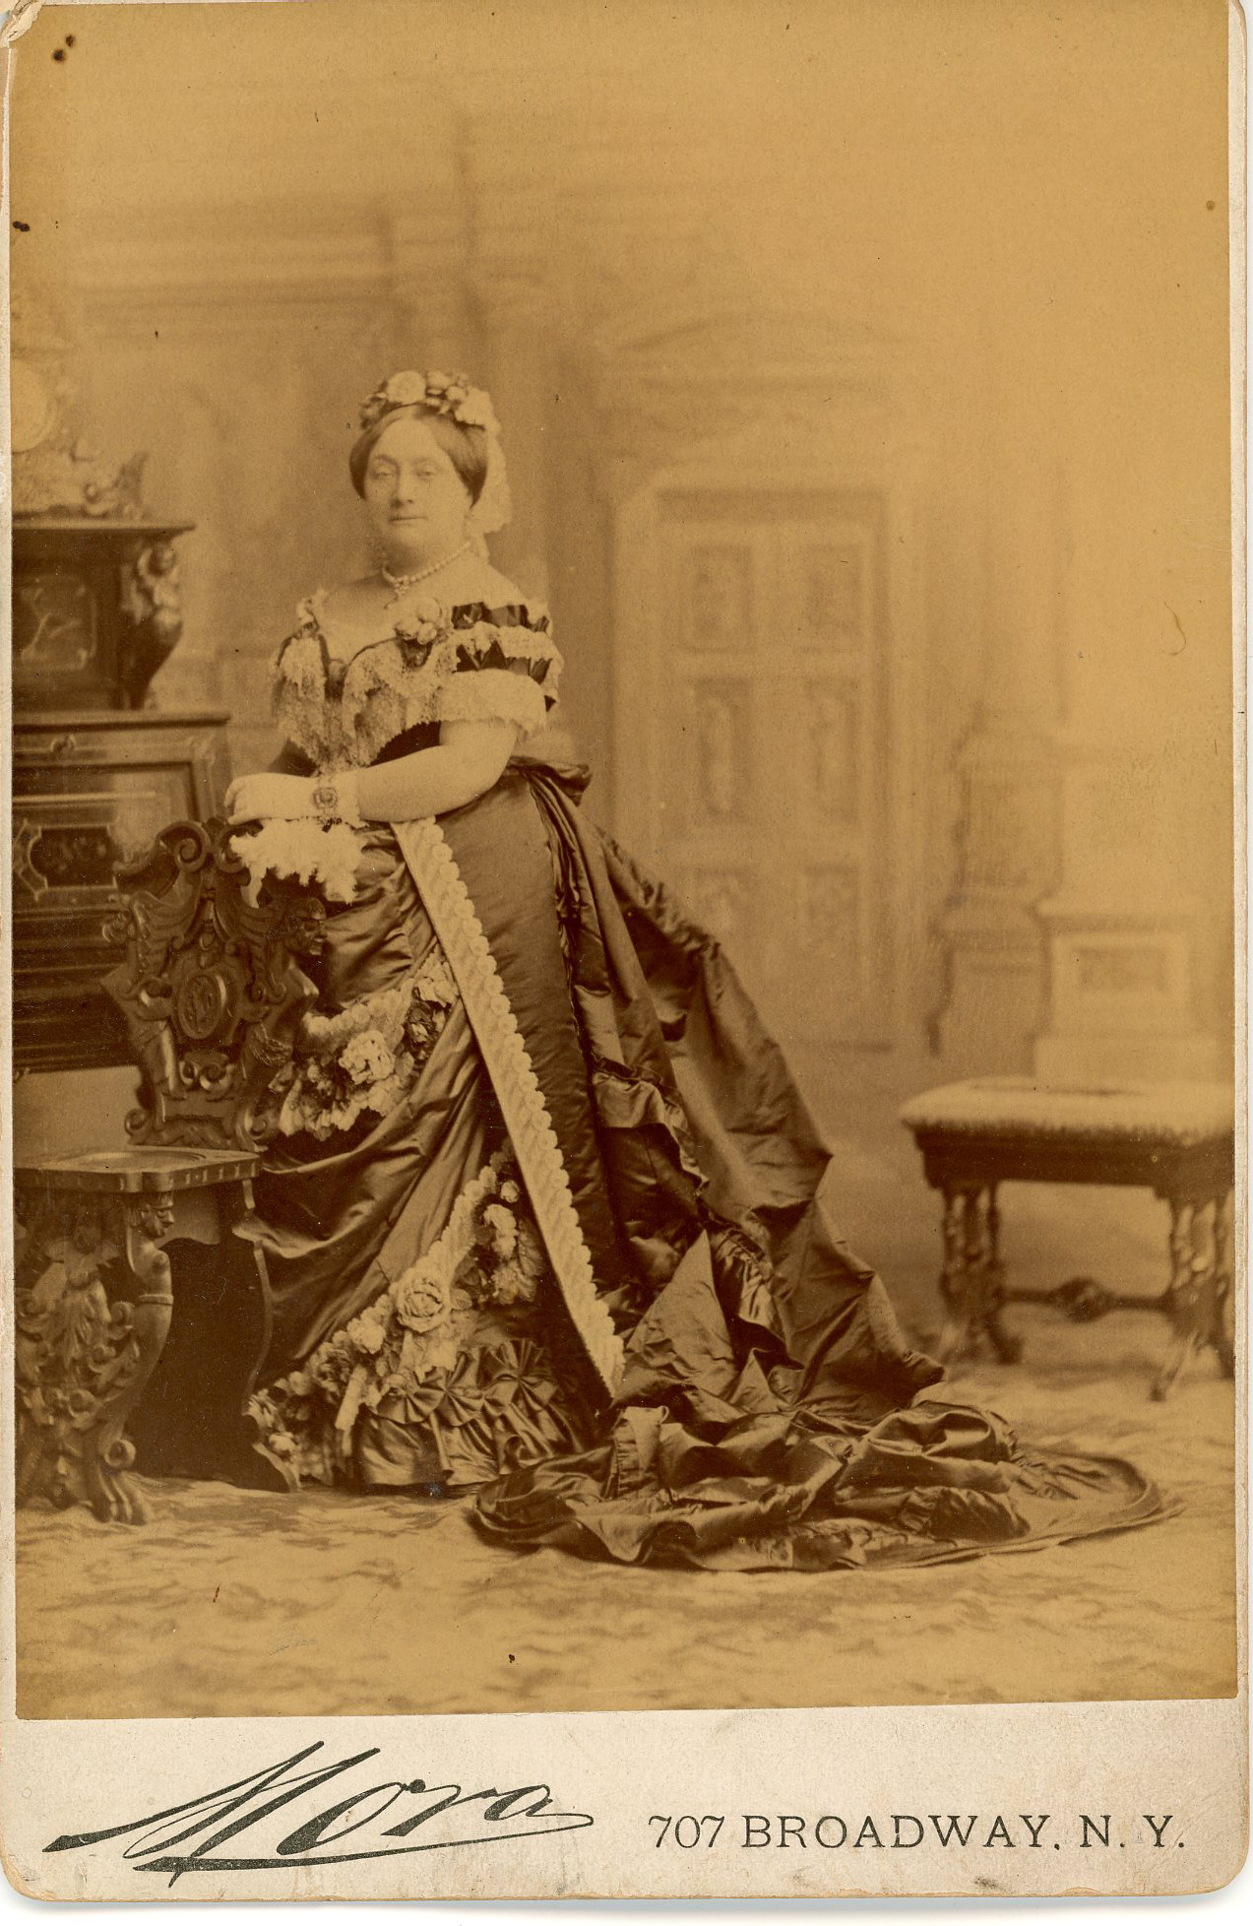
Eleanor kingsland field jay
Jose Mora Photography Studio, 707 Broadway, New York, NY
1880s
JJ.1961.4

Slide 15
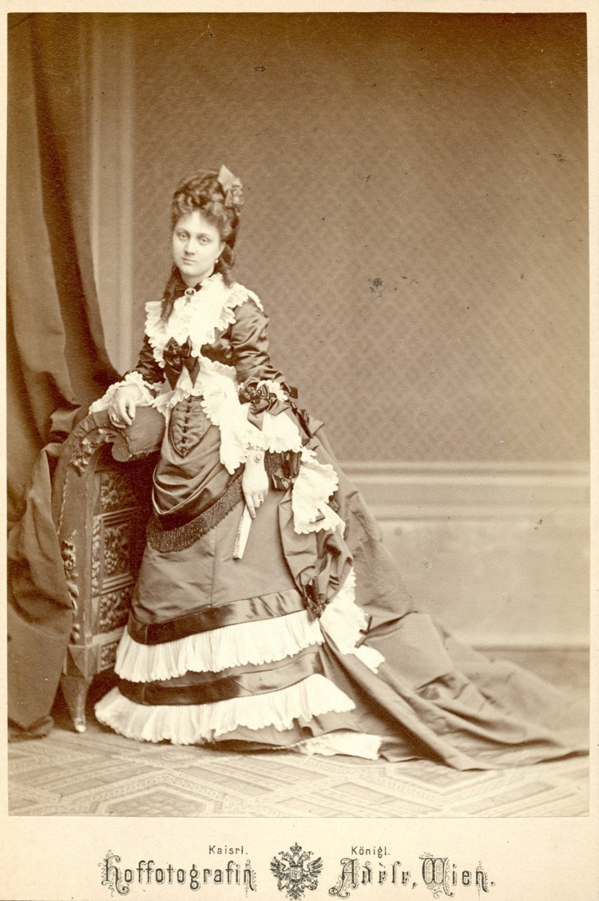
Mary jay schieffelin
Atelier Adelle Studio, Vienna, Austria-Hungary
1872
JJ.2015.10

Slide 16
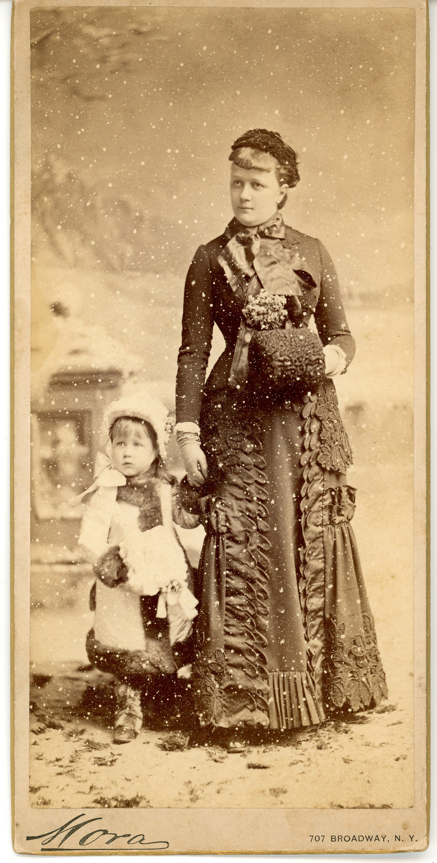
Lucie oelrichs jay and Julia jay
Mora Photography Studio, 707 Broadway, New York, NY
C. 1882
JJ.2015.12

Slide 17
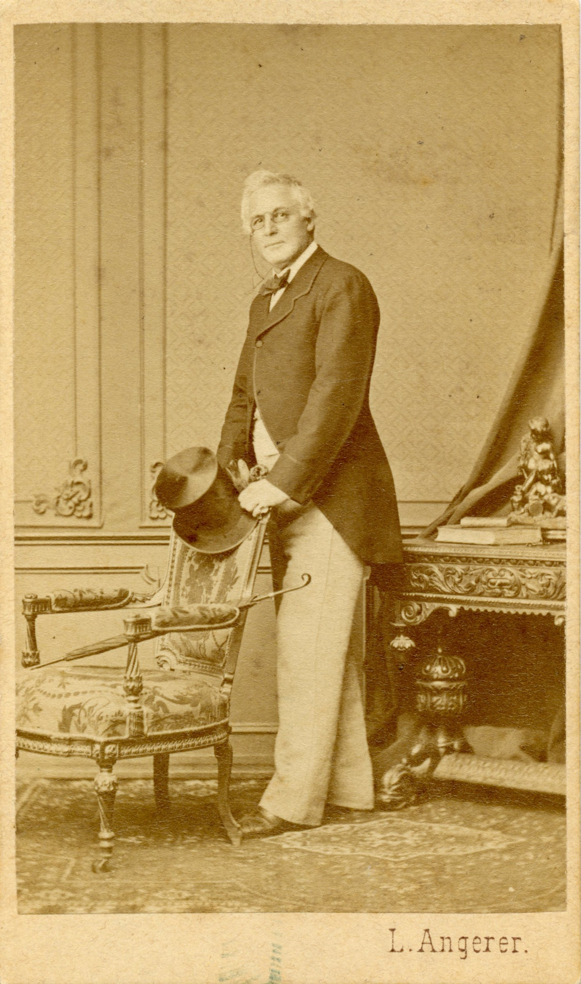
John jay II as minister to Austria
Ludwig Angerer Studio, Vienna, Austria
1872
JJ.2015.13

Slide 18
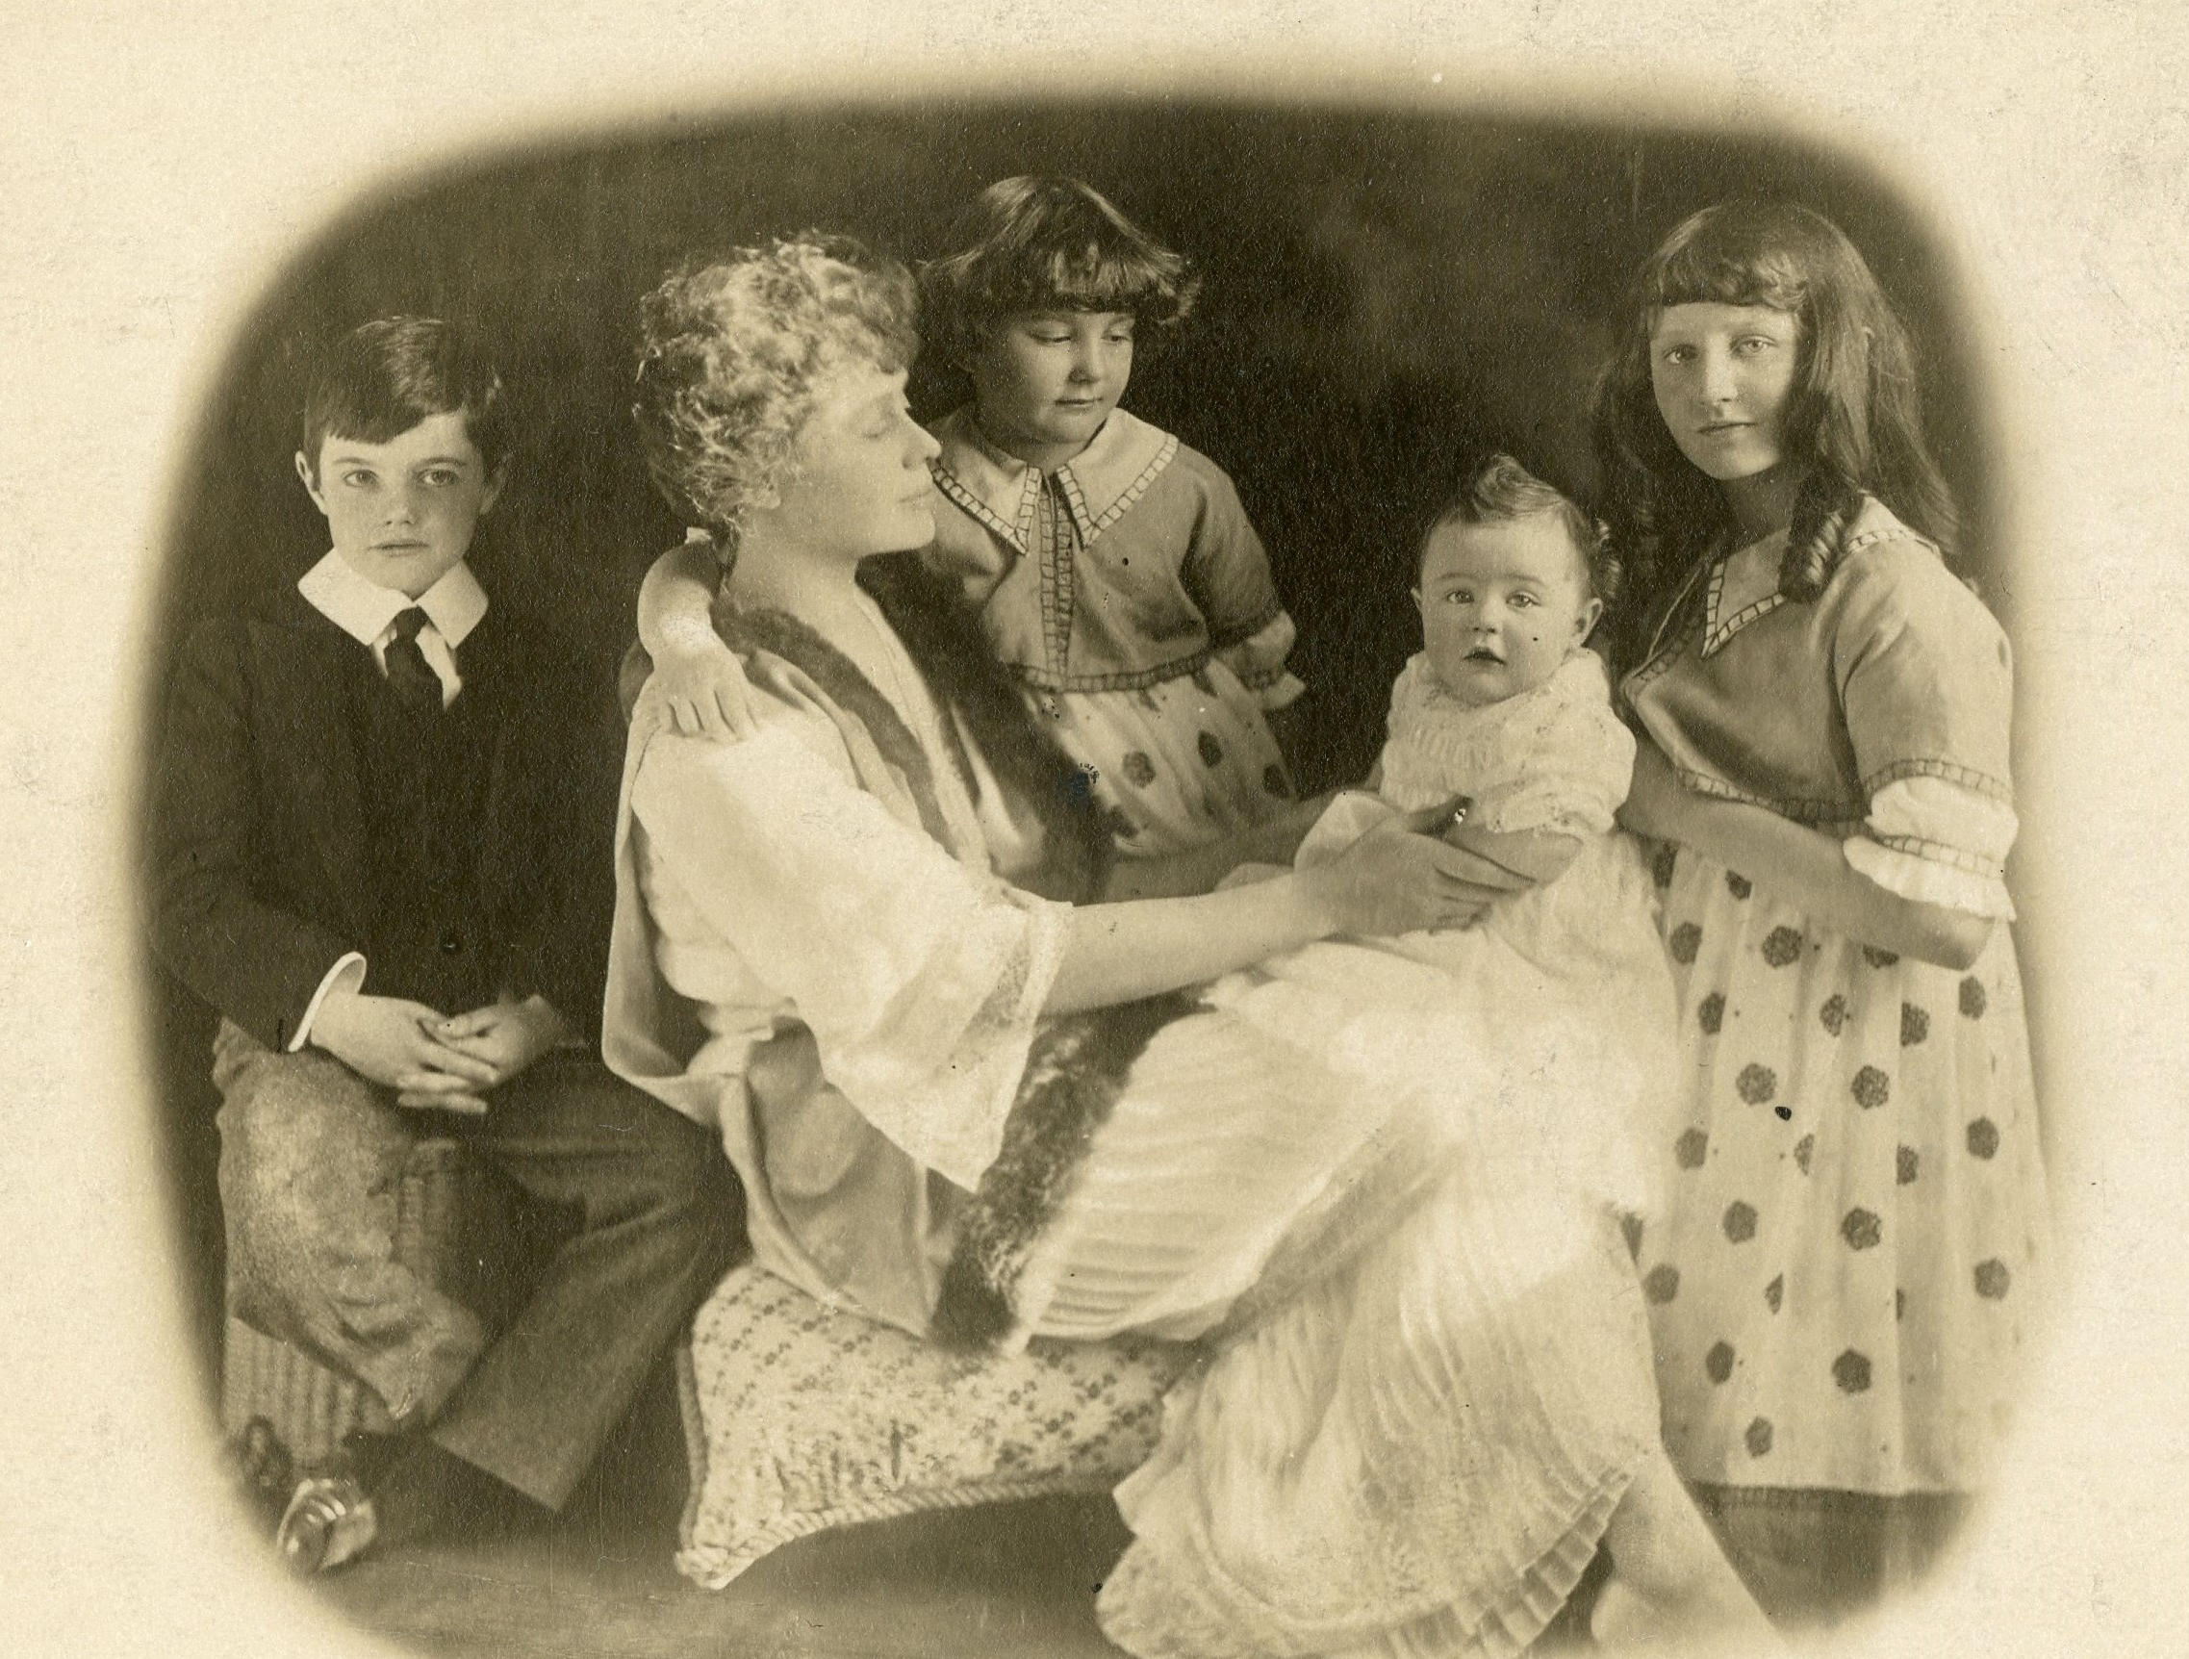
Eleanor jay Iselin with her children Arthur jr., Eleanor,
William, and Dorothy
Place unknown
1917
JJ.2015.35

Slide 19
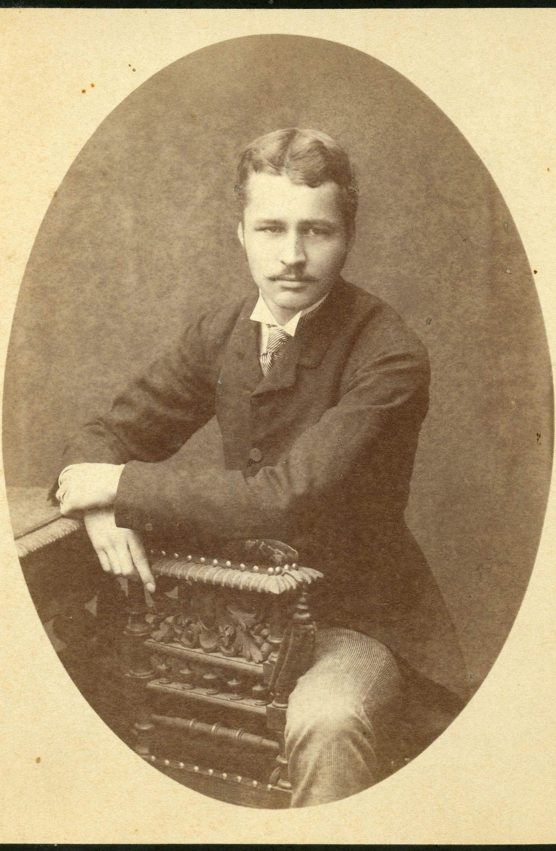
John jay chapman
Place unknown
C. 1890
JJ.2015.33

Slide 20
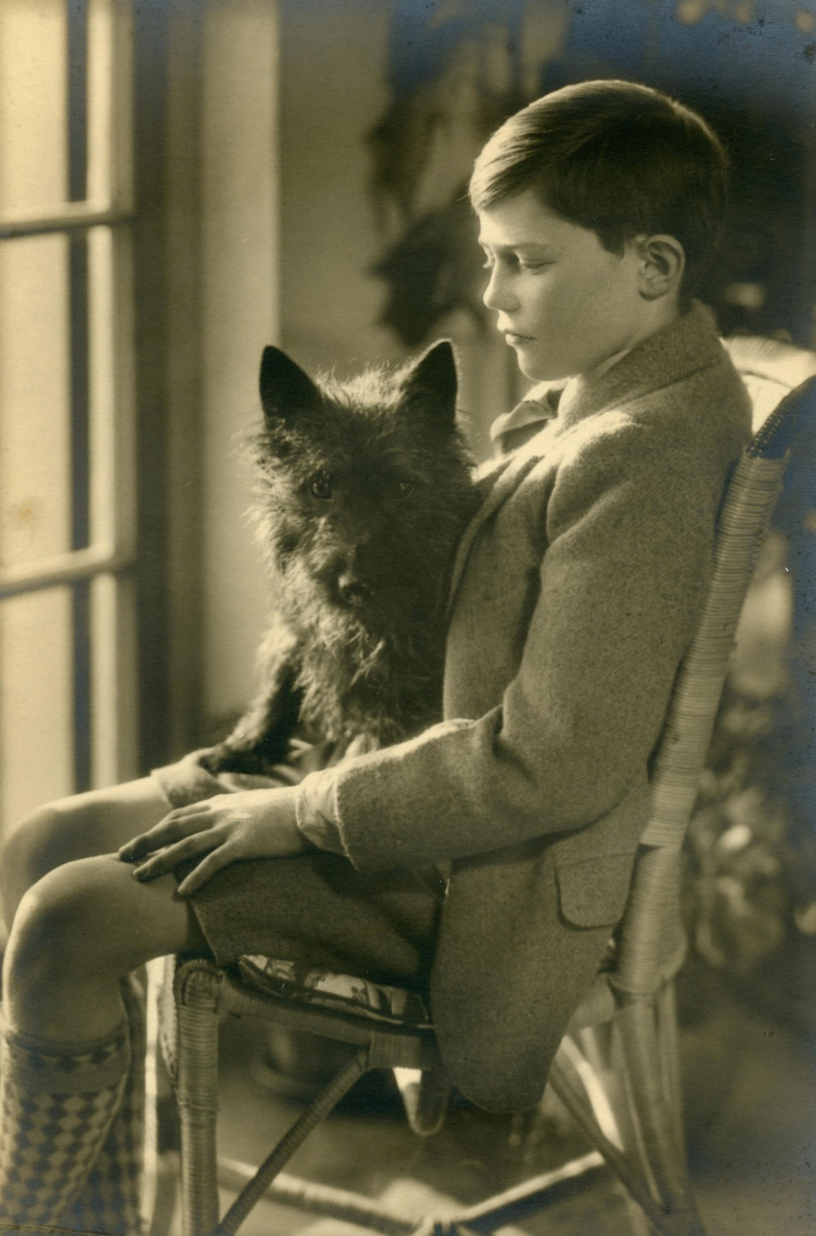
Arthur Iselin jr. with Scottish terrier
“pooh bear”
Glass Porch, Bedford House
C. 1923
JJ.2015.27

Slide 21
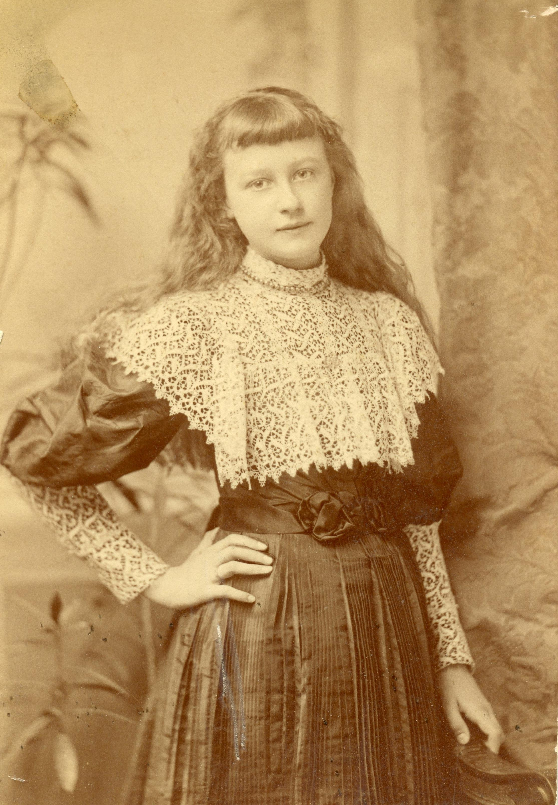
Julia Jay
Place unknown
C. 1892
JJ.2015.32

Slide 22
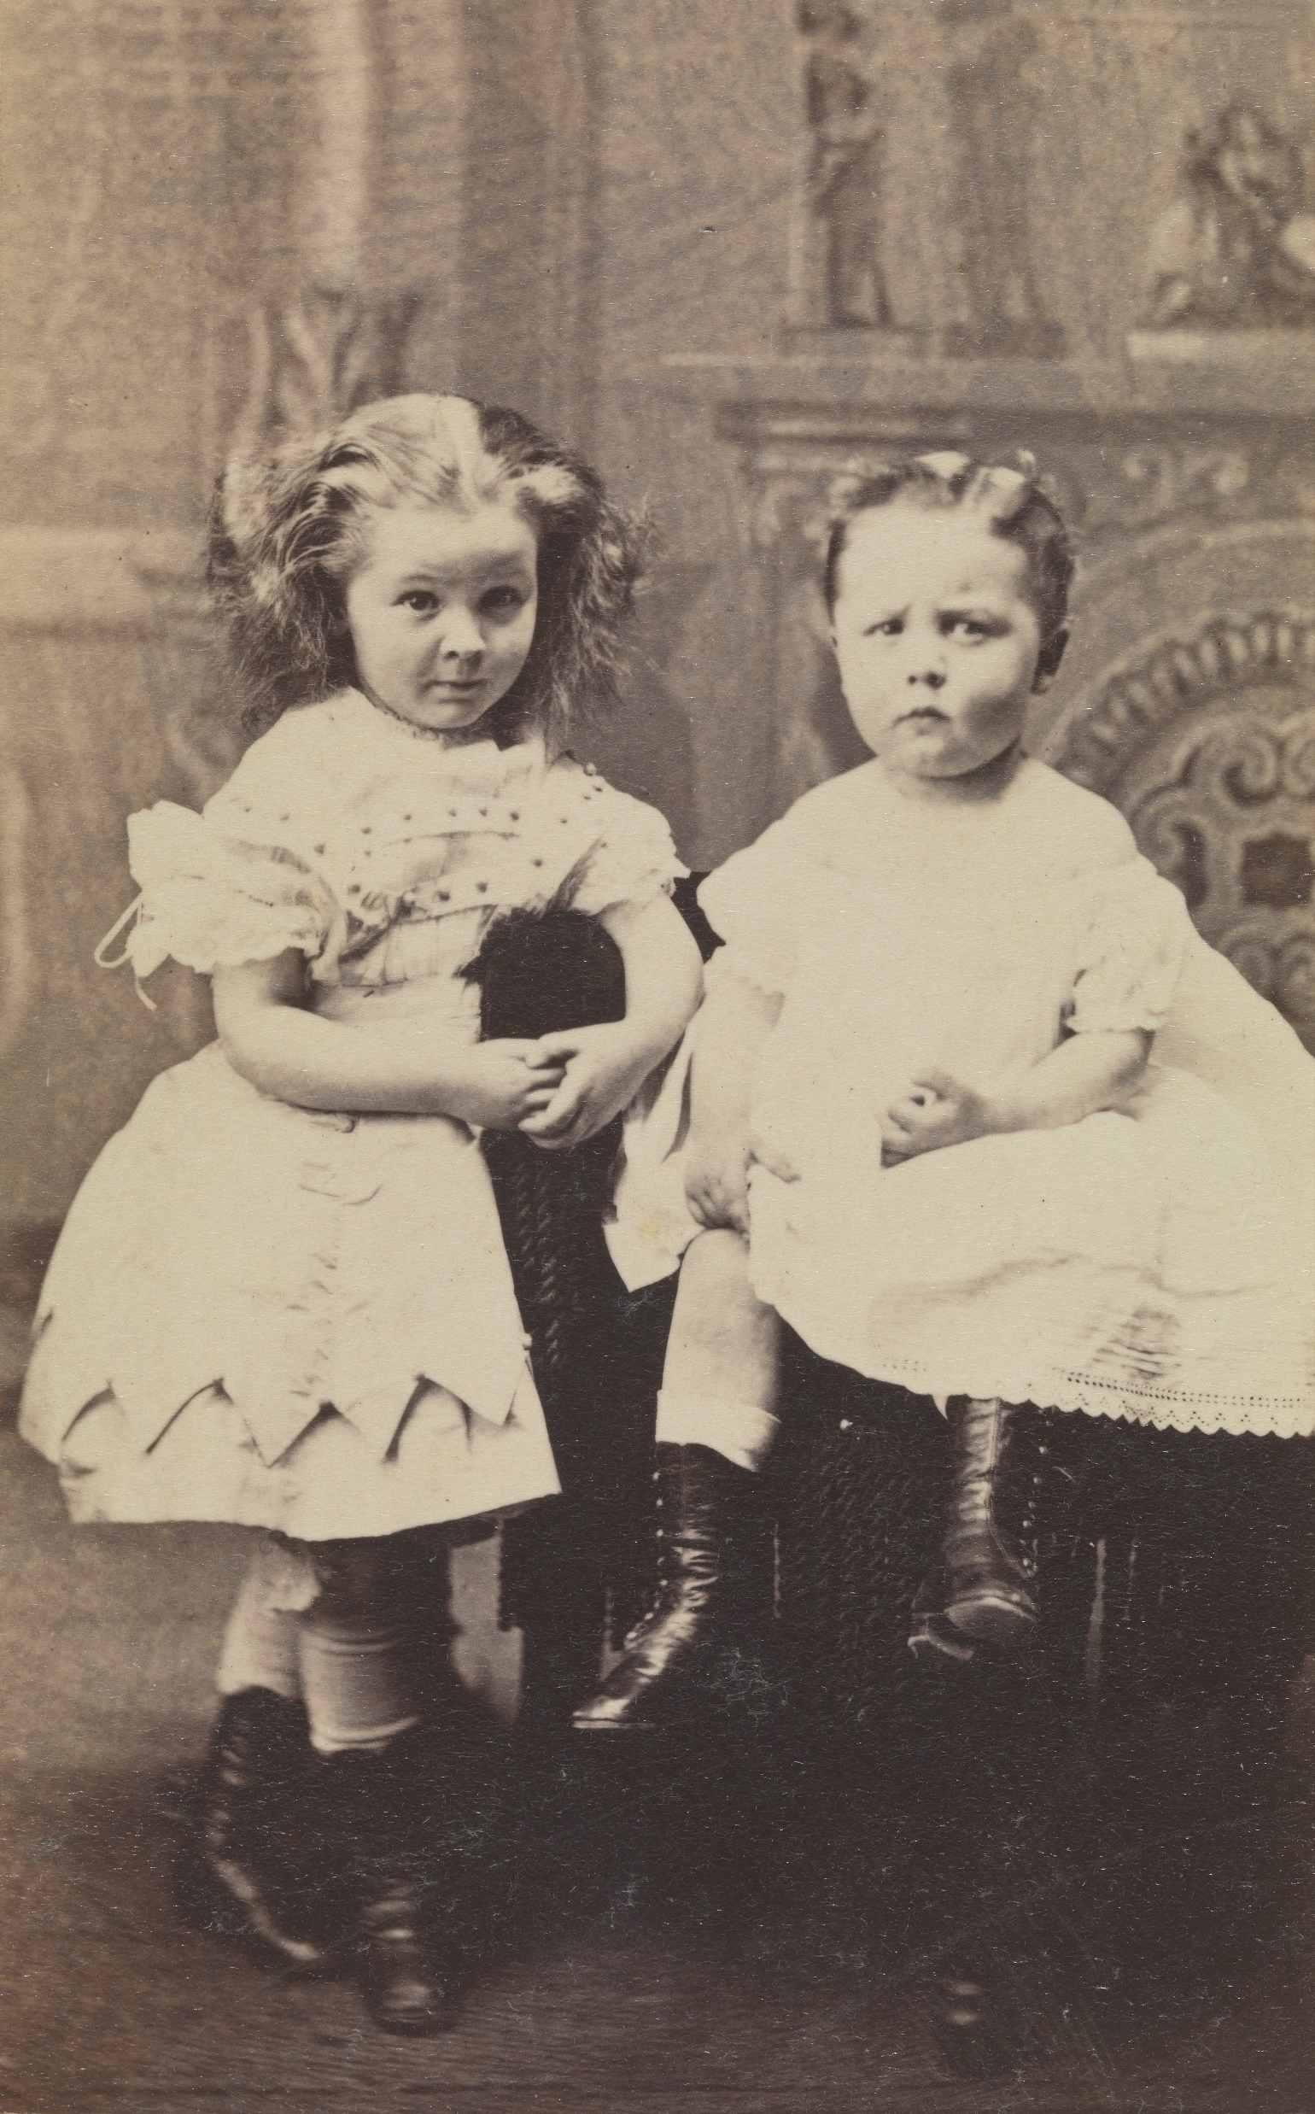
Eleanor and William Schieffelin
Place unknown
C. 1868
JJ.2015.21.e

Slide 23
Generations

Slide 24
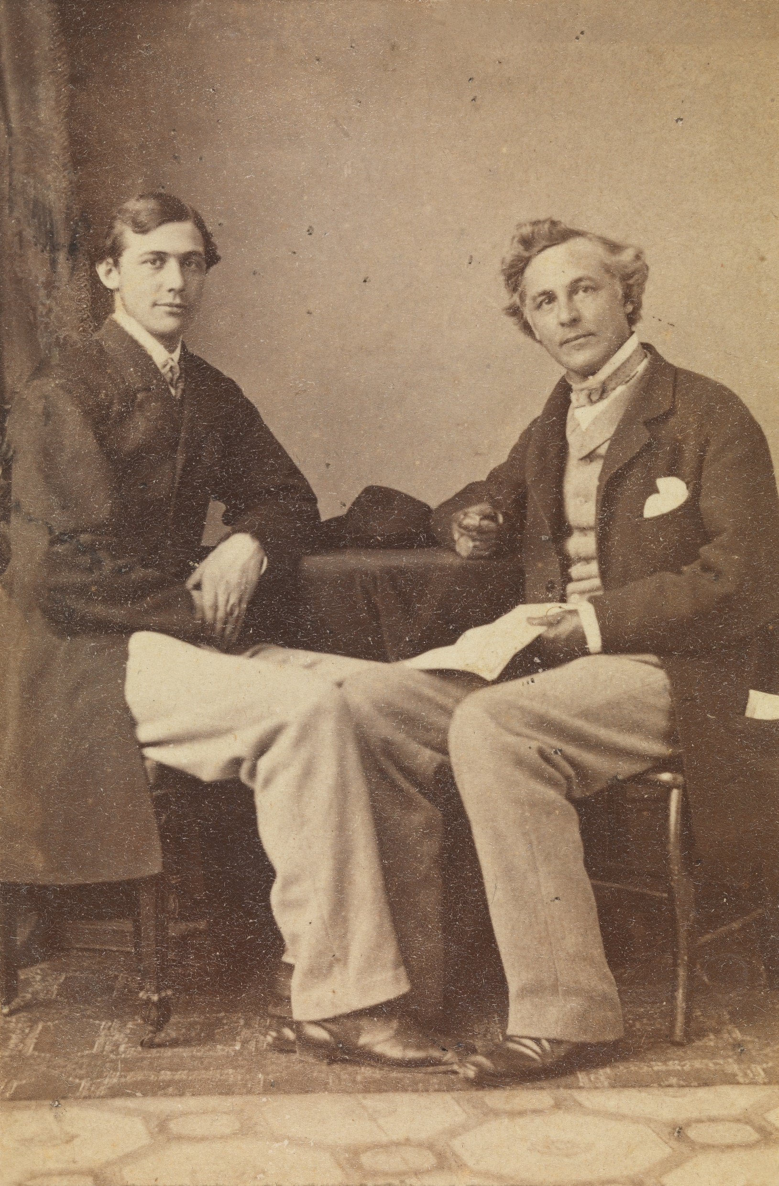
William Jay II and John Jay II
Matthew Brady Studio, New York, NY
1860s
JJ.2015.3.13.d

Slide 25
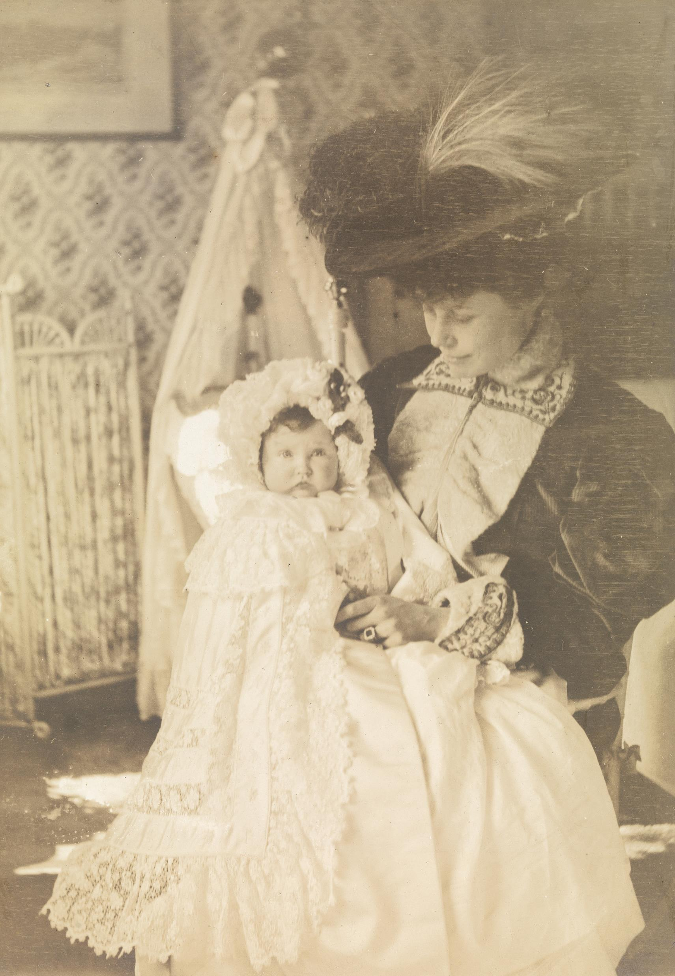
Eleanor jay Iselin and her daughter Dorothy
Bedford House
1907
JJ.1980.133.2.e

Slide 26
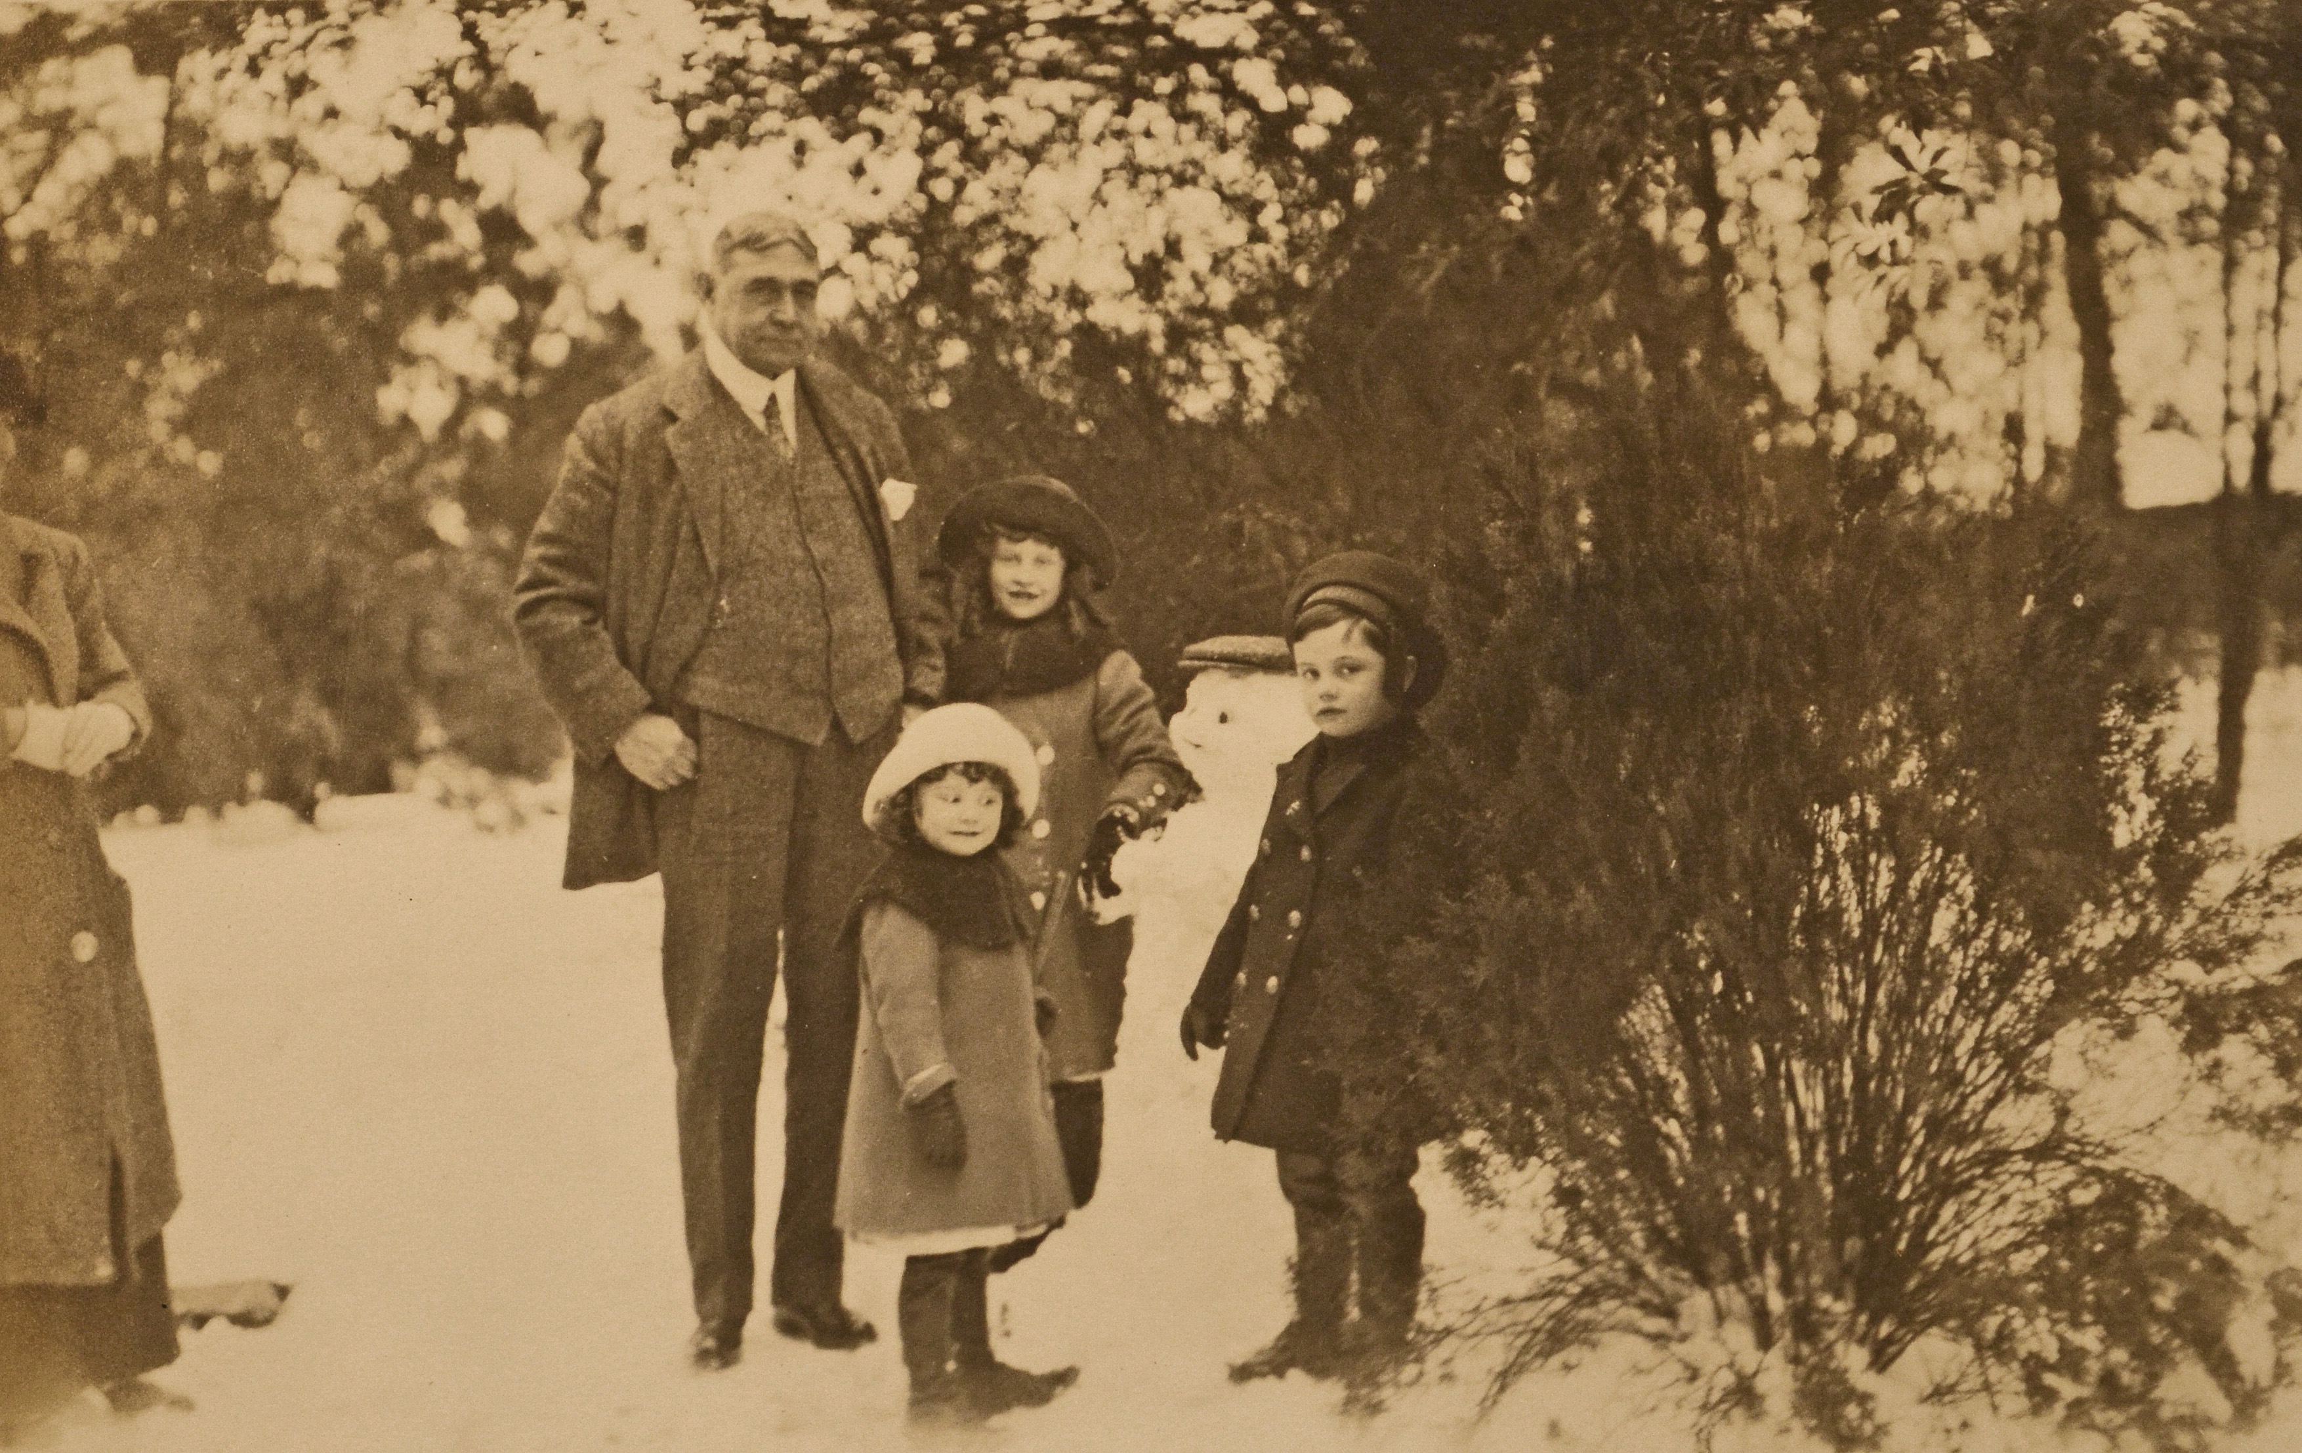
Col. William jay andgrandchildren Dorothy, William, and Eleanor Iselin
Central Park, New York, NY
1911
JJ.1980.140.19.g

Slide 27
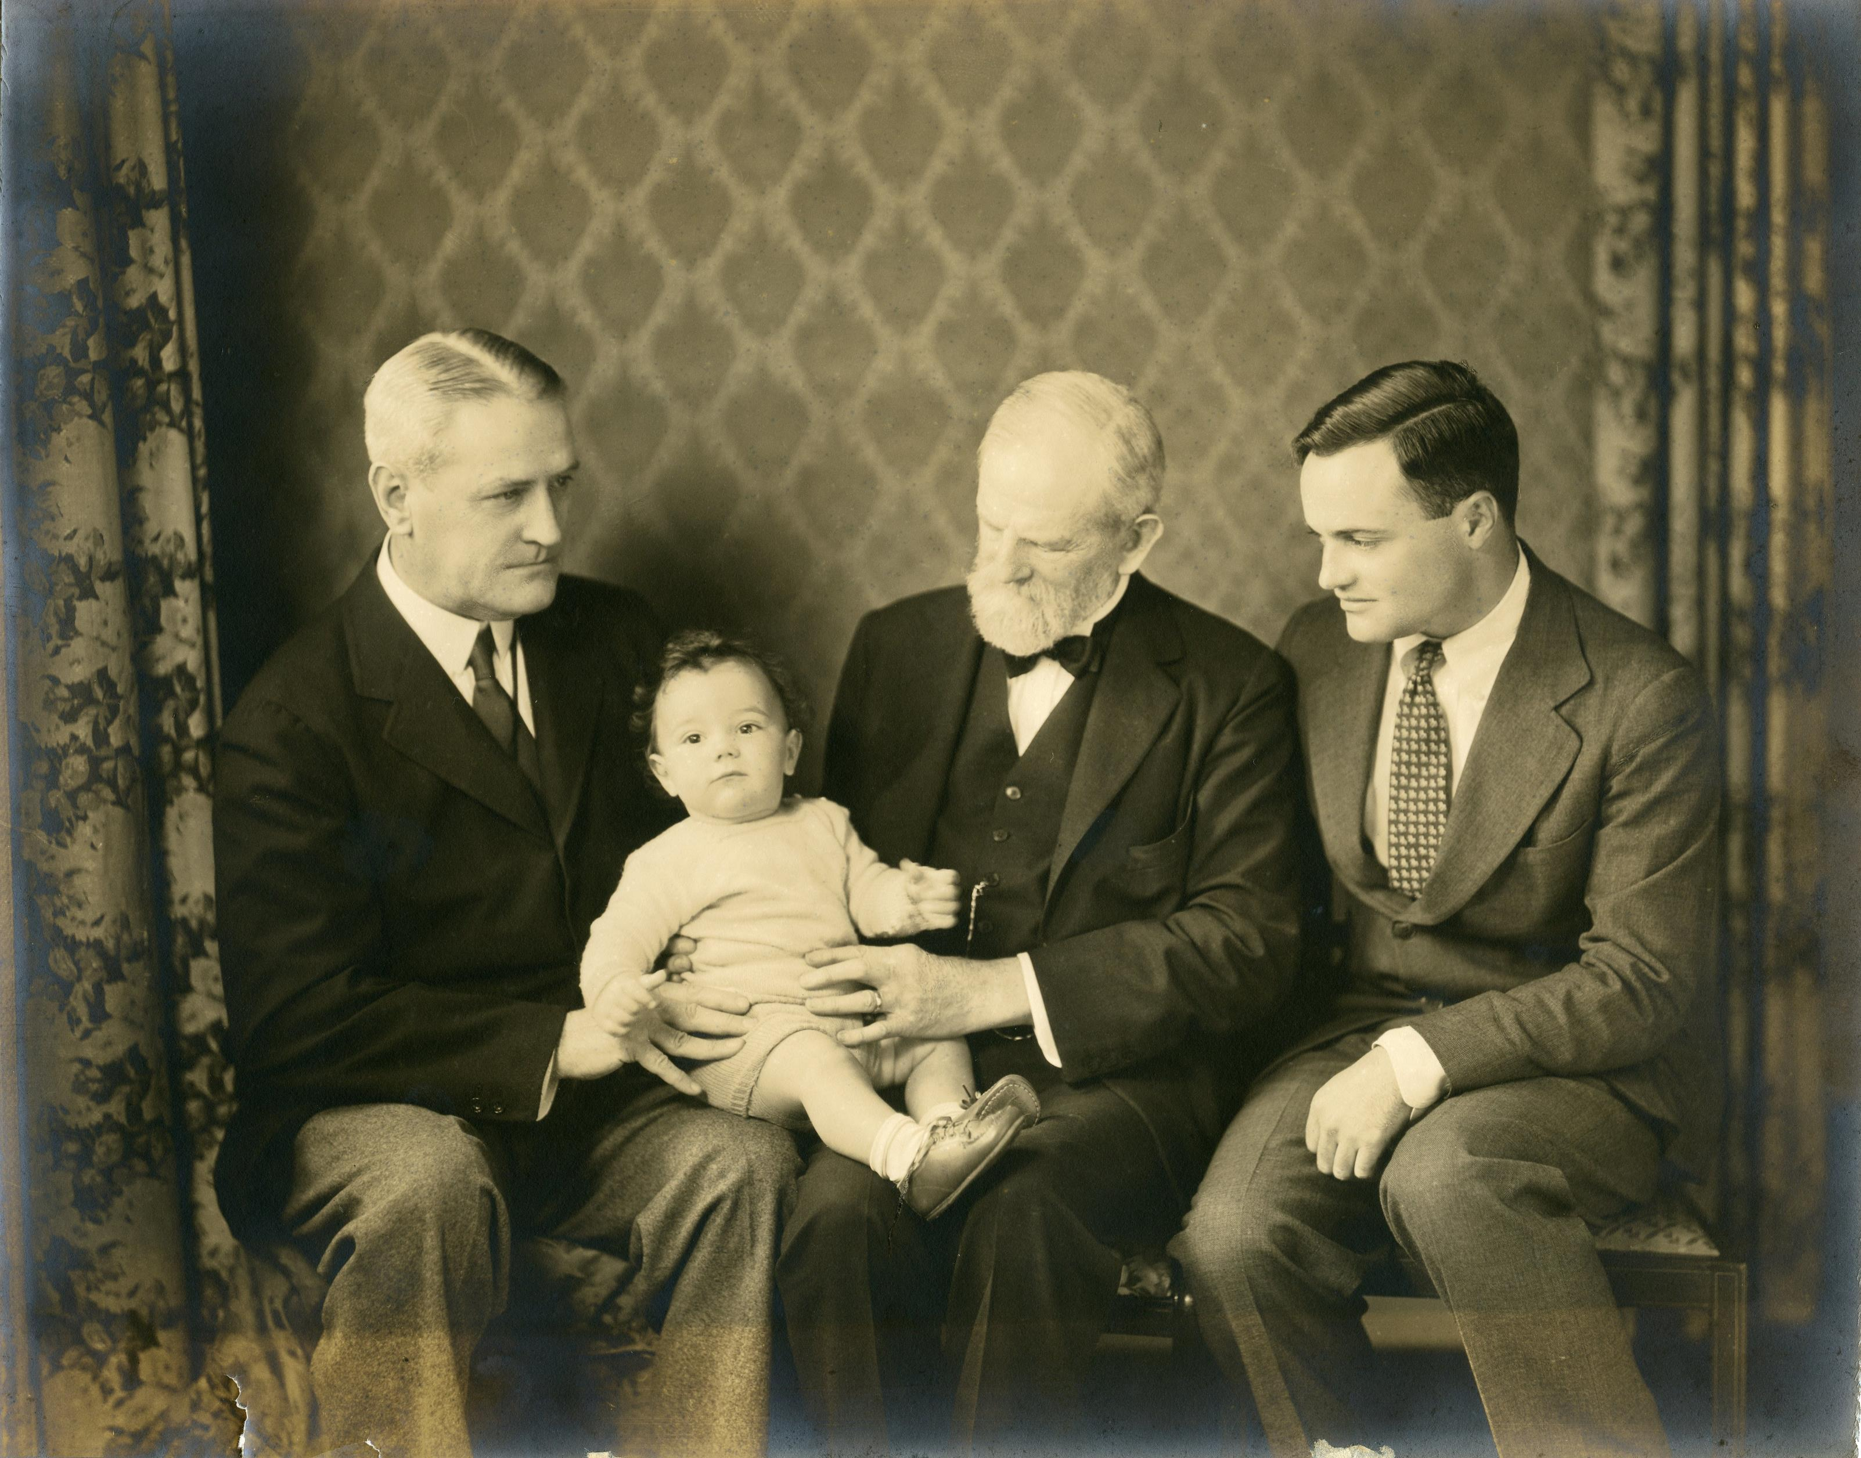
Arthur Iselin, john jay Iselin, William Iselin, and
William jay iselin
Place unknown
1934
JJ.2015.11

Slide 28
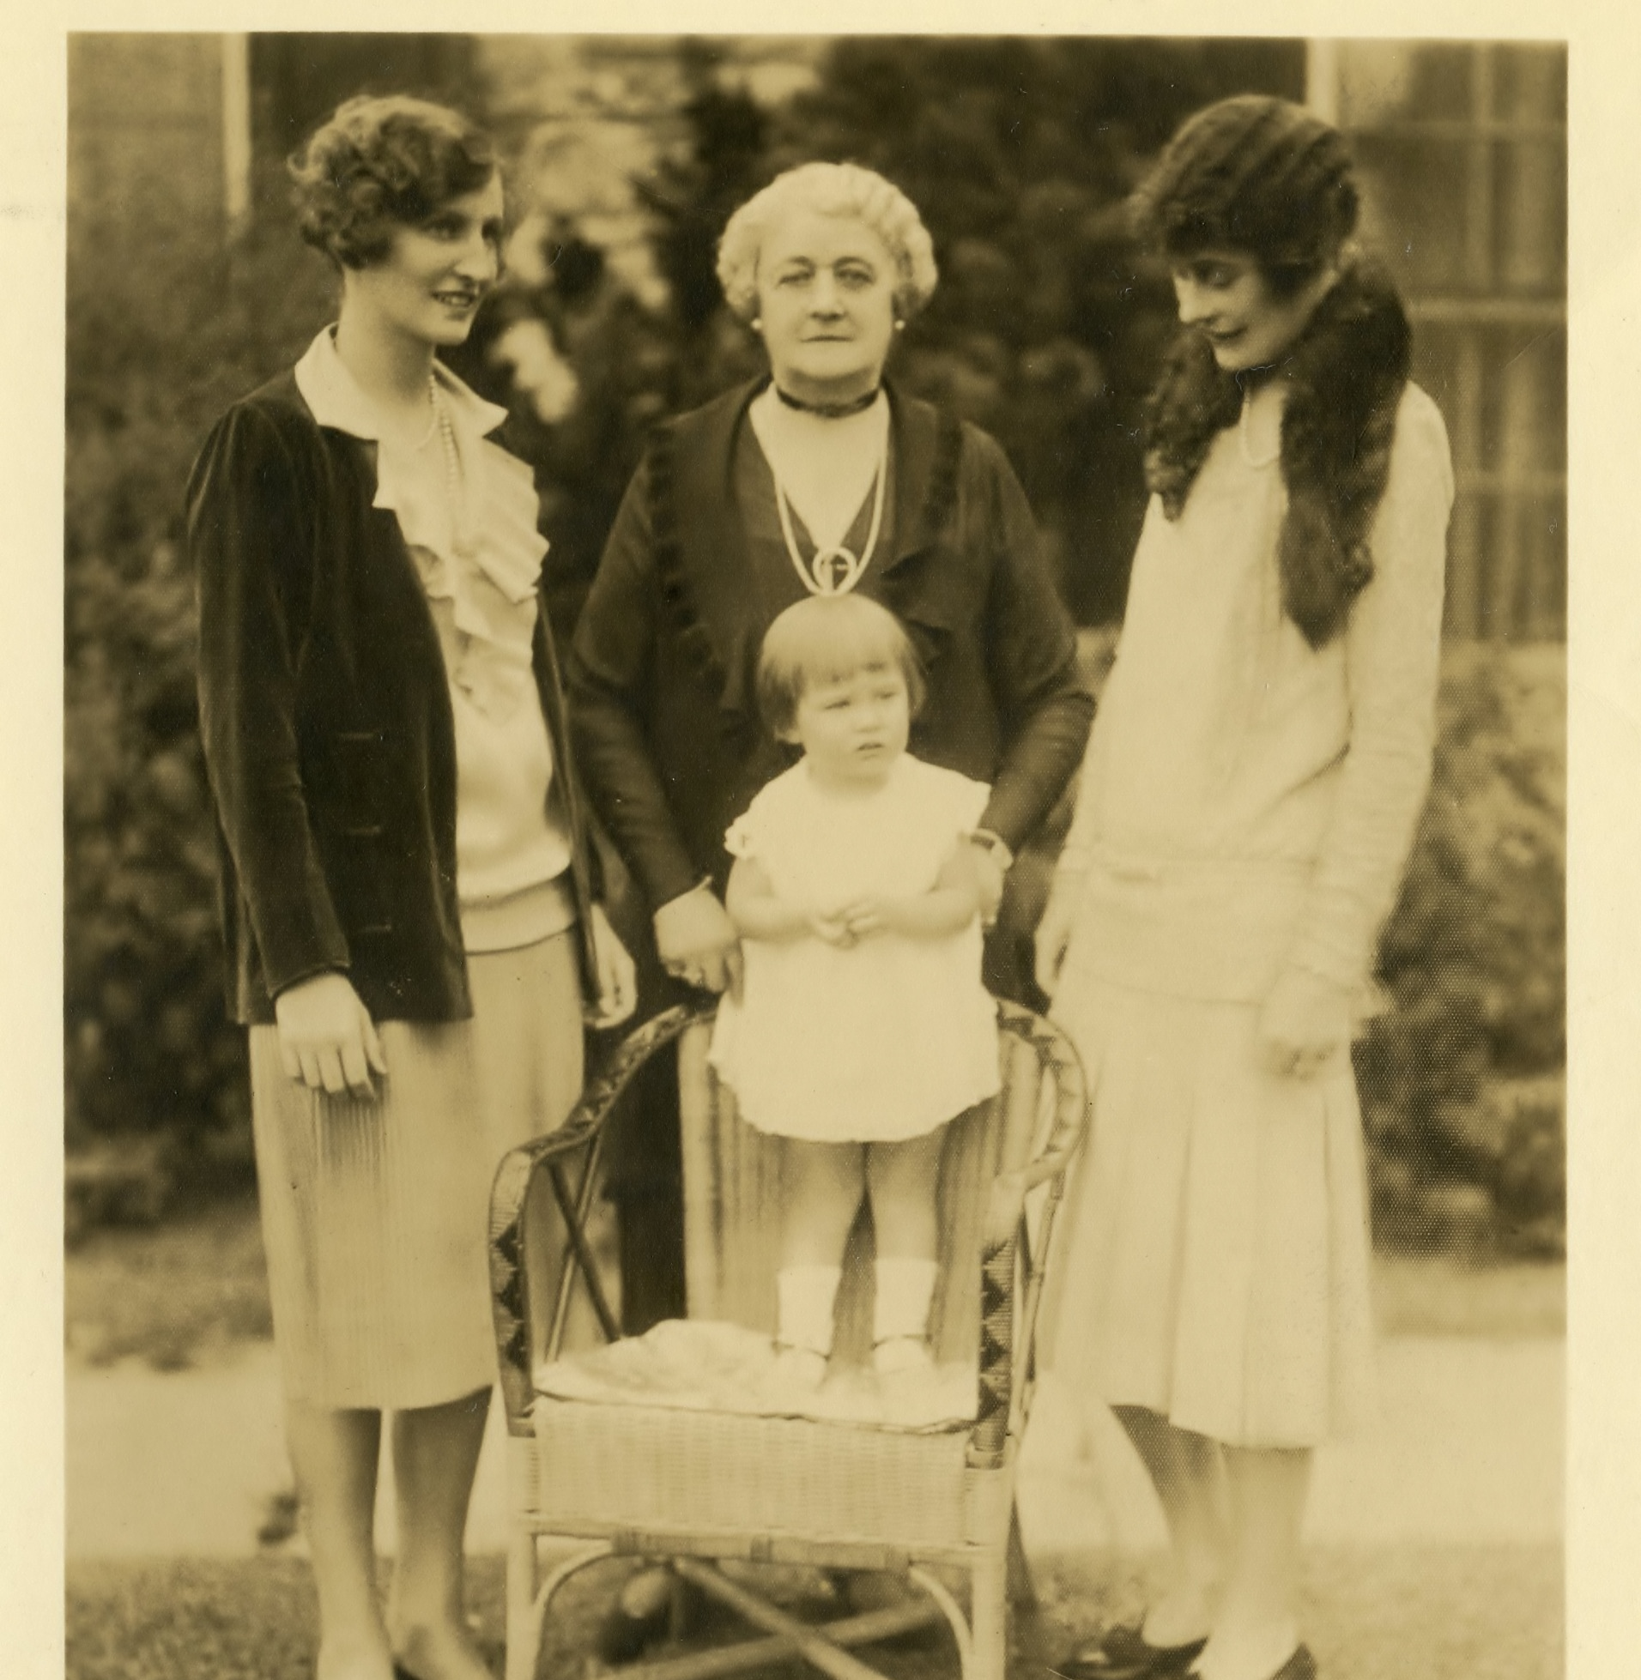
Dorothy pascal, lucie jay,
Eleanor Iselin, and Barbara pascal
Terrace Garden, Bedford House
1929
JJ.2015.37

Slide 29
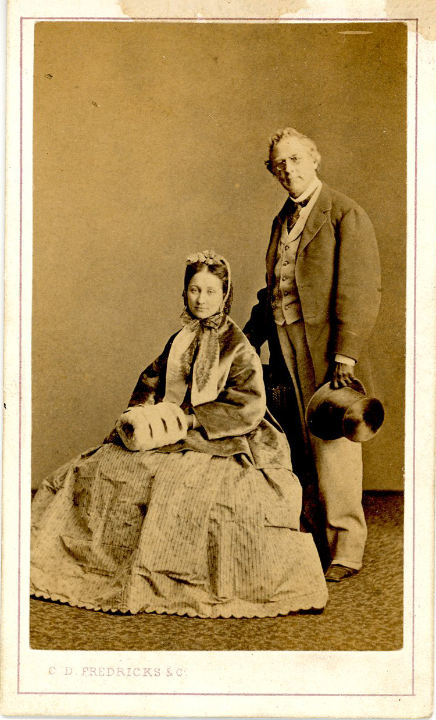
John Jay II and Eleanor jay chapman
Charles Frederick Studio, 587 Broadway, New York, NY
C. 1865
JJ.1984.120

Slide 30
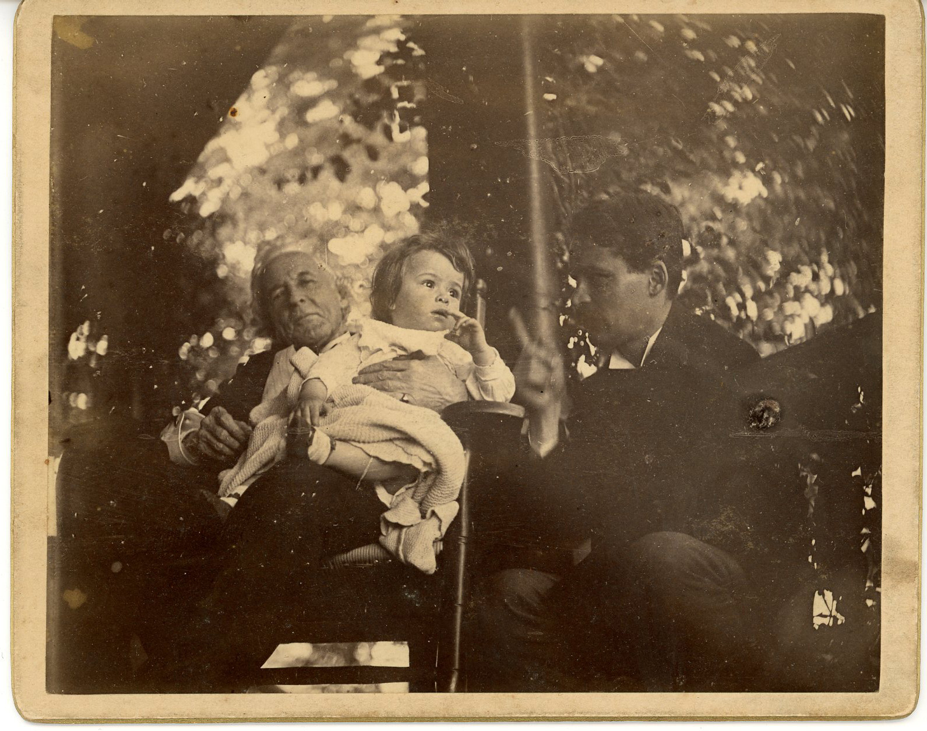
John jay chapman, john jay ii, and victor chapman
Front Porch, Bedford House
C. 1891
JJ.1984.119

Slide 31
Having fun

Slide 32
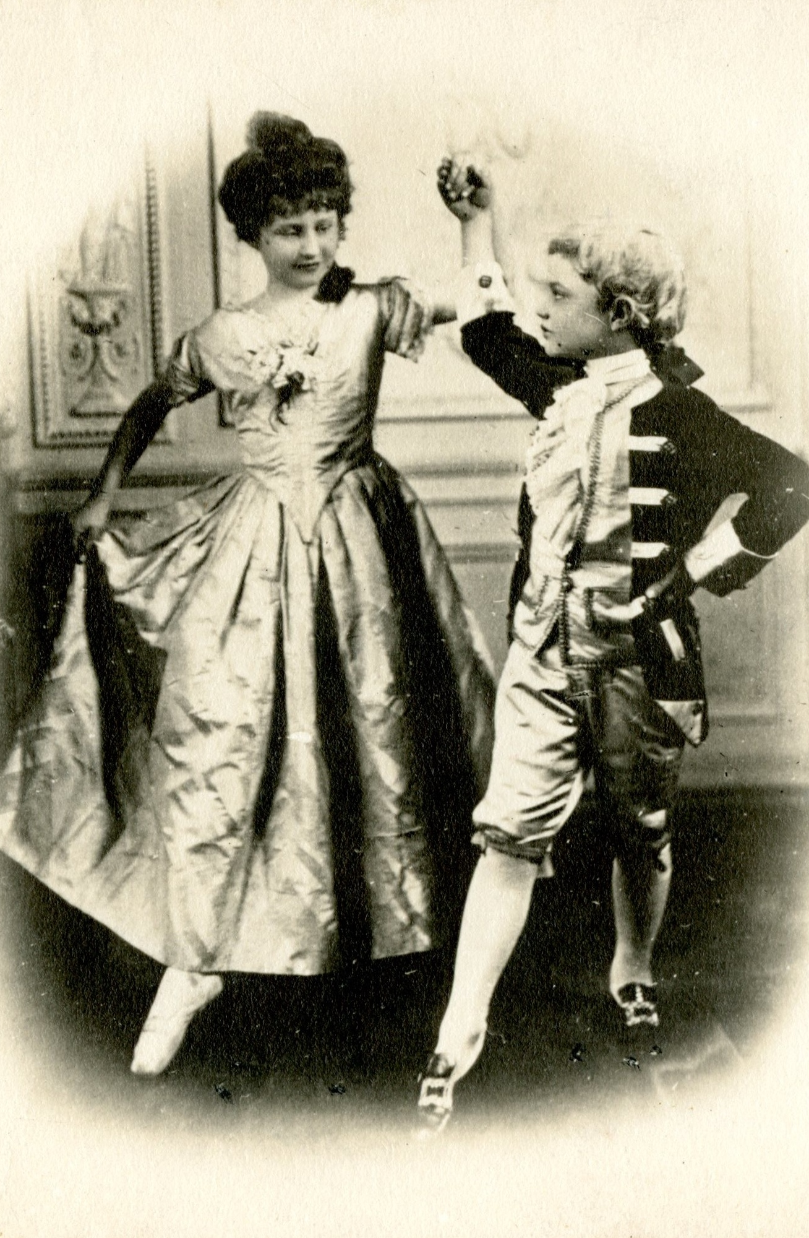
Dorothy and William jay Iselin in colonial dress
Bedford House
C. 1914
JJ.2015.16

Slide 33
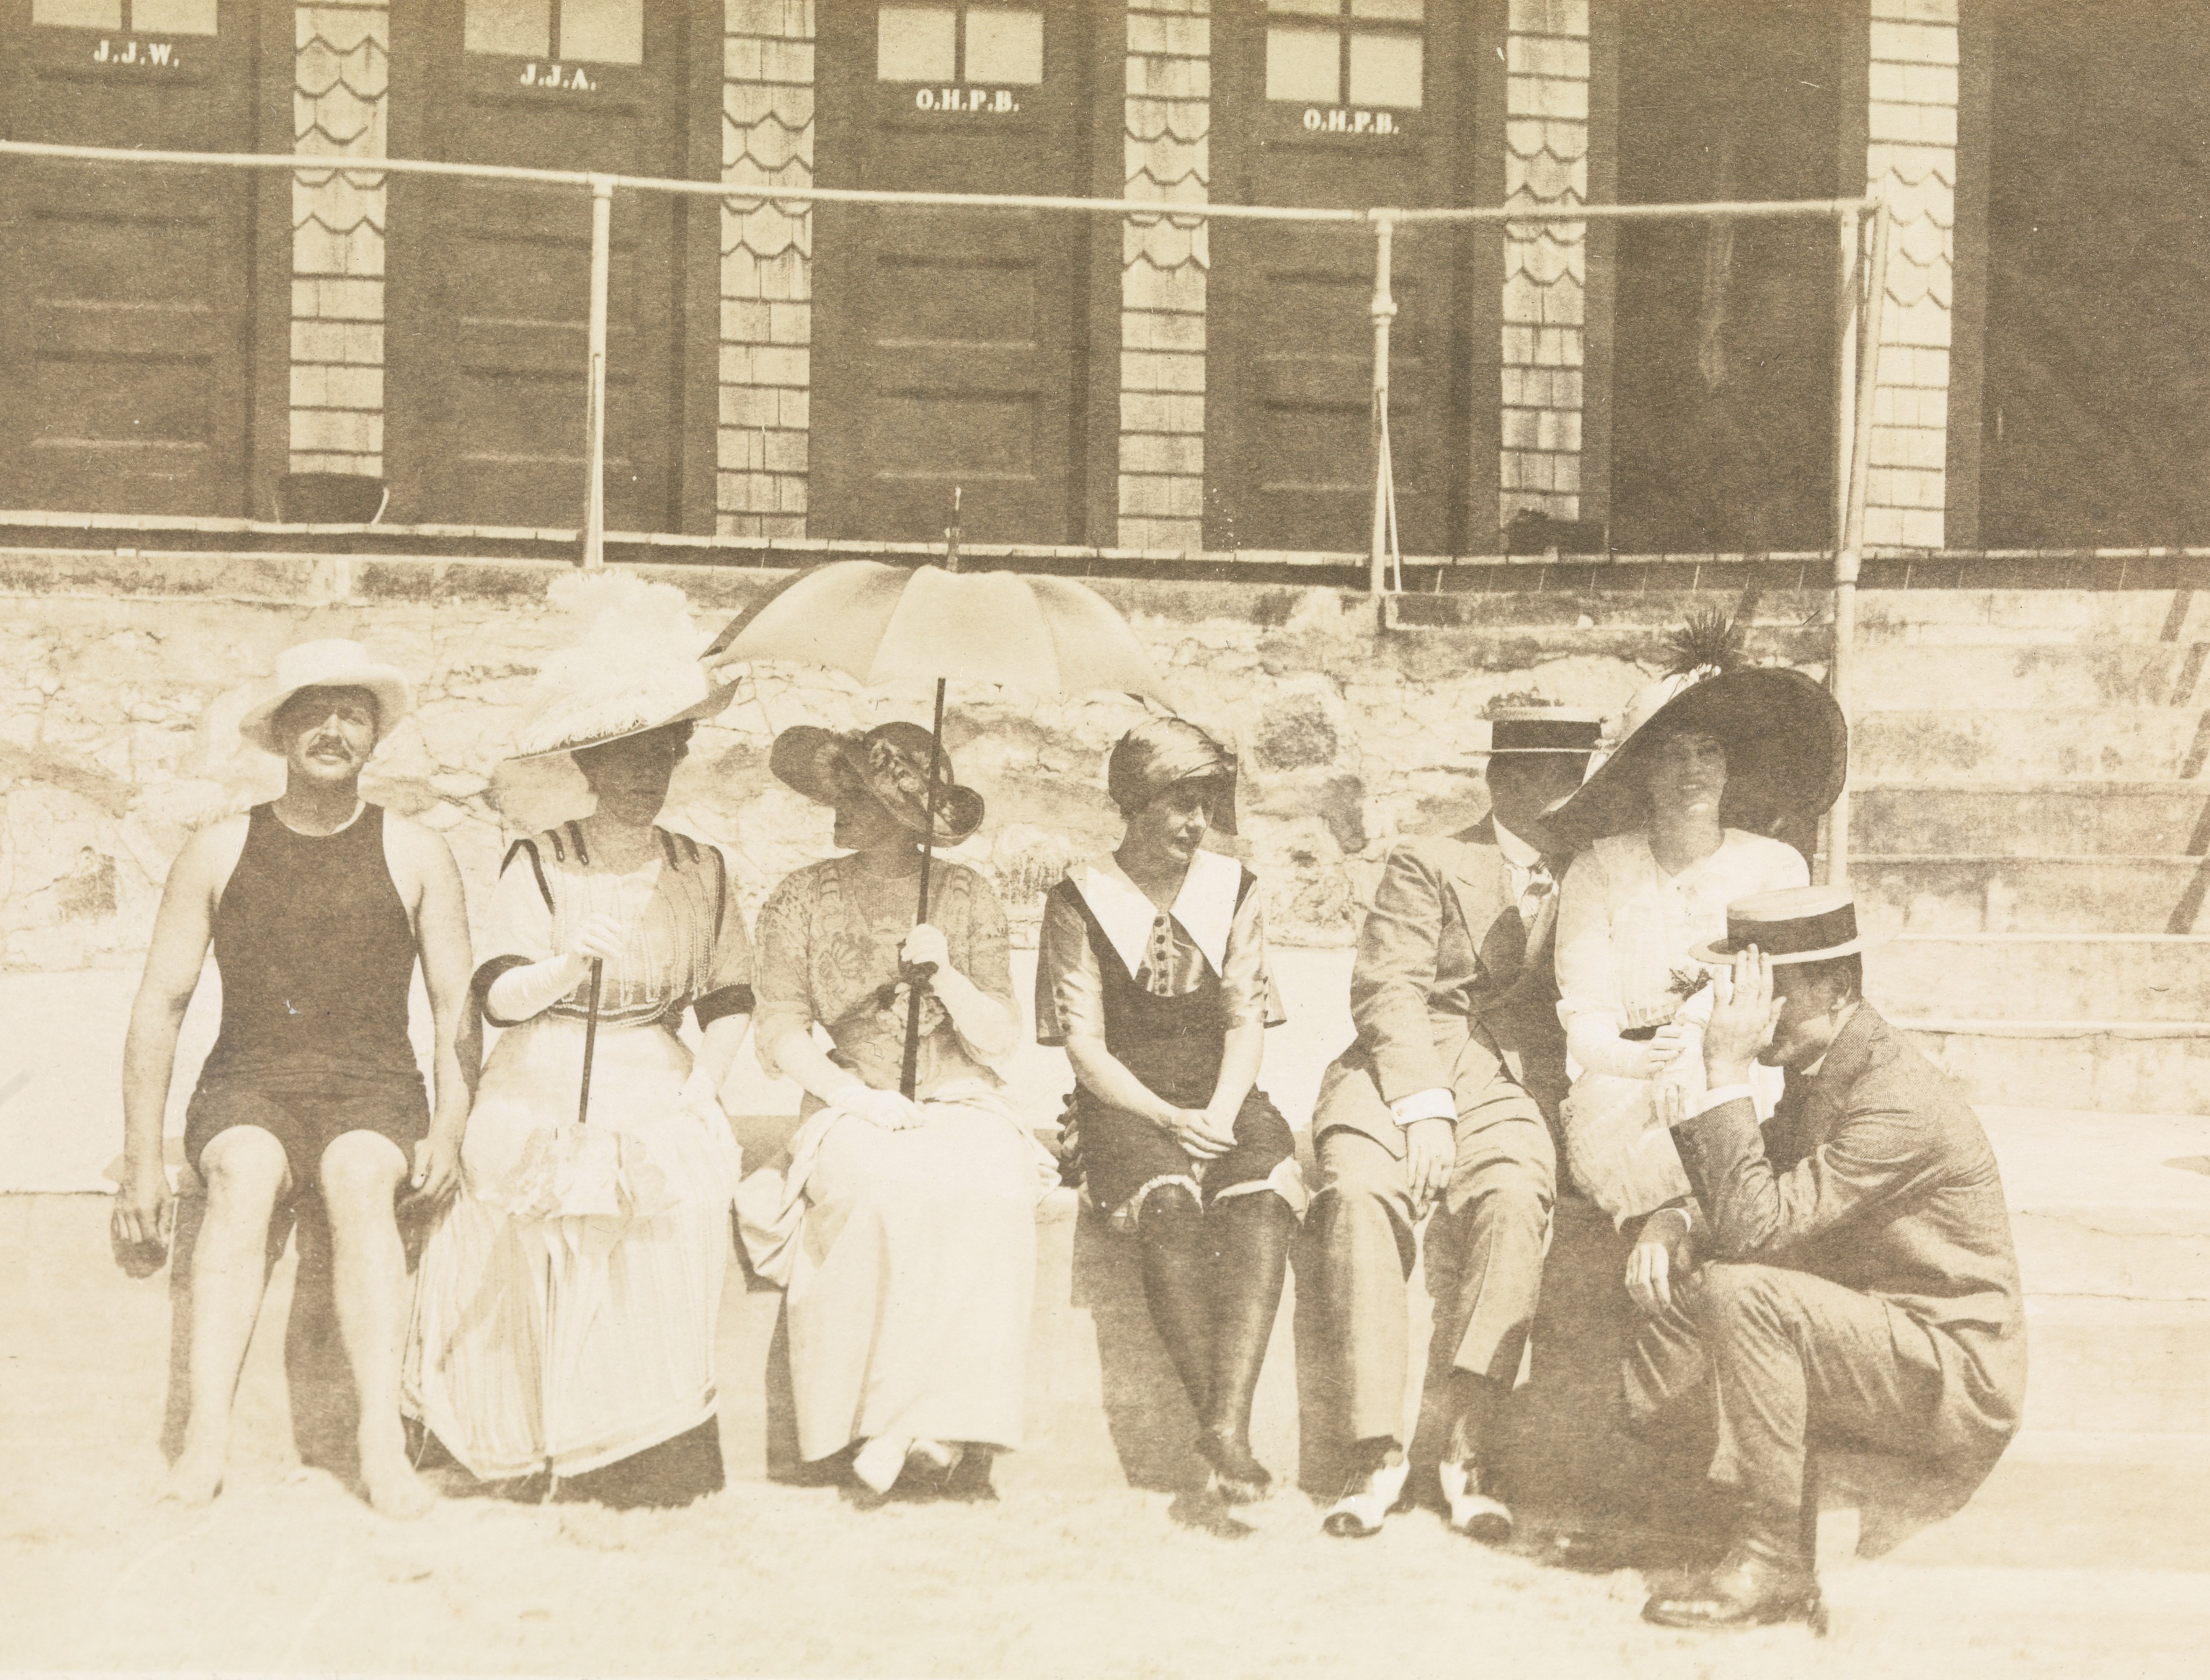
Eleanor Iselin (center, with headscarf)
Bailey’s Beach, Newport, RI
1900s
JJ.2015.6.12.e

Slide 34
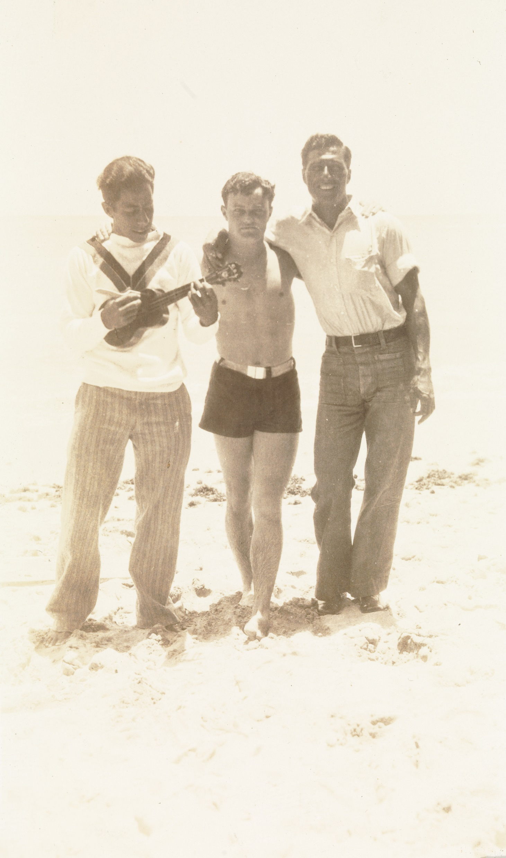
William jay Iselin (center) with friends audy and fred
Mokapu Beach, Oahu, HI
C. 1931
JJ.2015.7.6.f

Slide 35
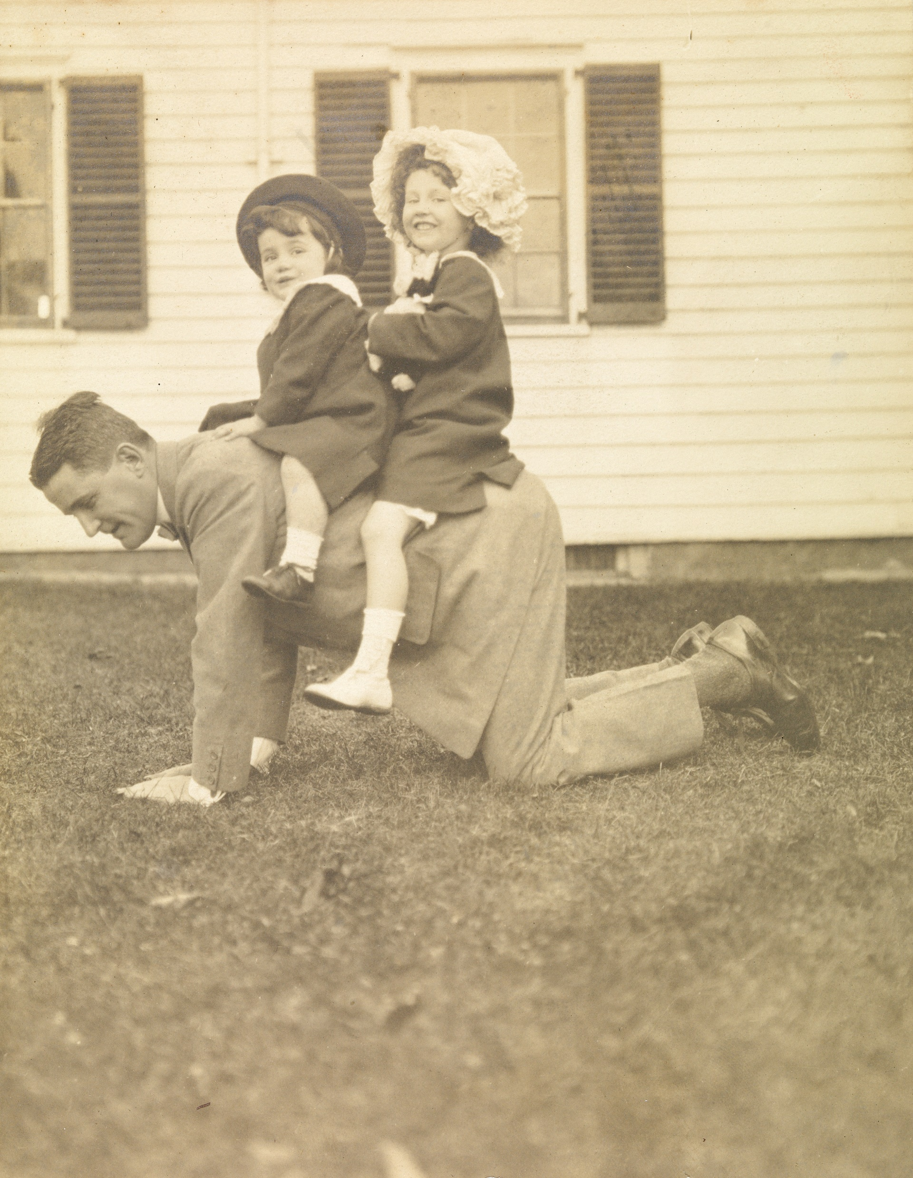
Dorothy and William jay Iselin on their father, Arthur’s, back
Bedford House
1910
JJ.1980.140.6.a

Slide 36
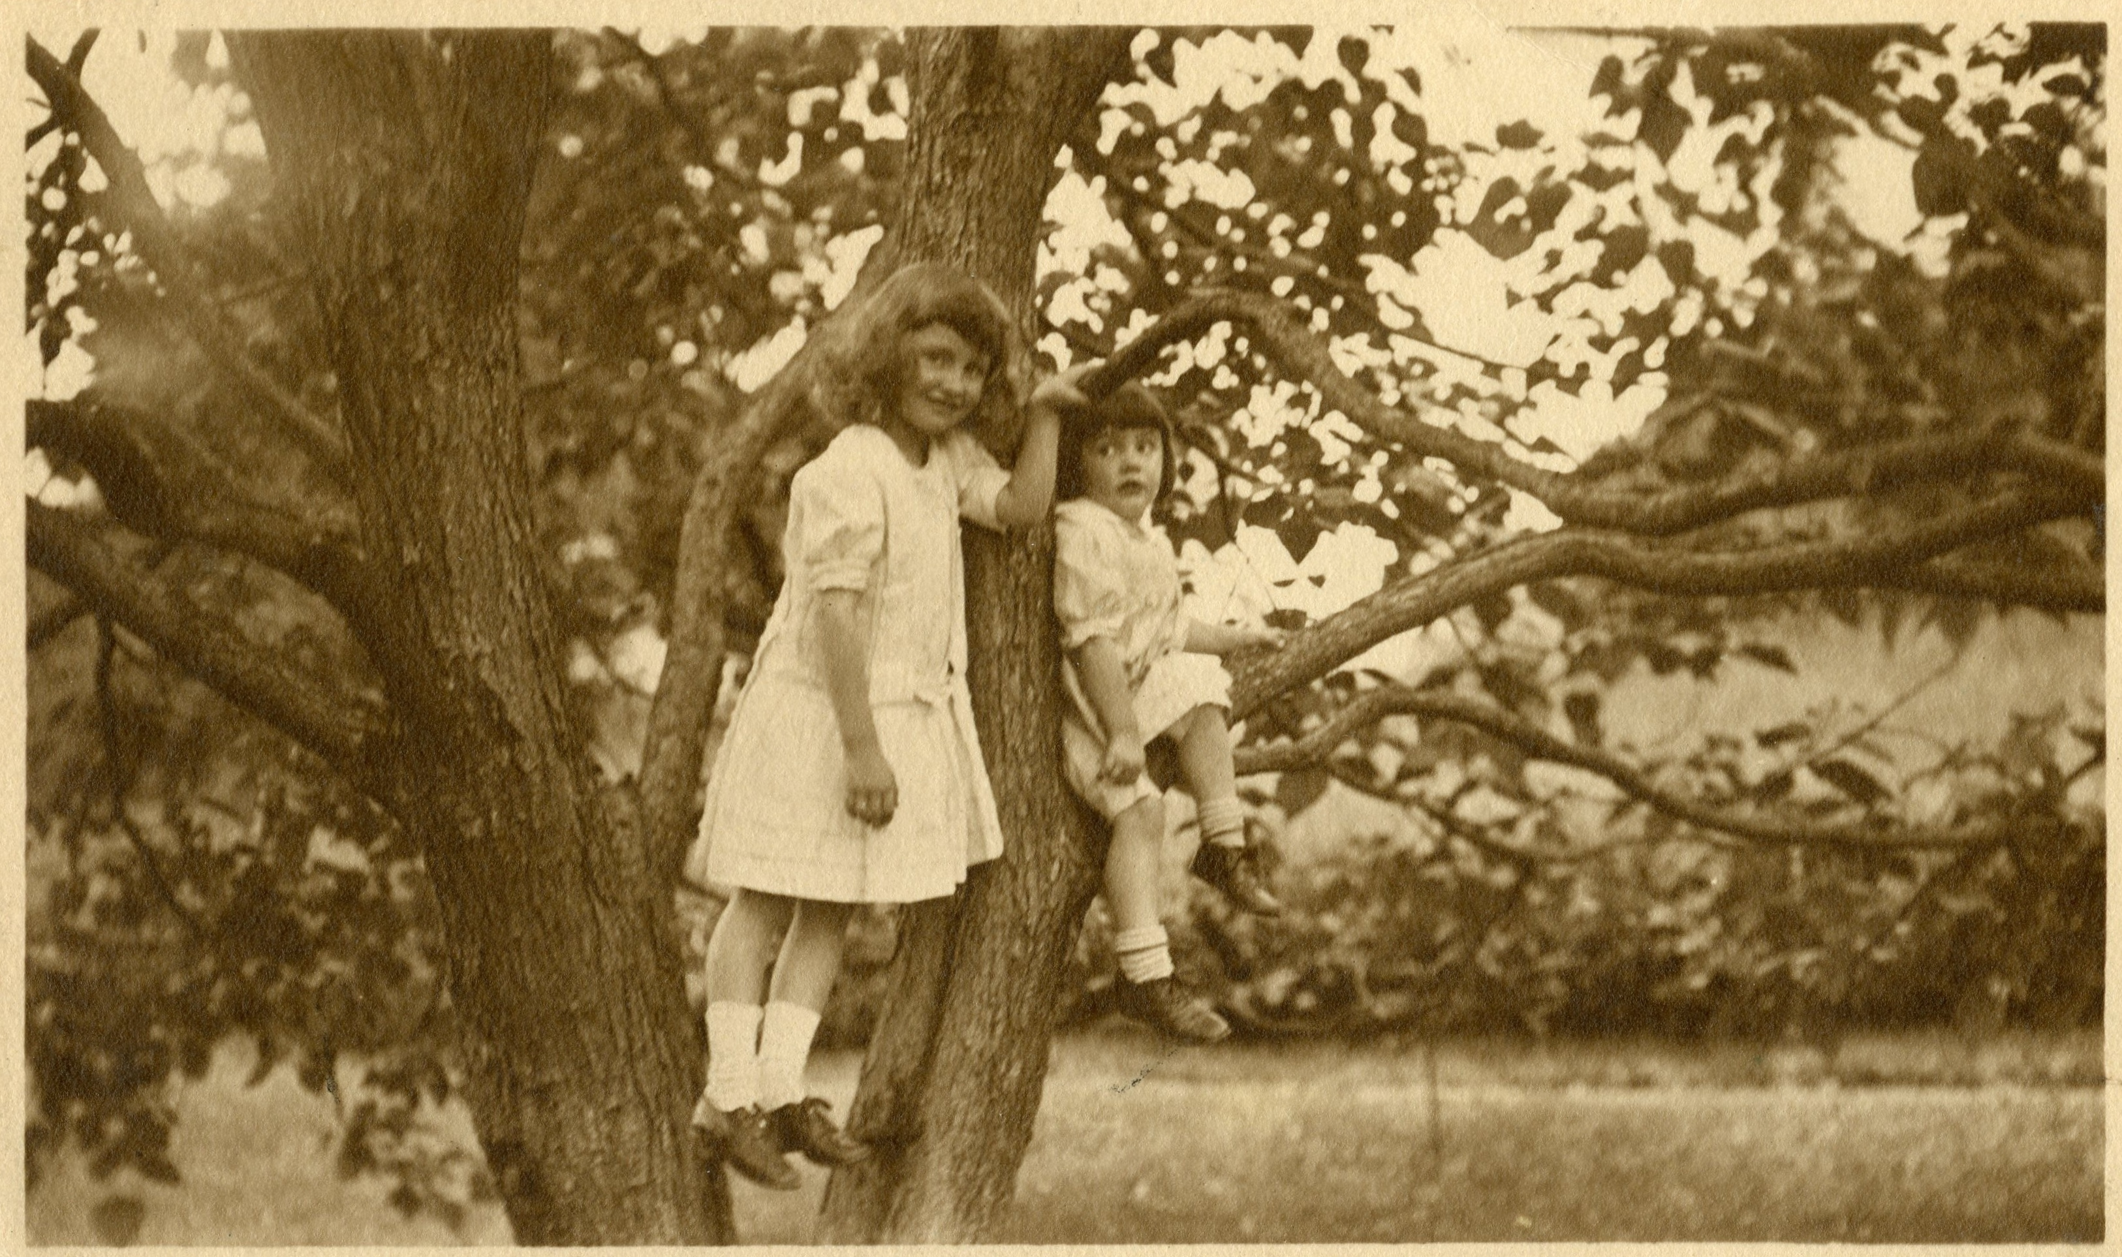
Dorothy and
William jay iselin
Bedford House
C. 1910
JJ.2015.35

Slide 37
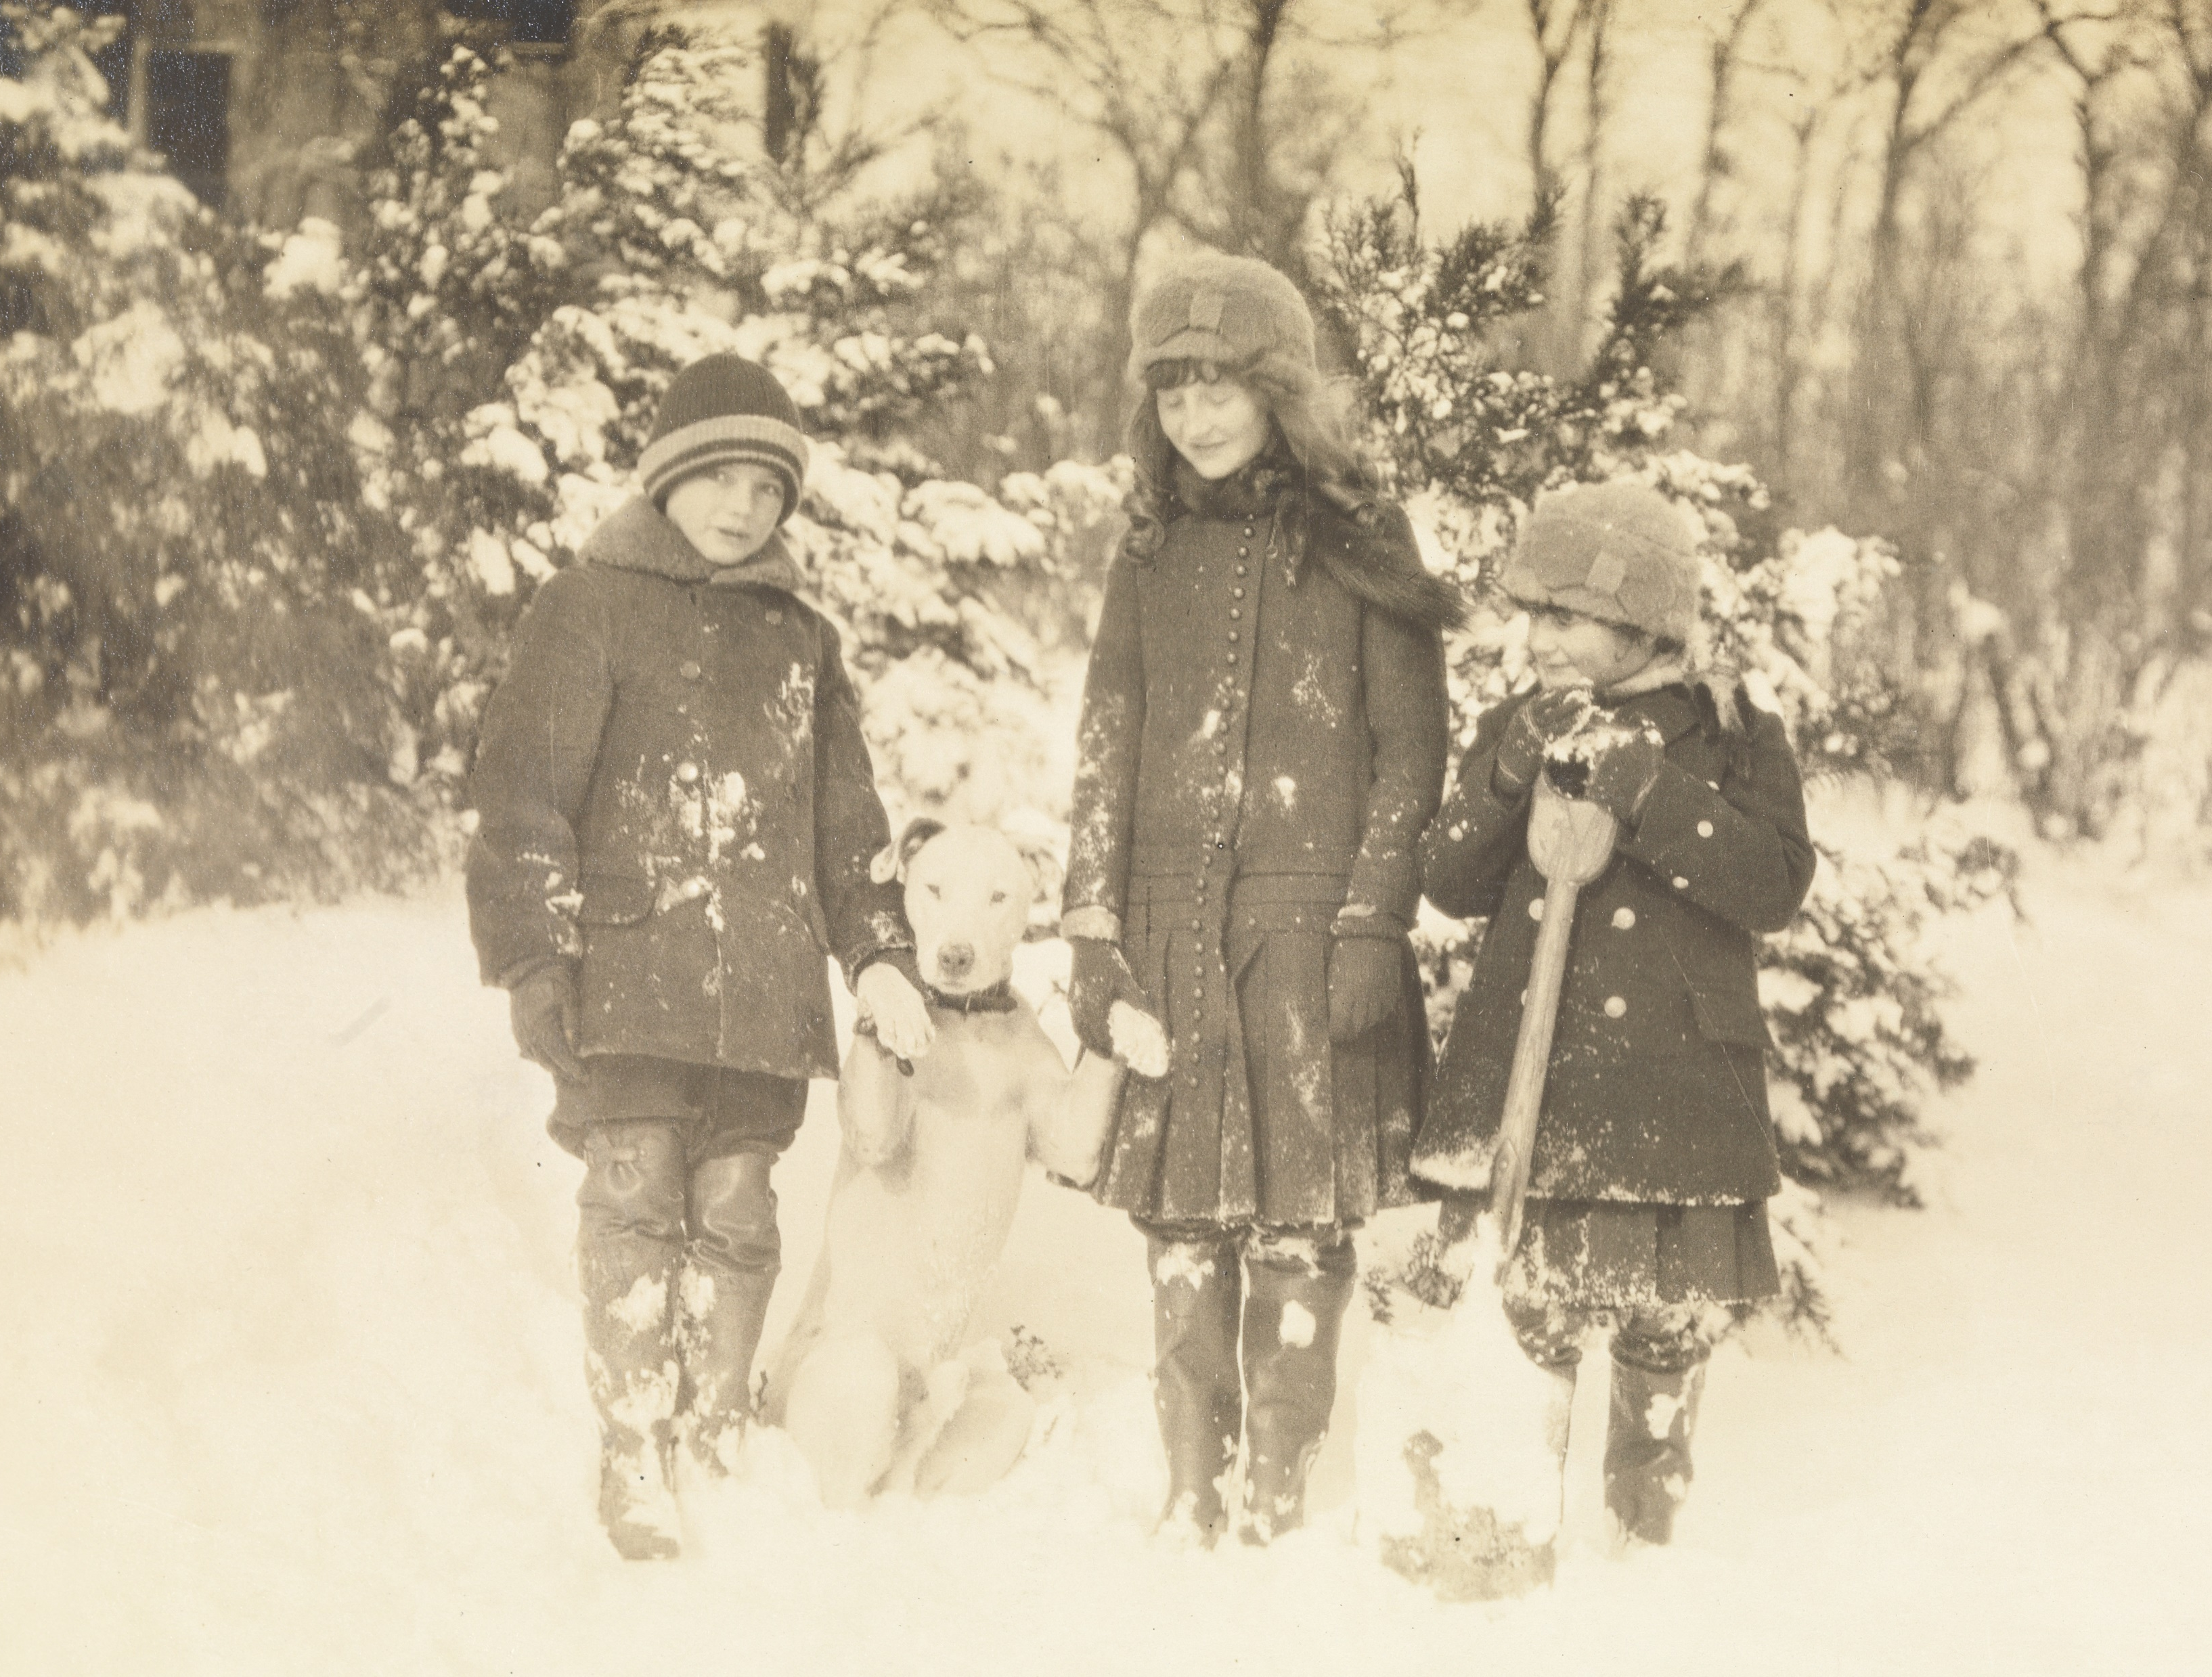
Siblings
William jay Iselin, Dorothy Iselin, and Eleanor Iselin with dog
Bedford House
C. 1914
JJ.1980.33.17.d

Slide 38
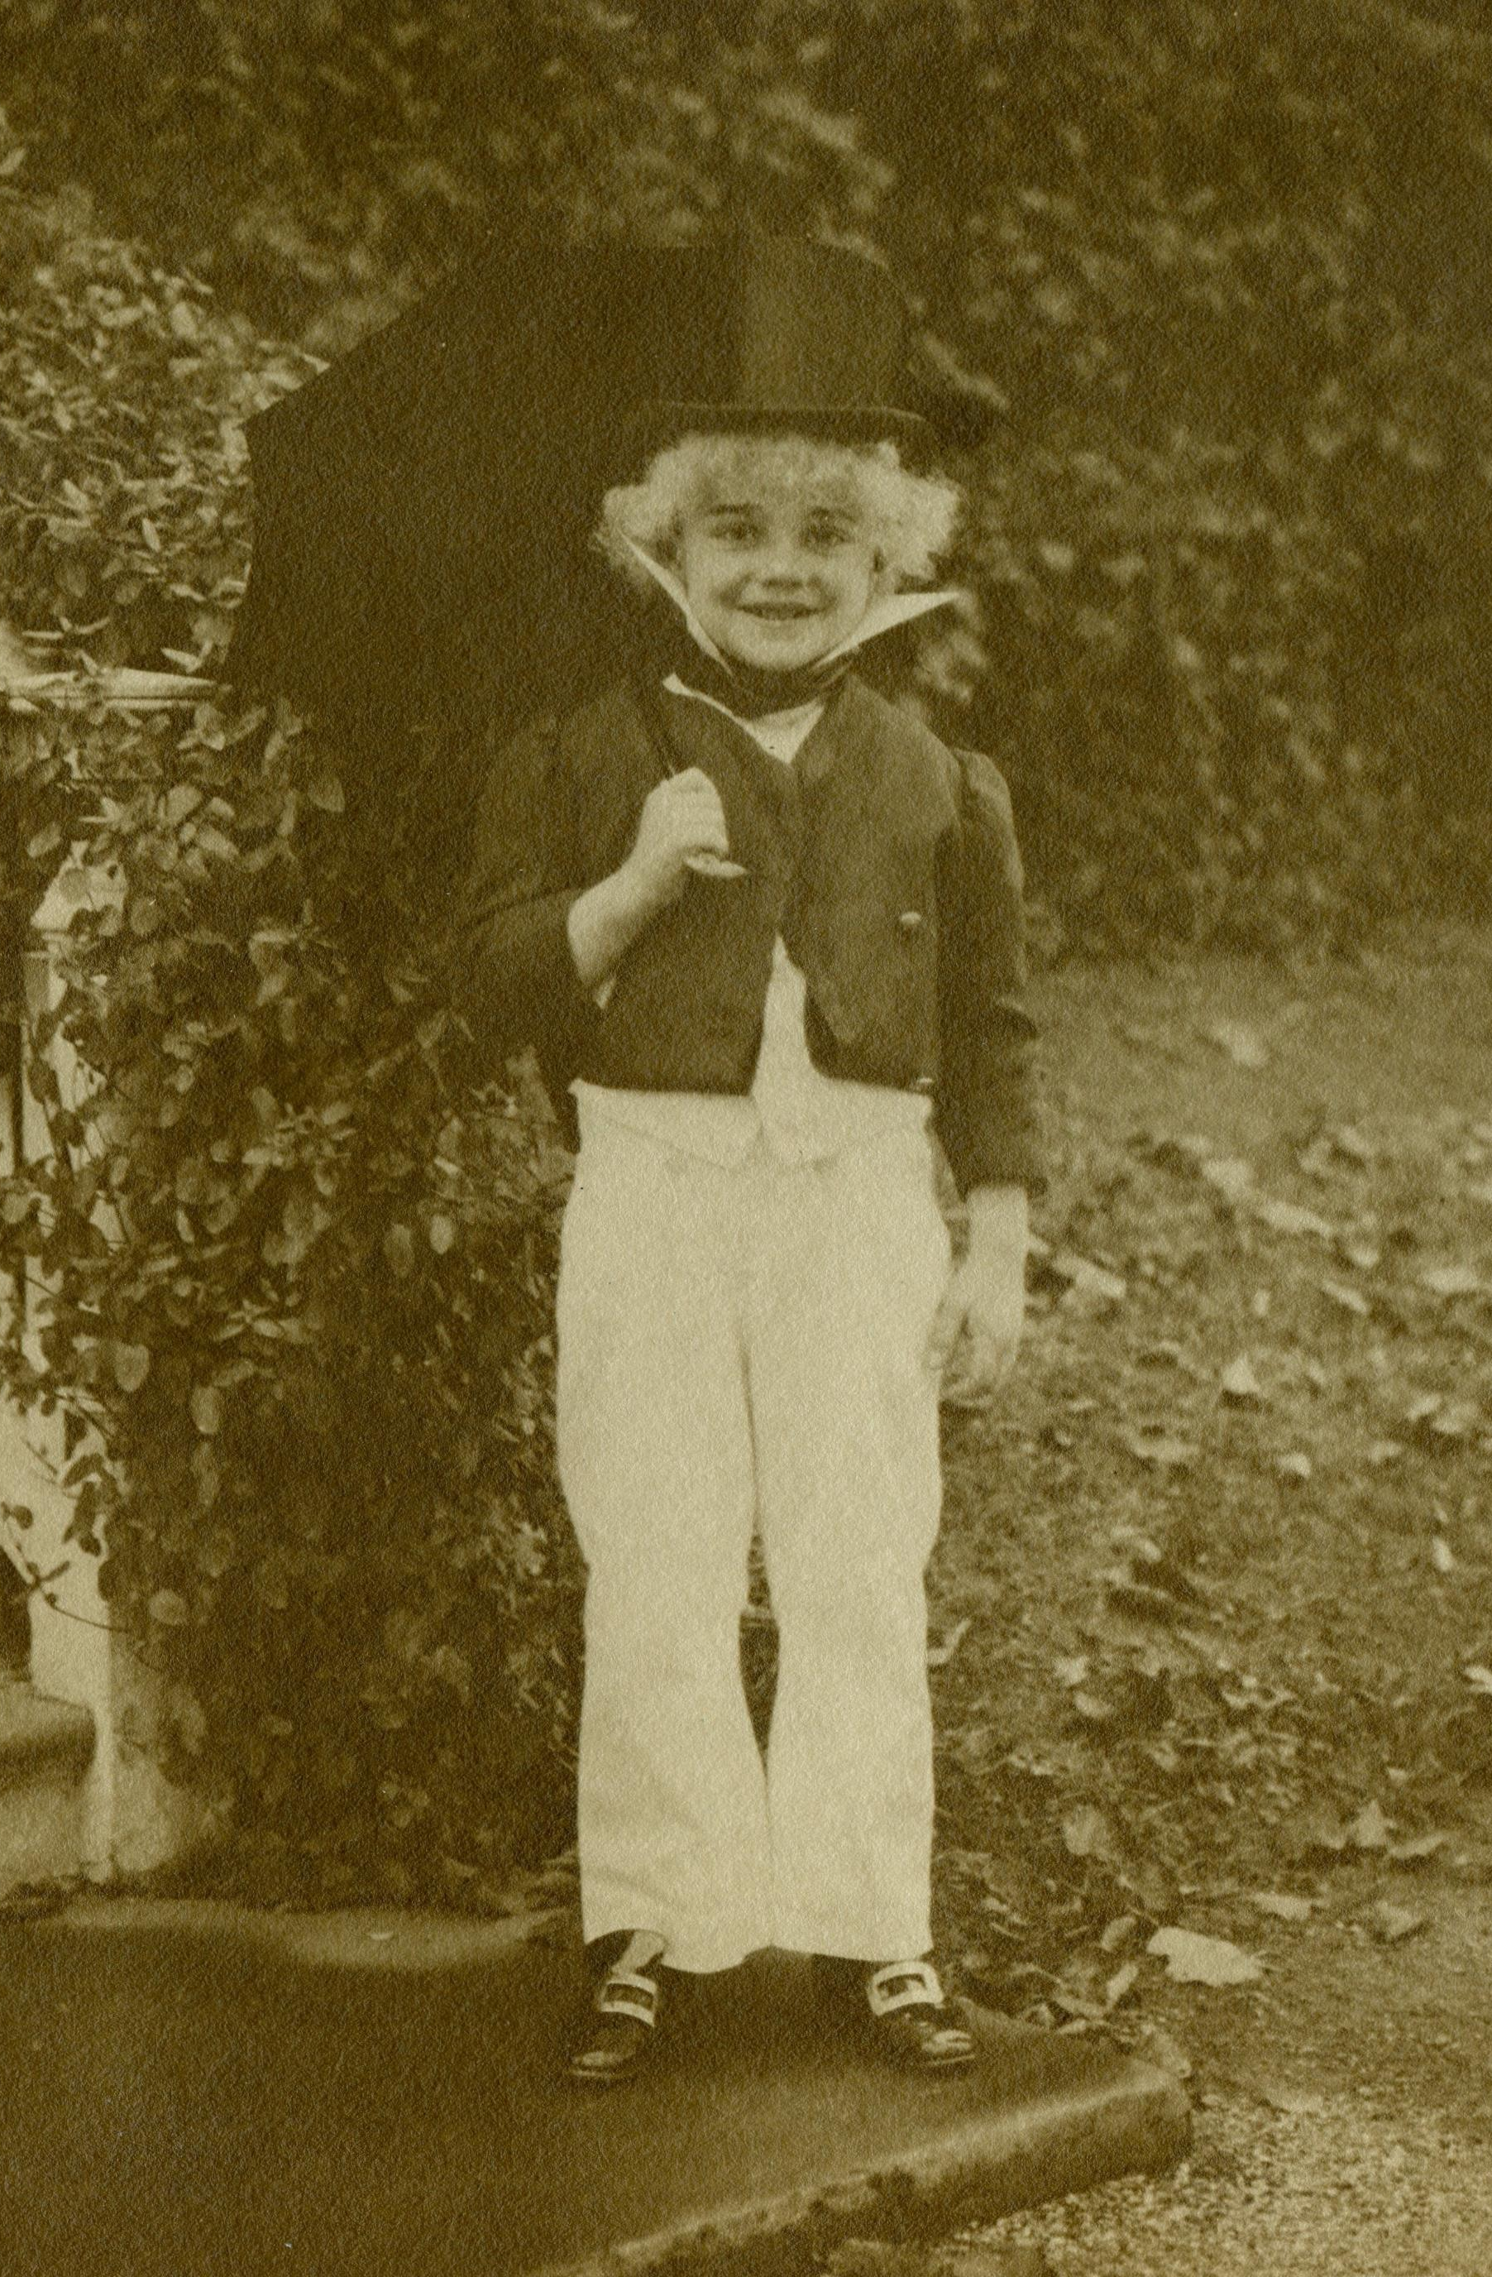
William jay Iselin dressed as a dandy
Bedford House
C. 1915
JJ.2015.30

Slide 39
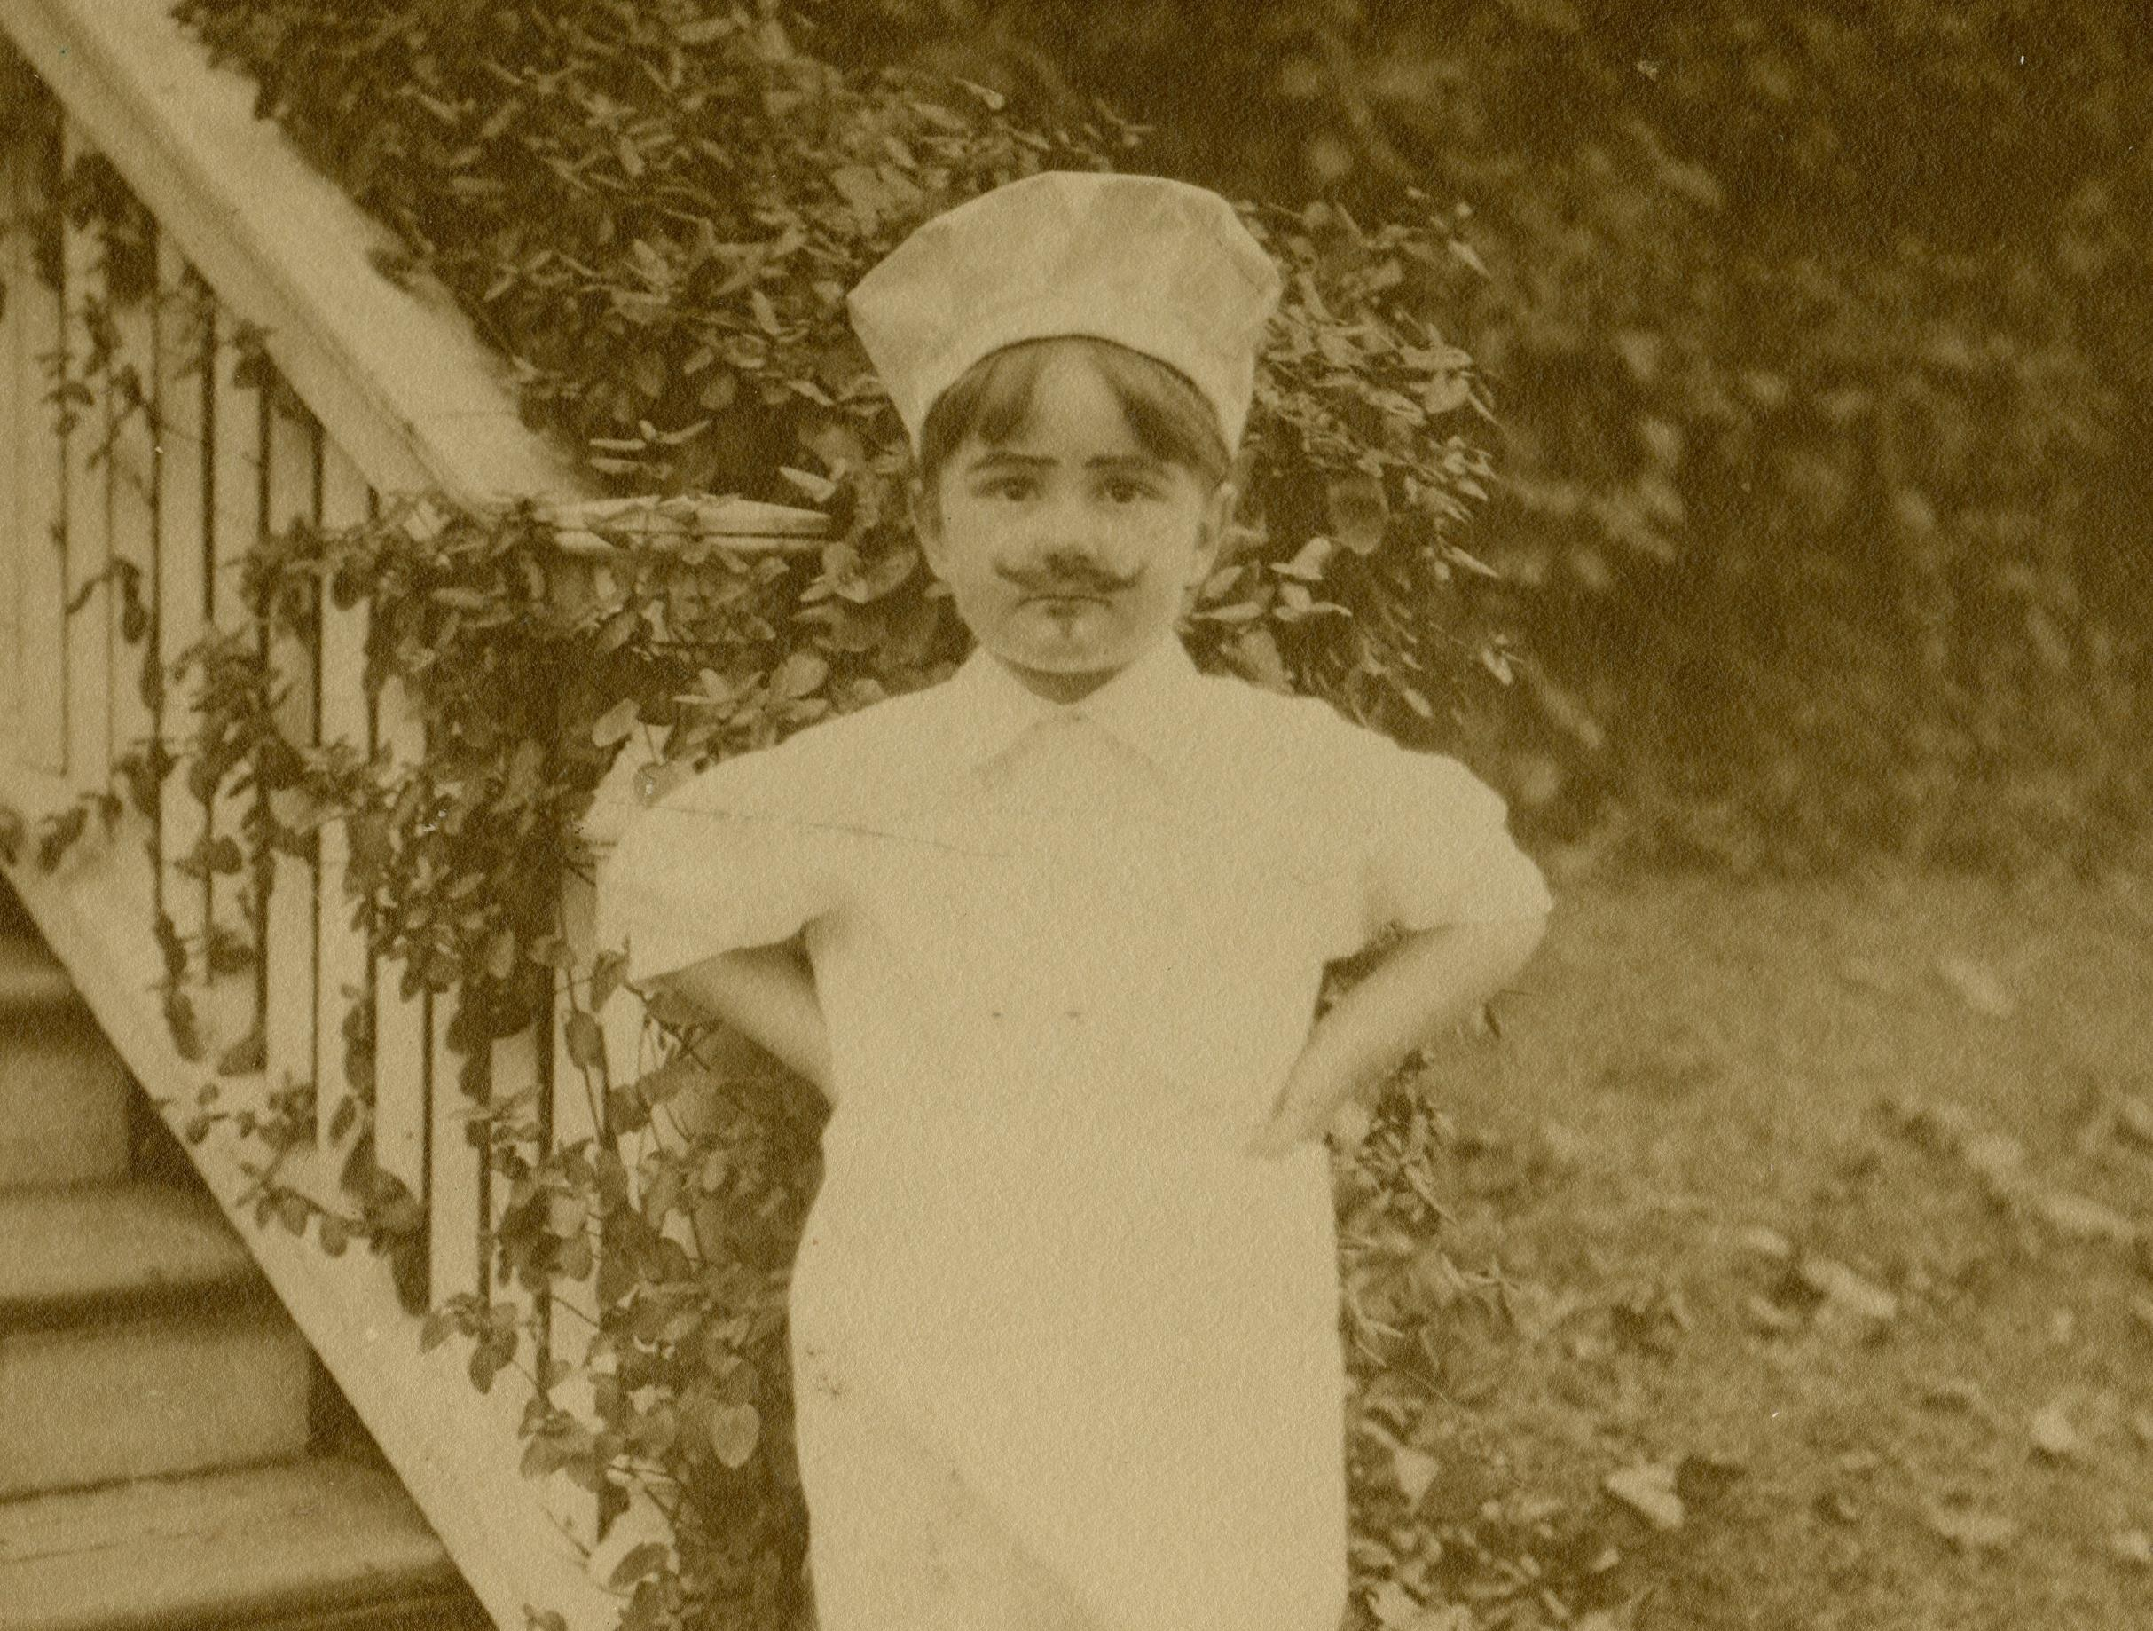
Eleanor Iselin dressed as a French chef
Bedford House
C. 1915
JJ.2015.28

Slide 40
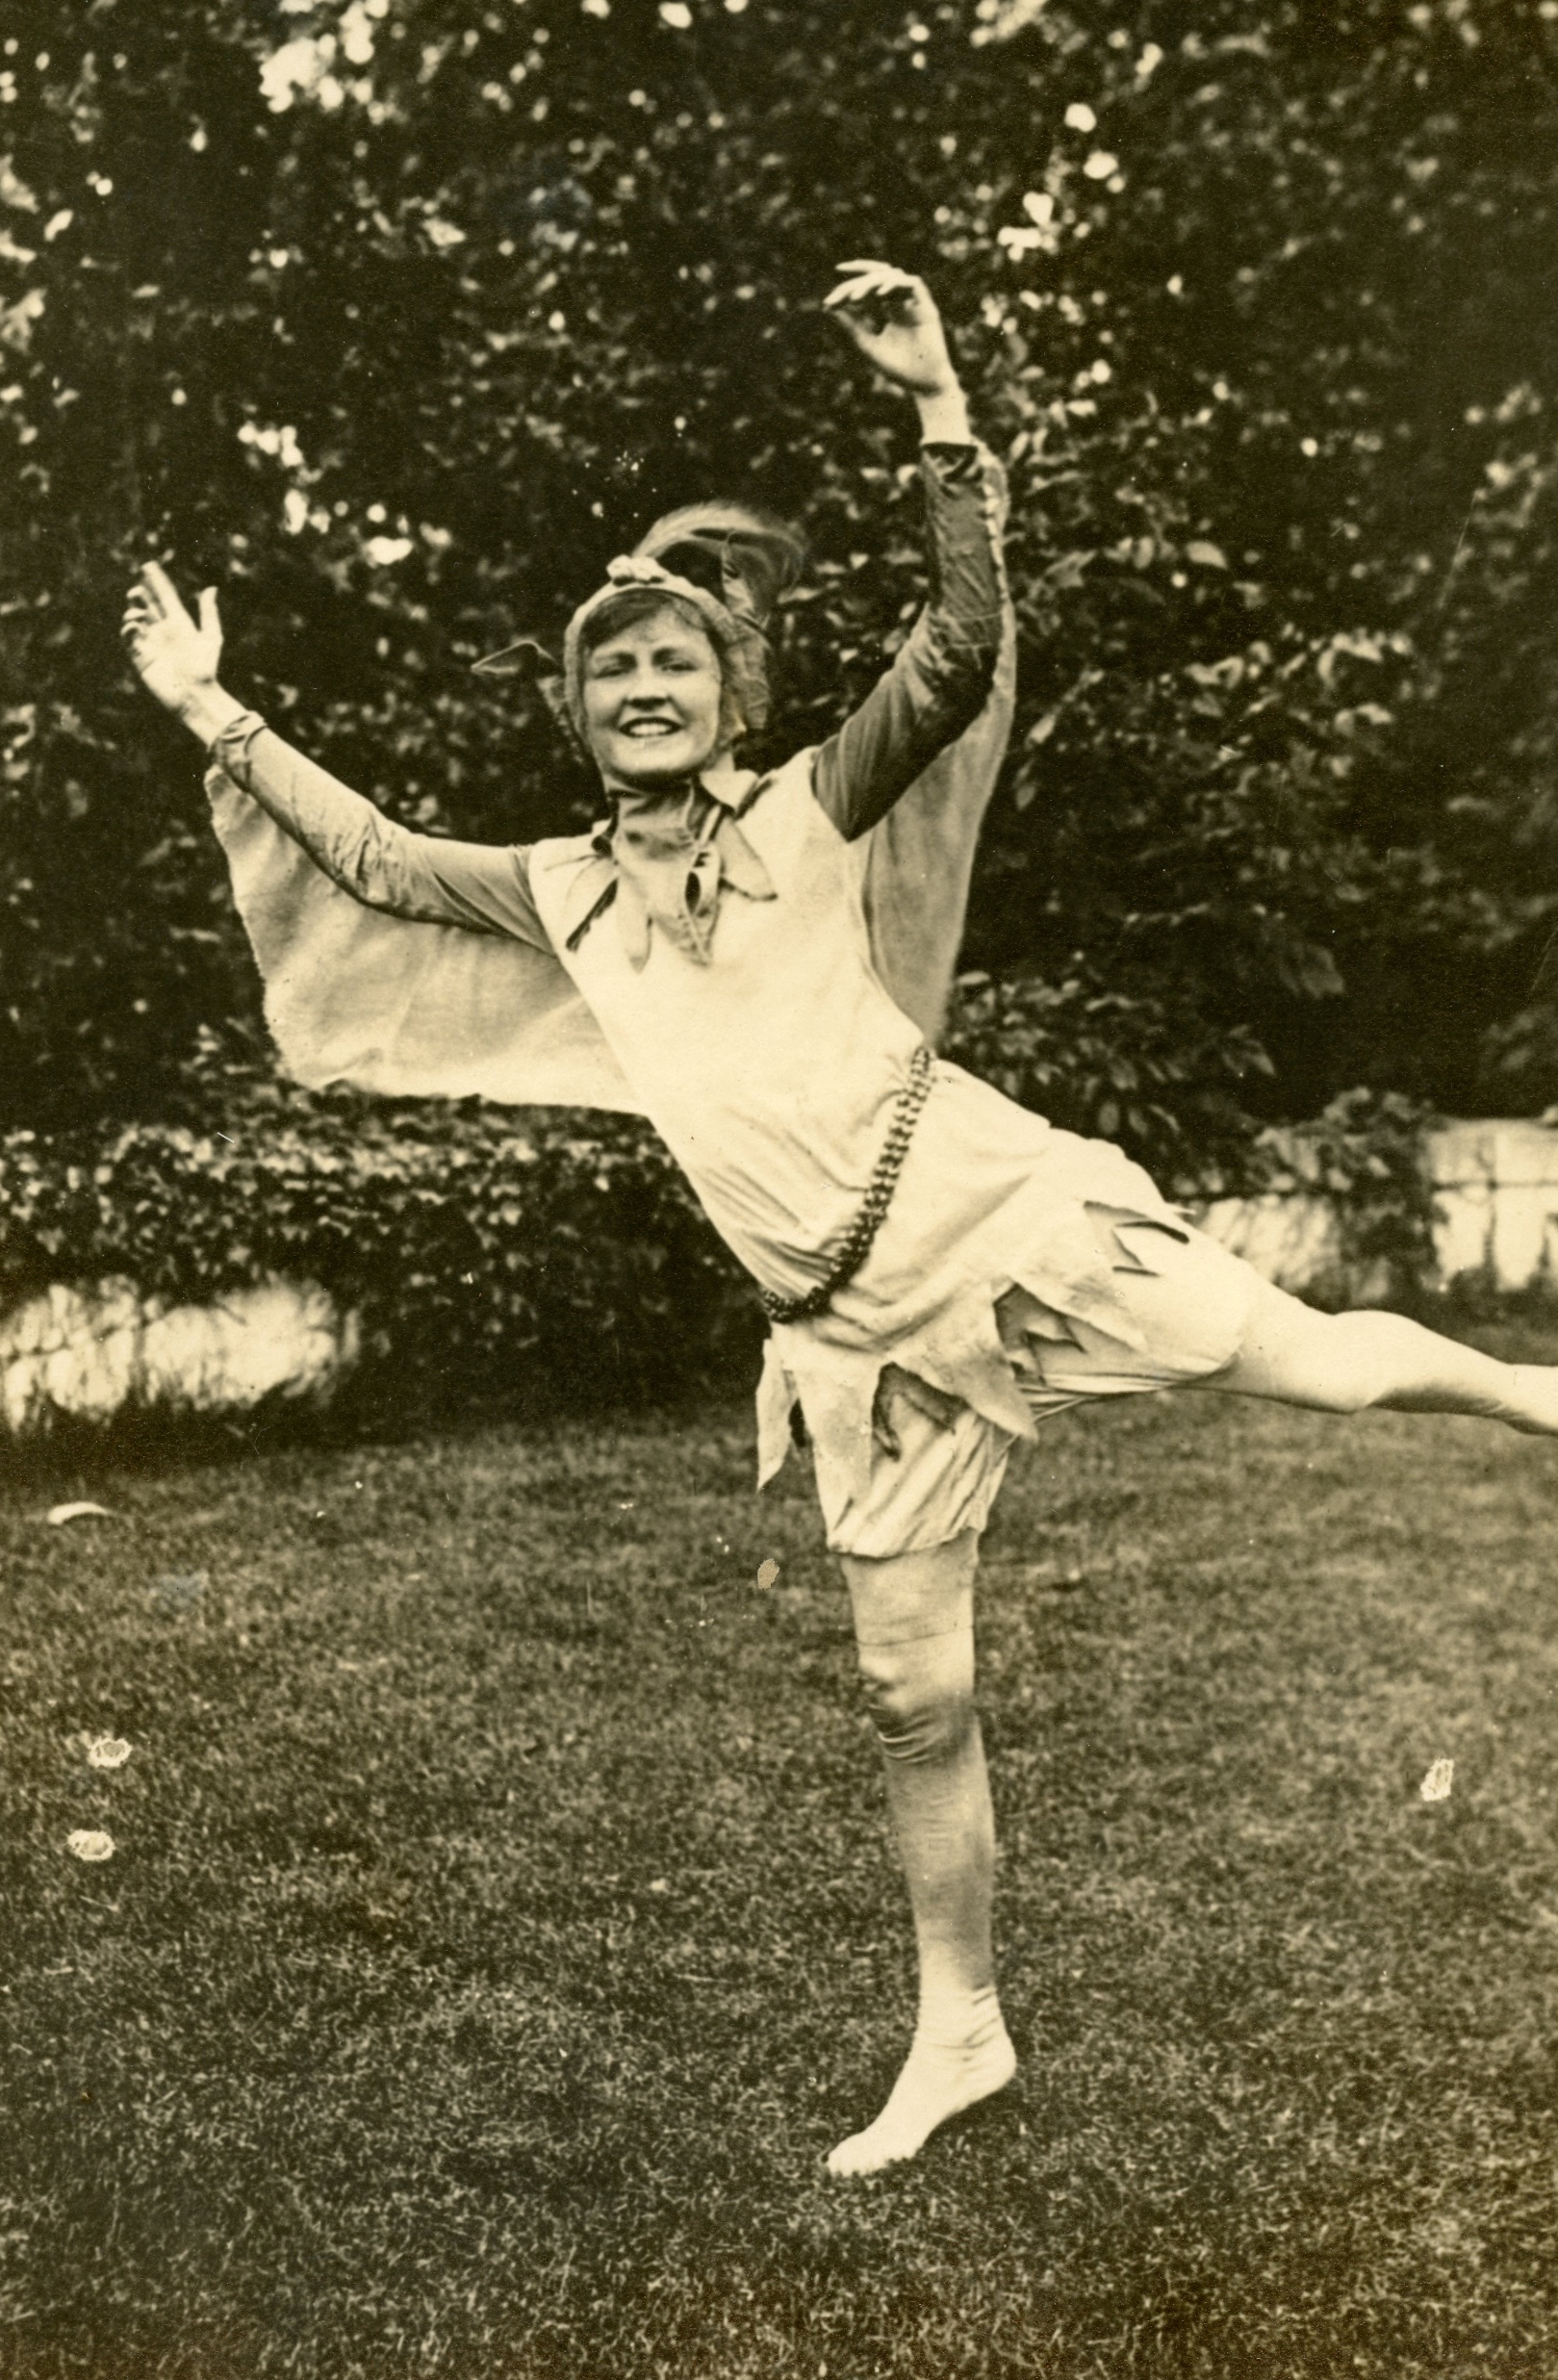
Dorothy Iselin dressed as peter pan
Bedford House
C. 1915
JJ.2015.18

Slide 41
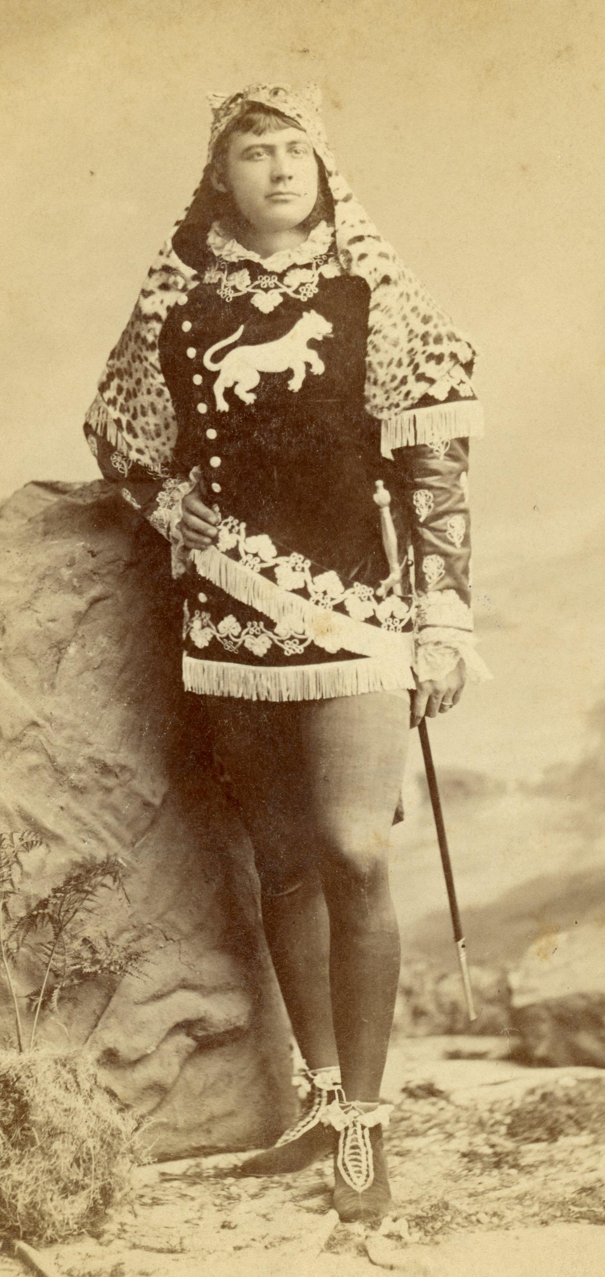
William jay II
Delmonico Ball, New York, NY
1875
JJ.2015.34

Slide 42
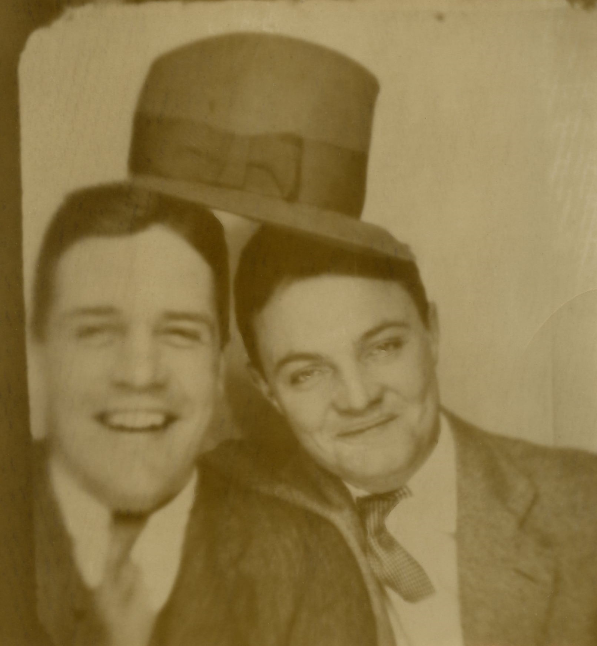
William jay Iselin and friend in photo both
Place unknown
Early 1930s
JJ.2015.20.1.c

Slide 43
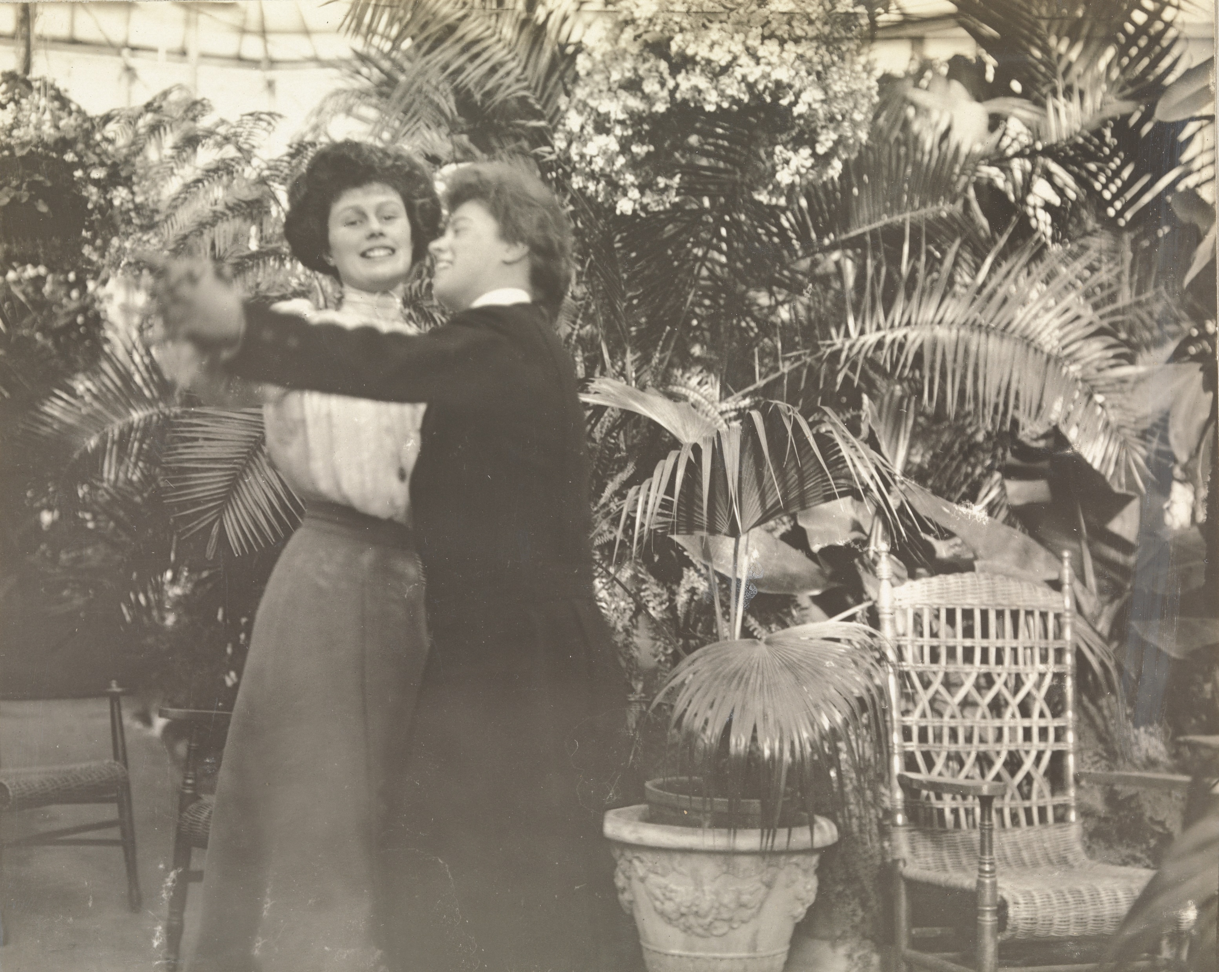
Eleanor jay Iselin and friend in winter garden
Place unknown
1910
JJ.2008.3.43.a

Slide 44
childhood

Slide 45
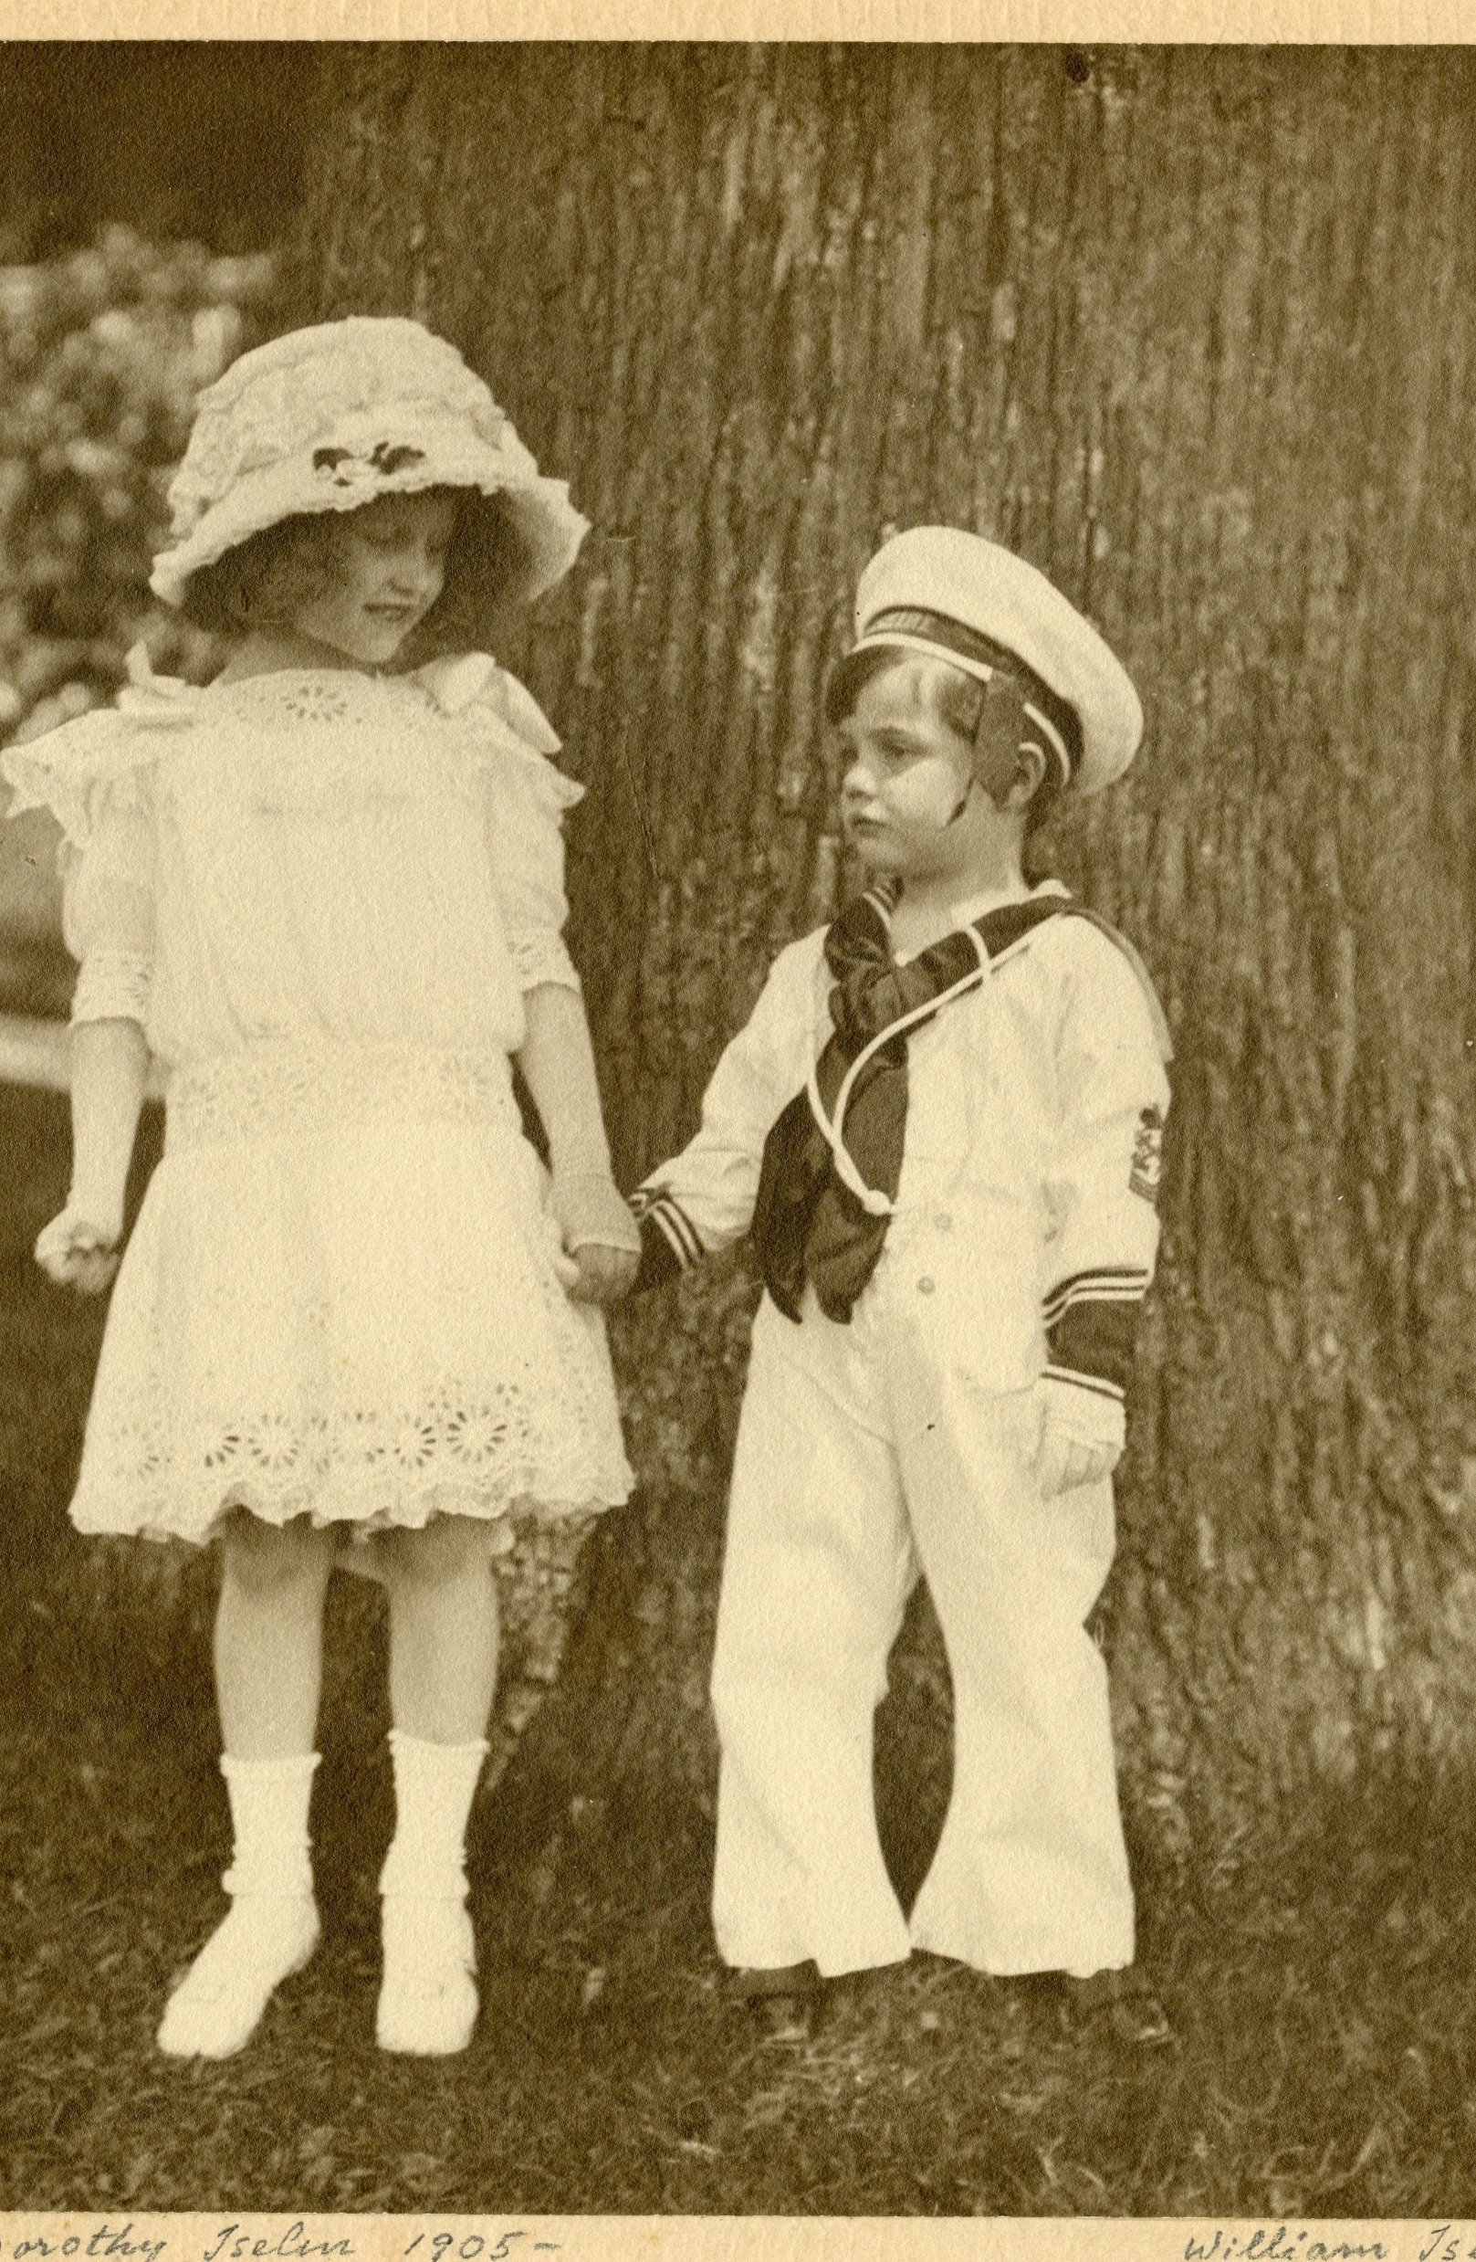
Dorothy and
William jay iselin
Bedford House
C. 1910
JJ.2015.26

Slide 46
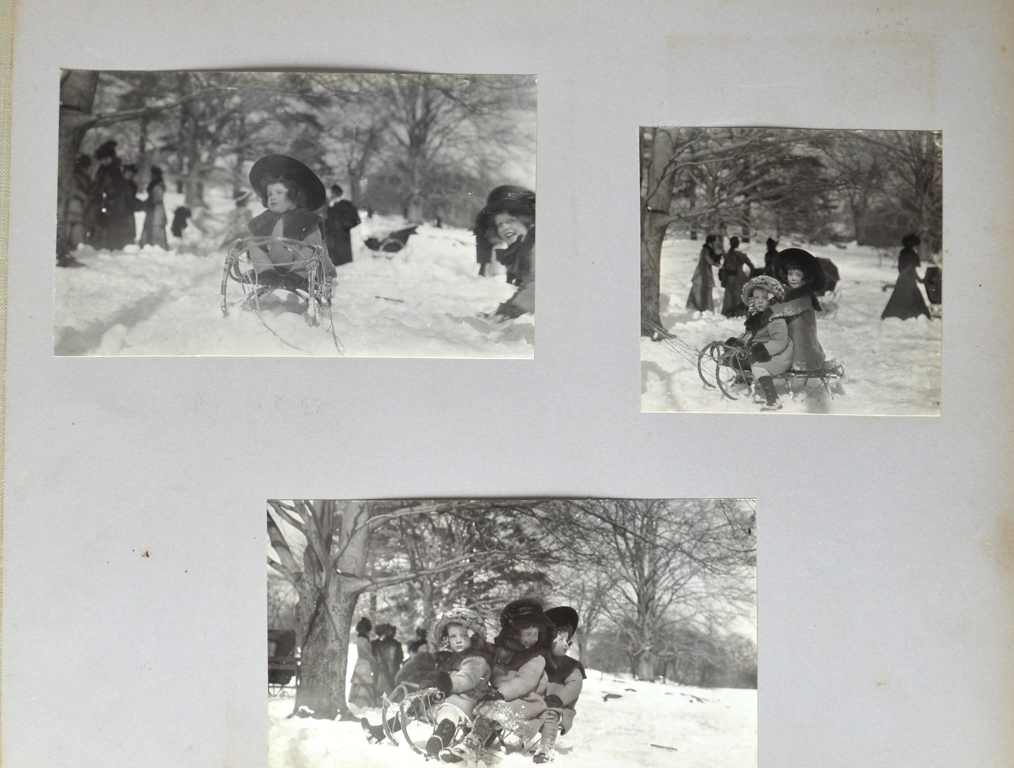
Marie Iselin (cousin), Dorothy, and
William jay iselin
Central Park, New York, NY
1911
JJ.1980.140.6.d

Slide 47
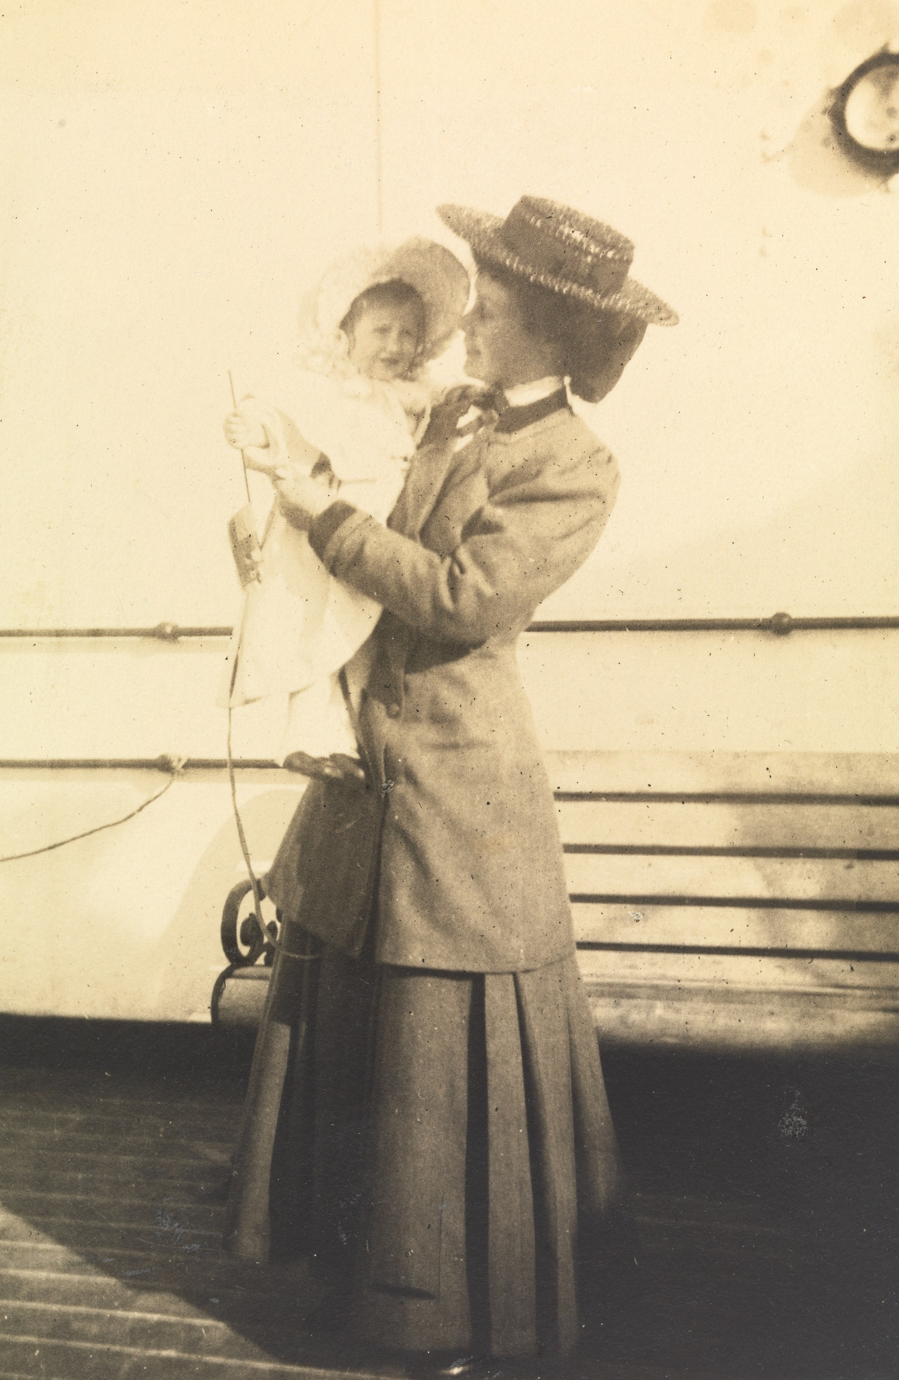
Eleanor jay Iselin holding baby Dorothy
R.M.S. Baltic
1907
JJ.2015.38.12.c

Slide 48
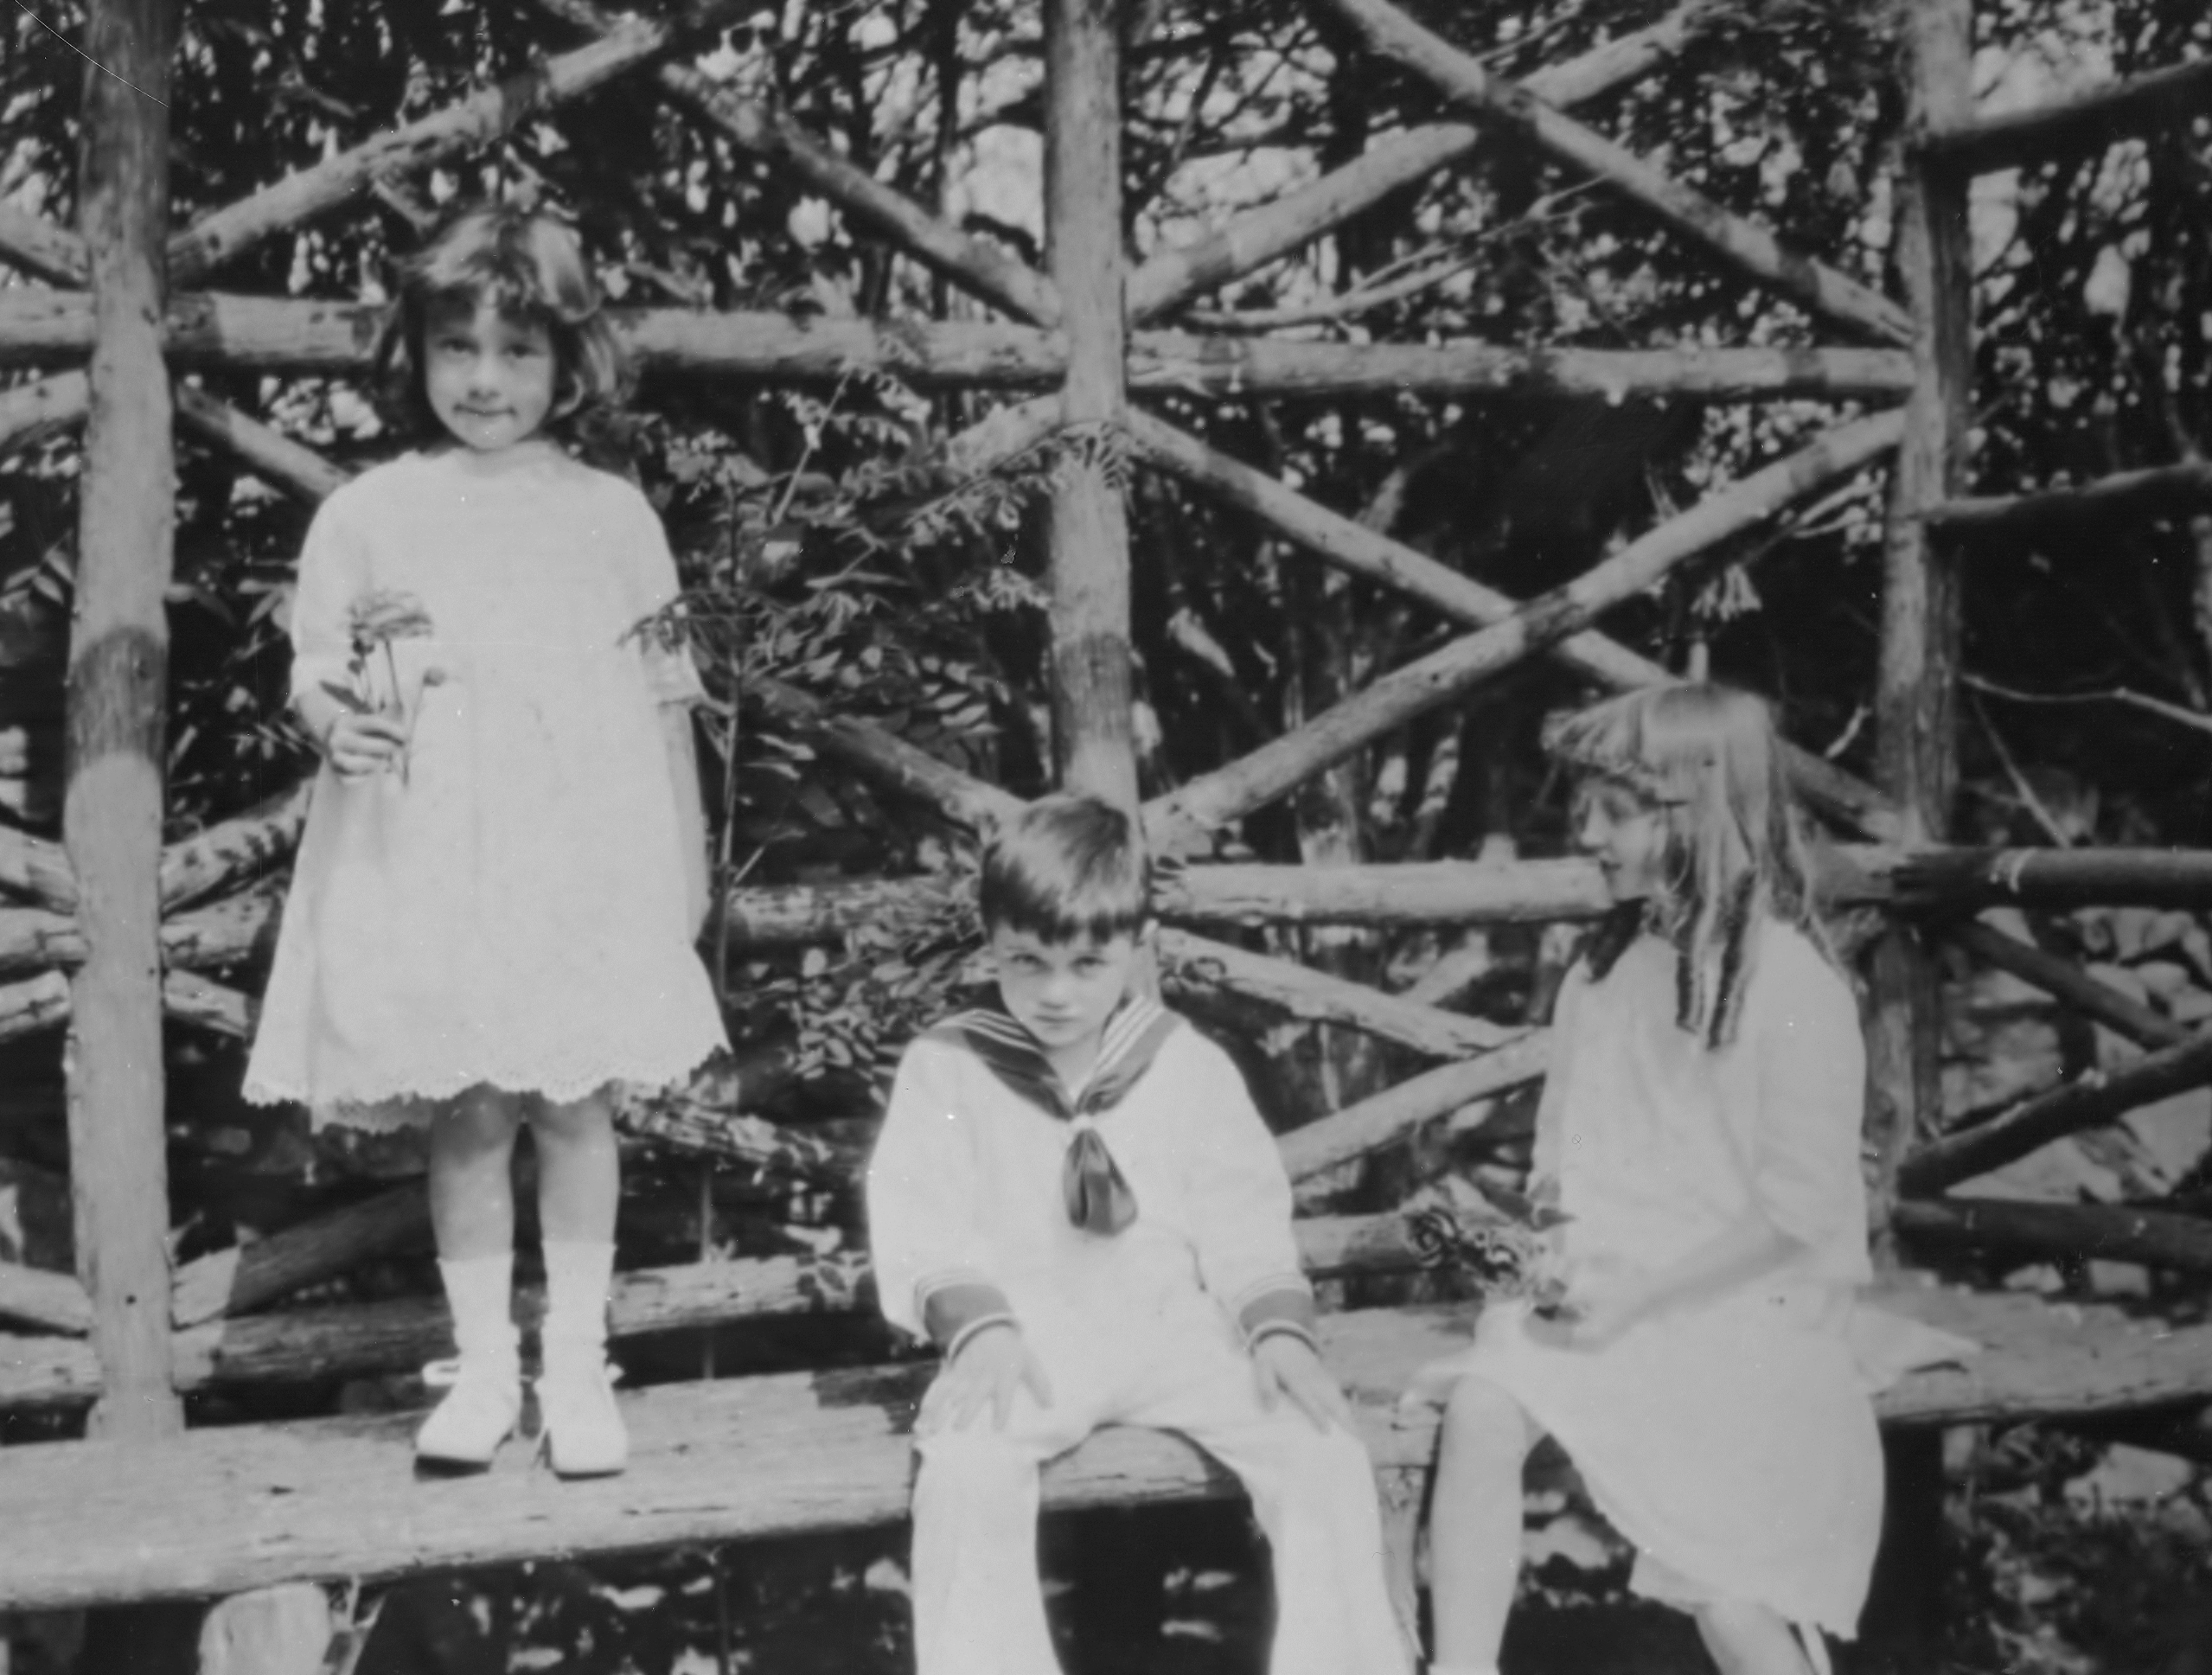
Eleanor,
William, and
Dorothy iselin
Bedford House
1910s
JJ.1980.140.16.g

Slide 49
travel

Slide 50
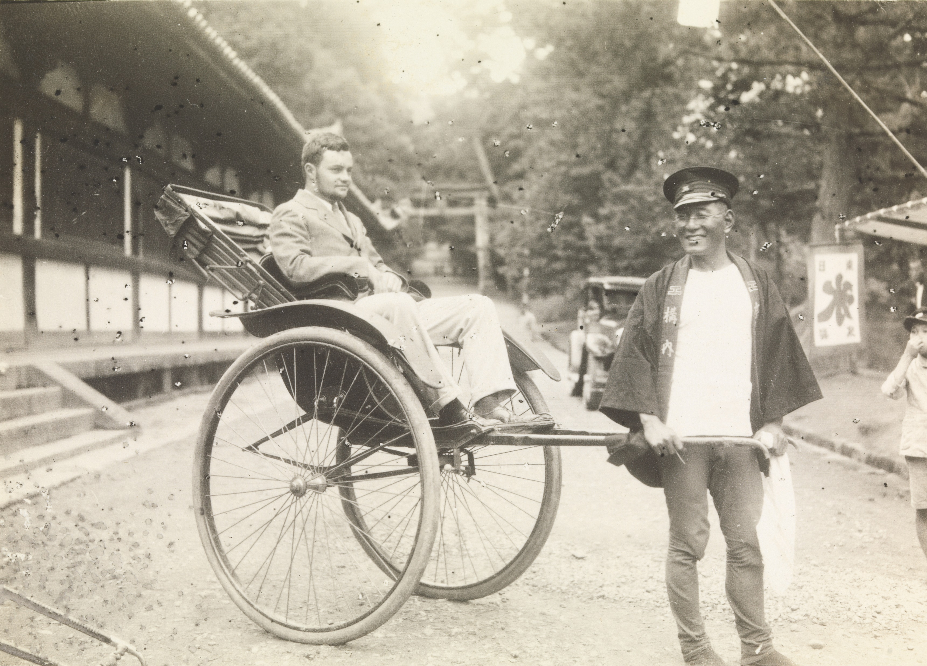
William jay Iselin in rickshaw
Japan
C. 1931
JJ.2015.7.12.h

Slide 51
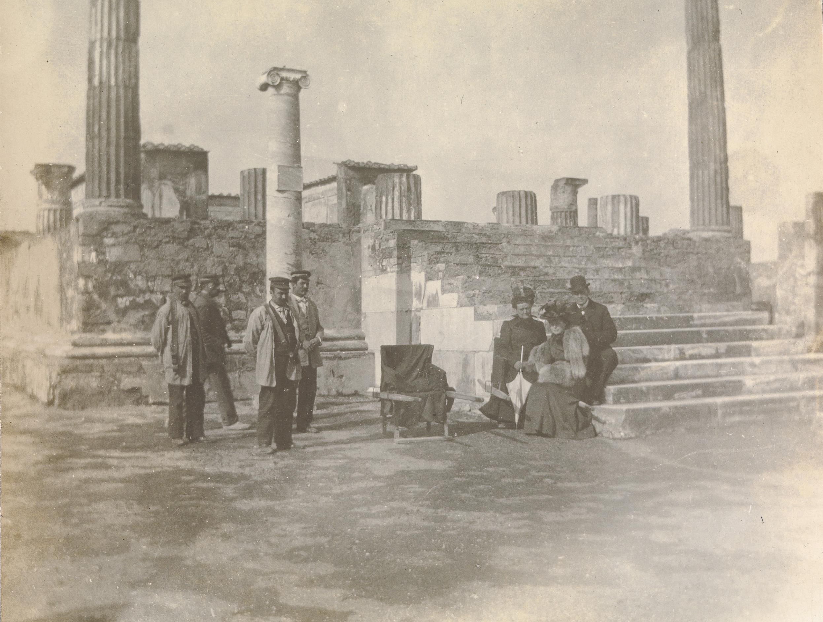
Col. William jay, lucie oelrichs jay, and Dorothy jay
Pompeii, Italy
1900
JJ.2015.8.7.a

Slide 52
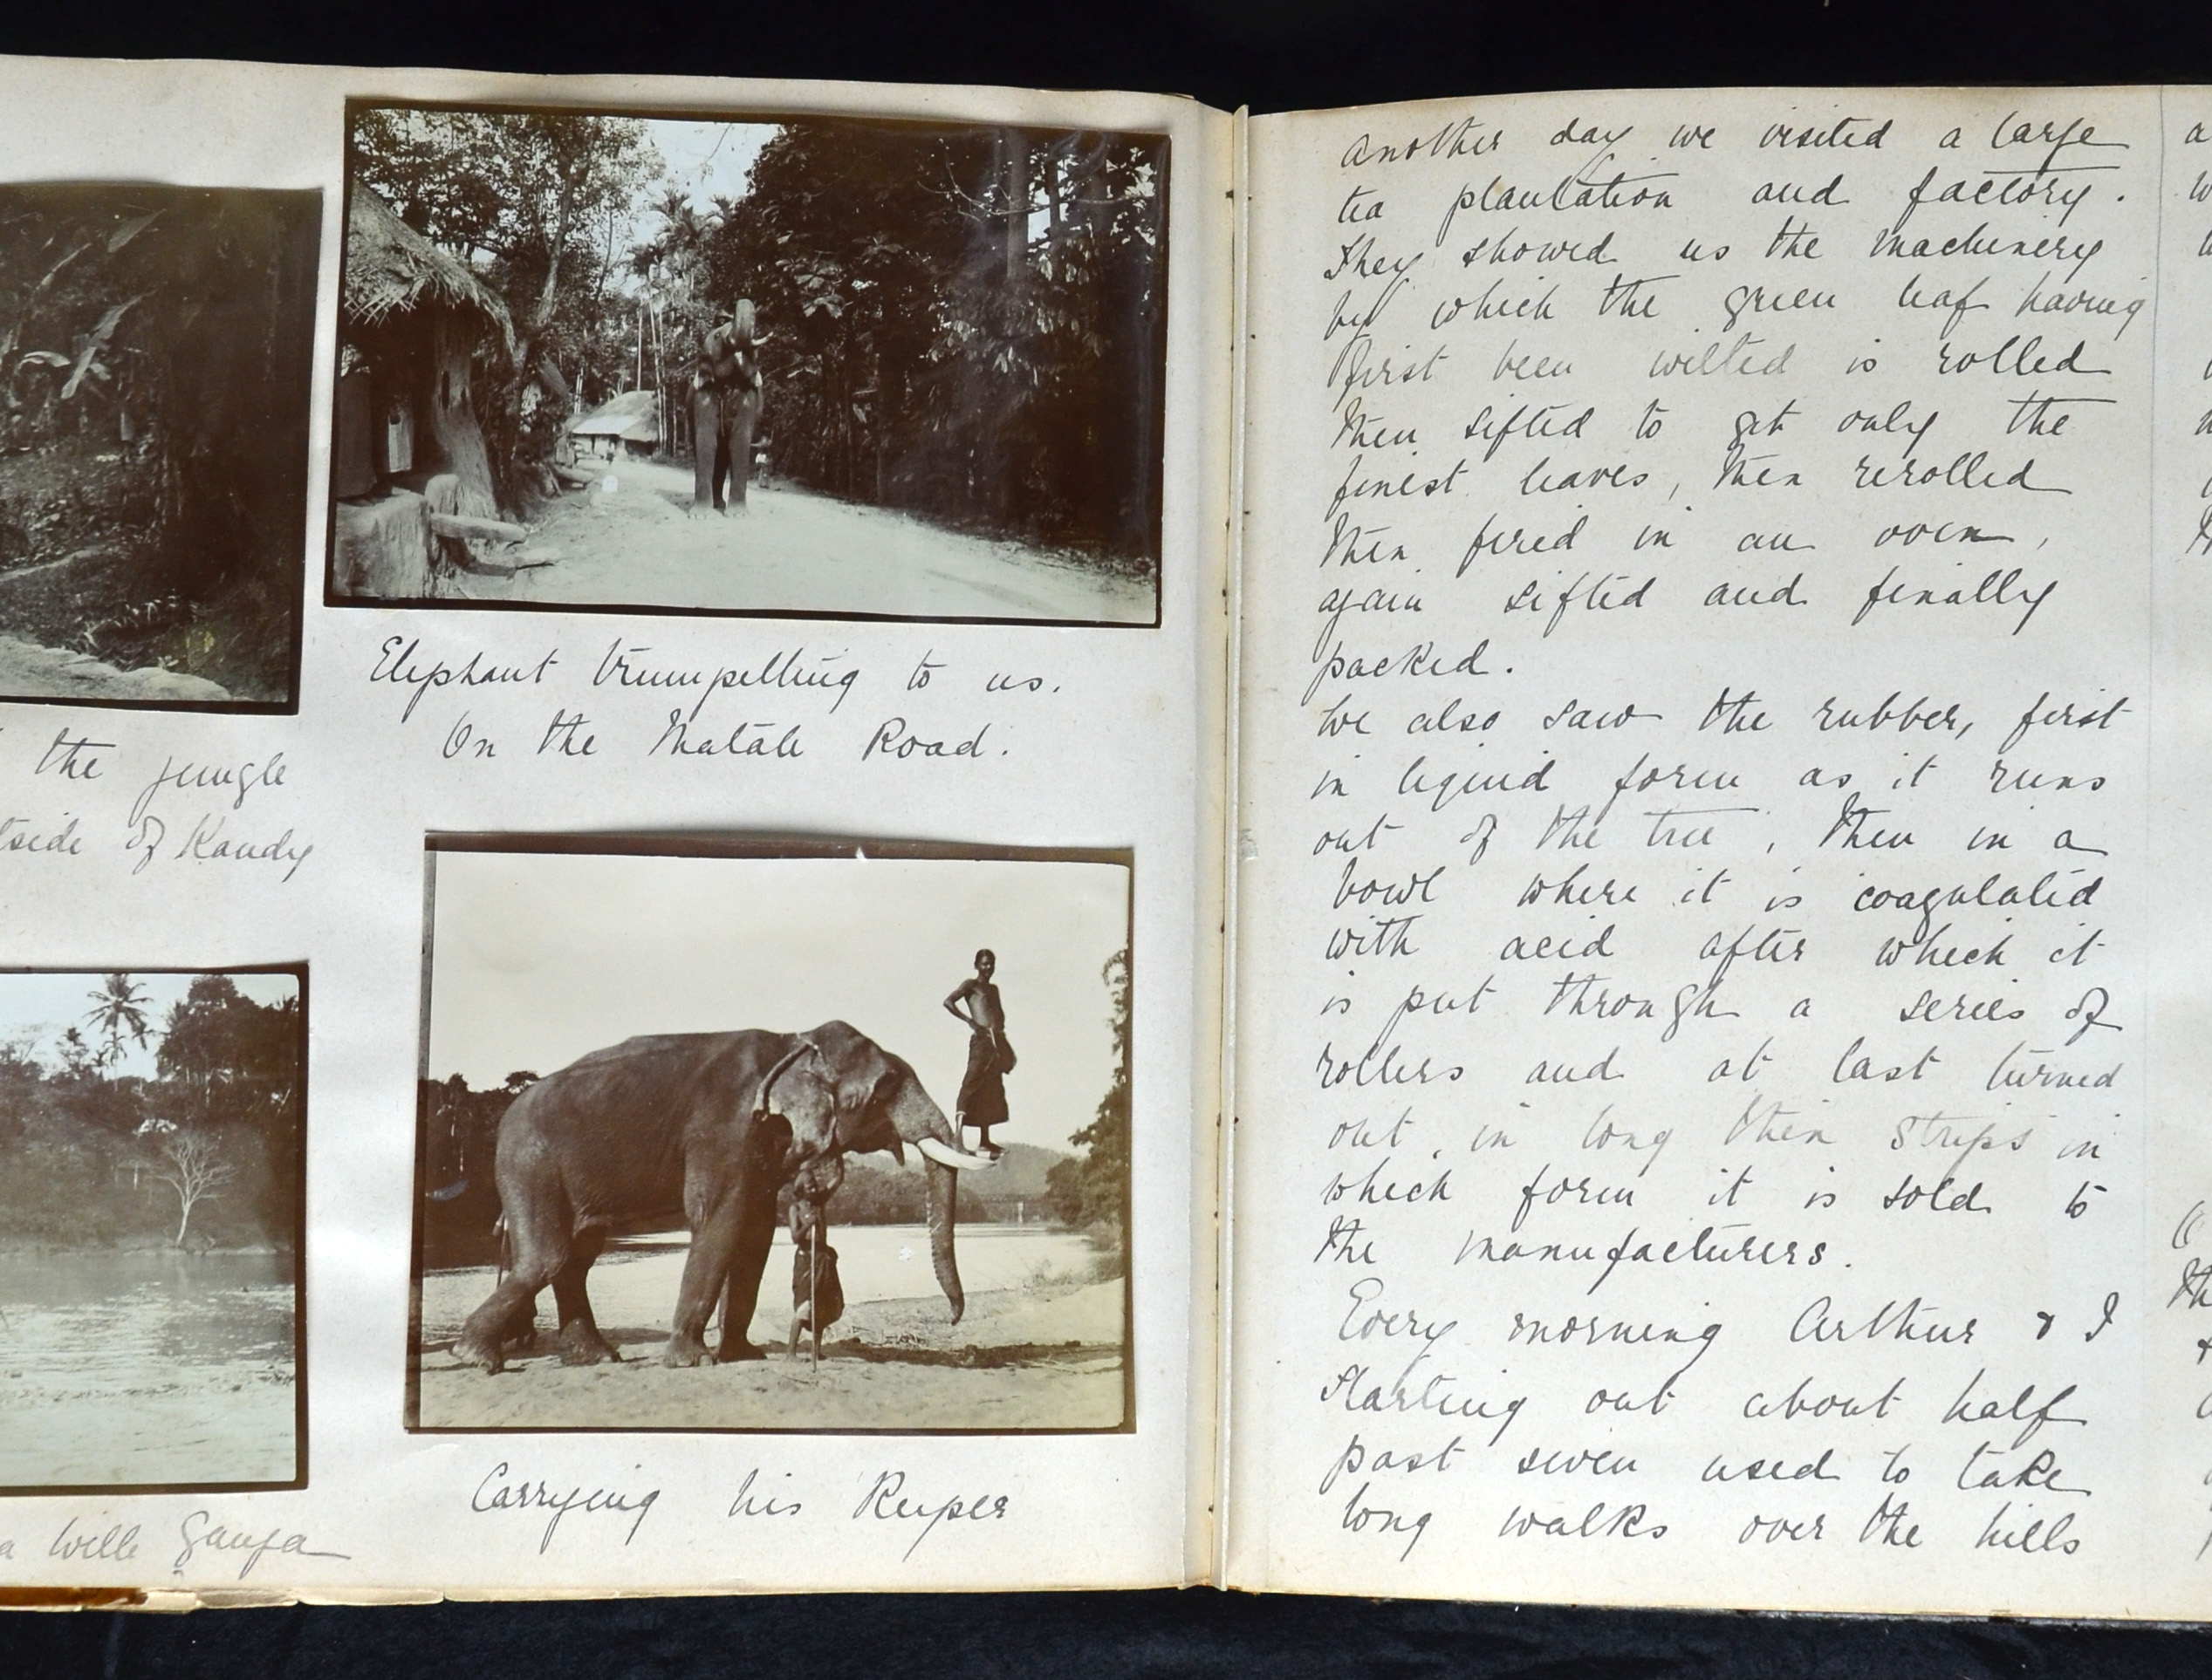
Eleanor Iselin’s travel diary
Kandi, West Bengal, India
1913
JJ.2015.4.33.a

Slide 53
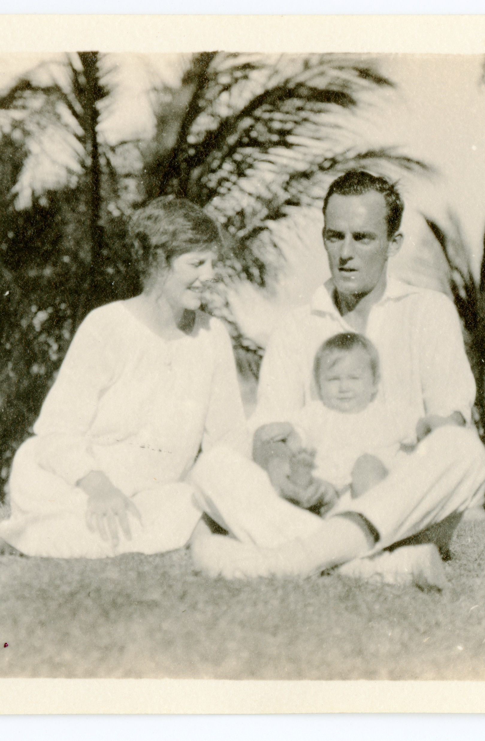
Dorothy jay pascal, guy Sherman paschal, Barbara paschal
Palm Beach, Fl
1928
JJ.2015.19.2.h

Slide 54
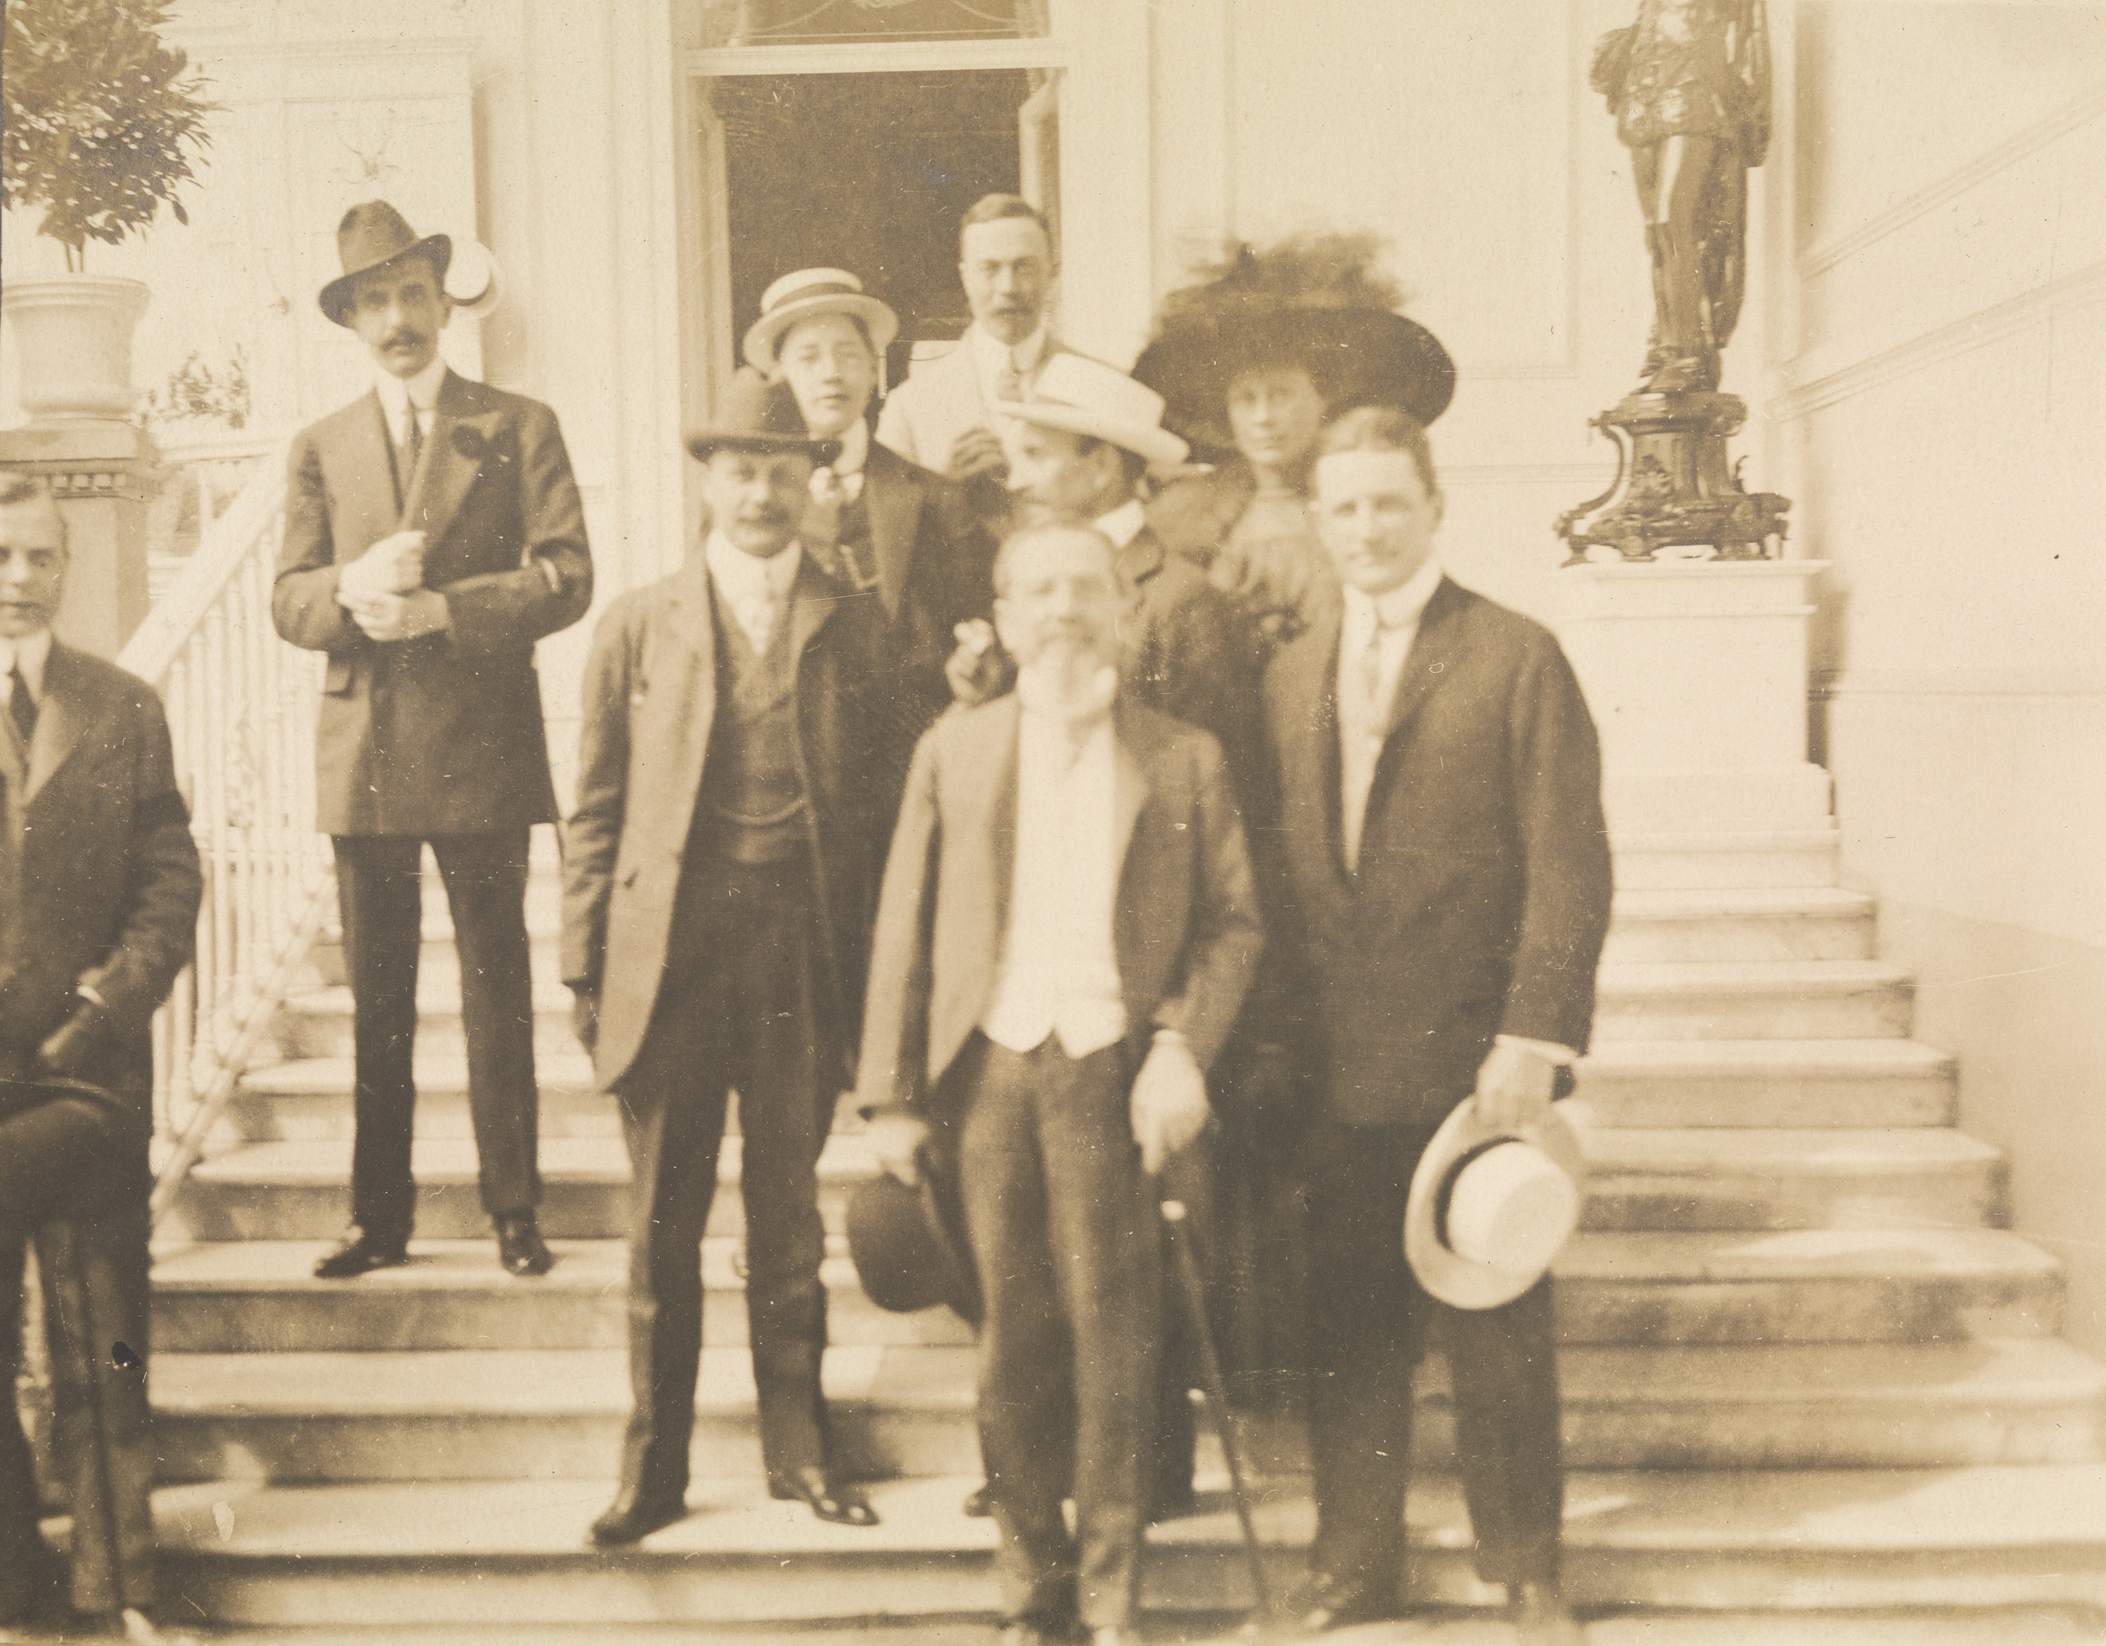
Eleanor jay Iselin and Arthur iselin
Mexico City, Mexico
1910
JJ.2015.5.25

Slide 55
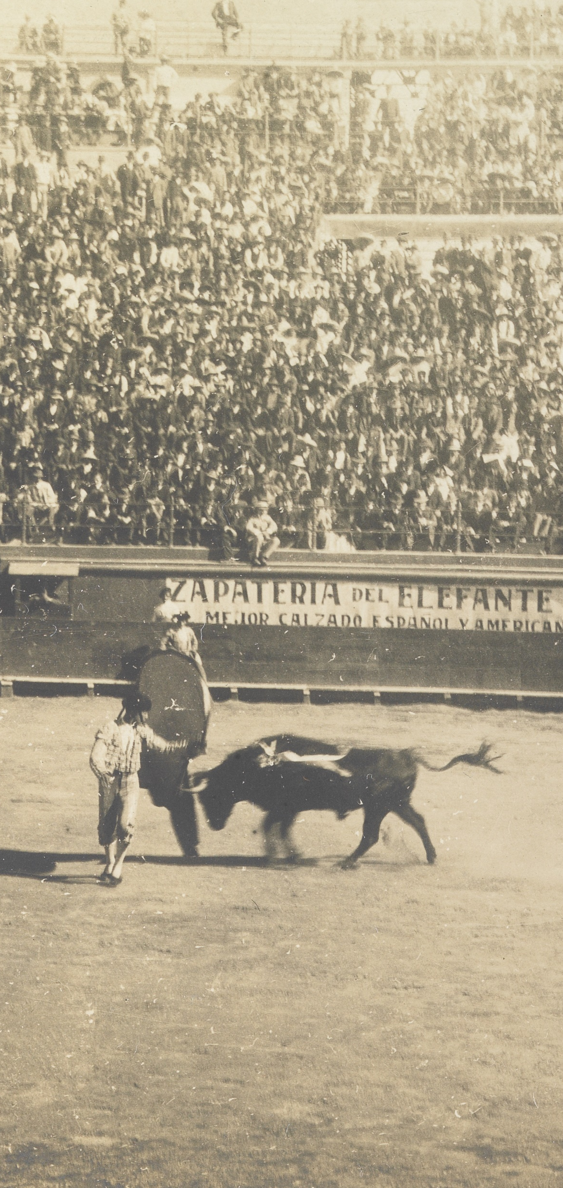
Bullfighter
Mexico City, Mexico
1910
JJ.2015.5.25.d

