Slide 1
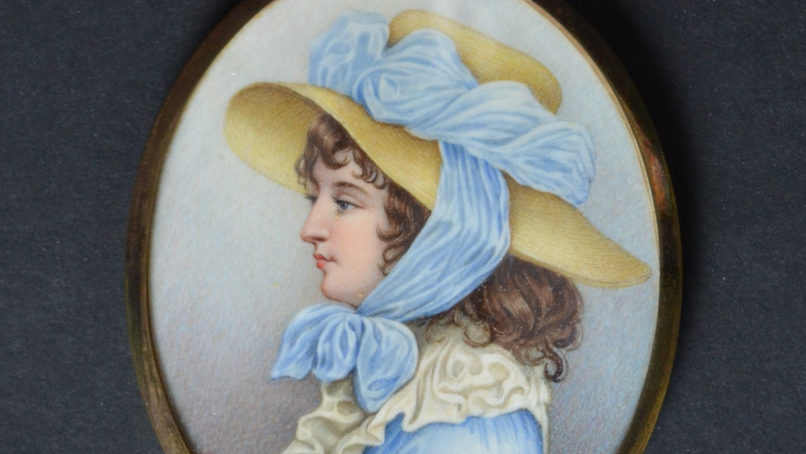
Mementos in Miniature

Slide 2
Delicate and diminutive, this collection of Jay descendant miniatures exemplifies the American iteration of this very personal art form. Miniature portraits were painted to celebrate an intimate relationship, whether it be of a lover, parent, sibling, or friend. They could be commissioned for celebratory purposes, such as a betrothal, or as a means to mourn and remember a deceased loved one. Many were housed in specially-crafted cases to be worn as jewelry or discreetly carried, enabling one to keep their beloved close.
In the early years of the republic, few artists created this dizzyingly detailed type of painting. Most miniatures of the 18th and 19th century were painted with watercolor on thin sheets of ivory, which lent a glowing quality but also proved a fickle canvas with no room for error. A minute, fine-pointed brush painstakingly applied layers and layers of watercolor. Textures and forms were created from hatched lines, stippling, or a combination of both. Many of the most important and talented American miniaturists are represented in the Jay collection, including John Ramage, Anson Dickinson, and John Wood Dodge.
American miniaturist and author Thomas Seir Cummings (1804–1894) said: “Miniature painting is governed by the same principles as any other branch of art, and works in miniature should possess the same beauty of composition, correctness of drawing, breadth of light and shade, brilliancy, truth of colour, and firmness of touch of works executed on a larger scale.”

Slide 3
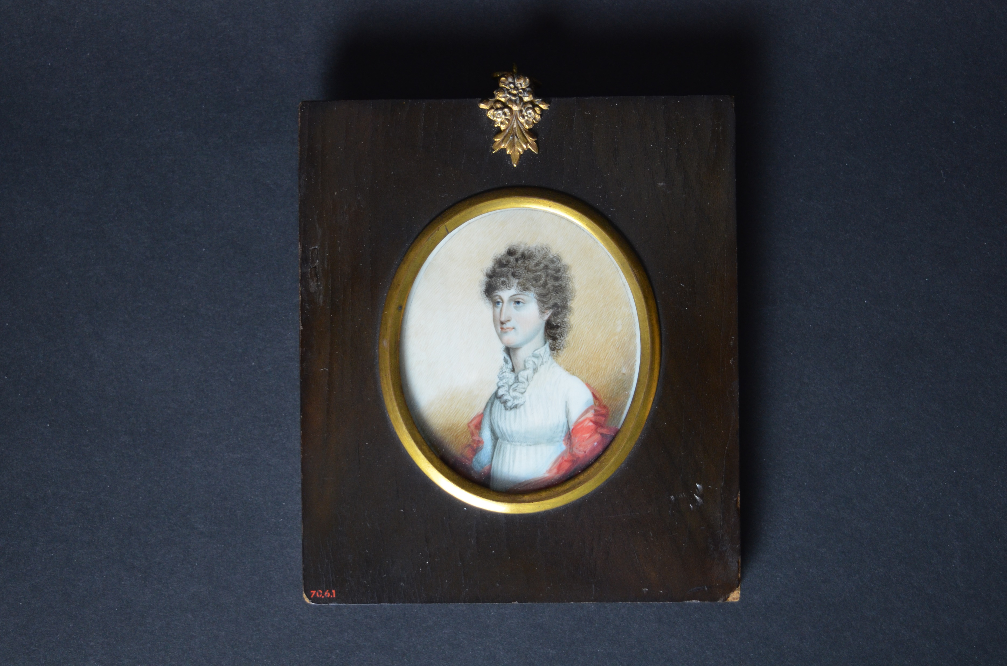
Ann “Nancy” Jay (1783–1856) c. 1810 Watercolor on ivory Att. Anson Dickinson (1779–1852) JJ.1970.9
This miniature depicts John Jay’s third daughter, Nancy Jay. The artist expertly captures Nancy’s well known equanimity in her placid expression. She wears a white muslin empire dress with high neck ruffles, a modest take on the fashion of the day. The gauzy orange shawl adds a playful pop of color and is perhaps a sign that there is more to Nancy than meets the eye.

Slide 4
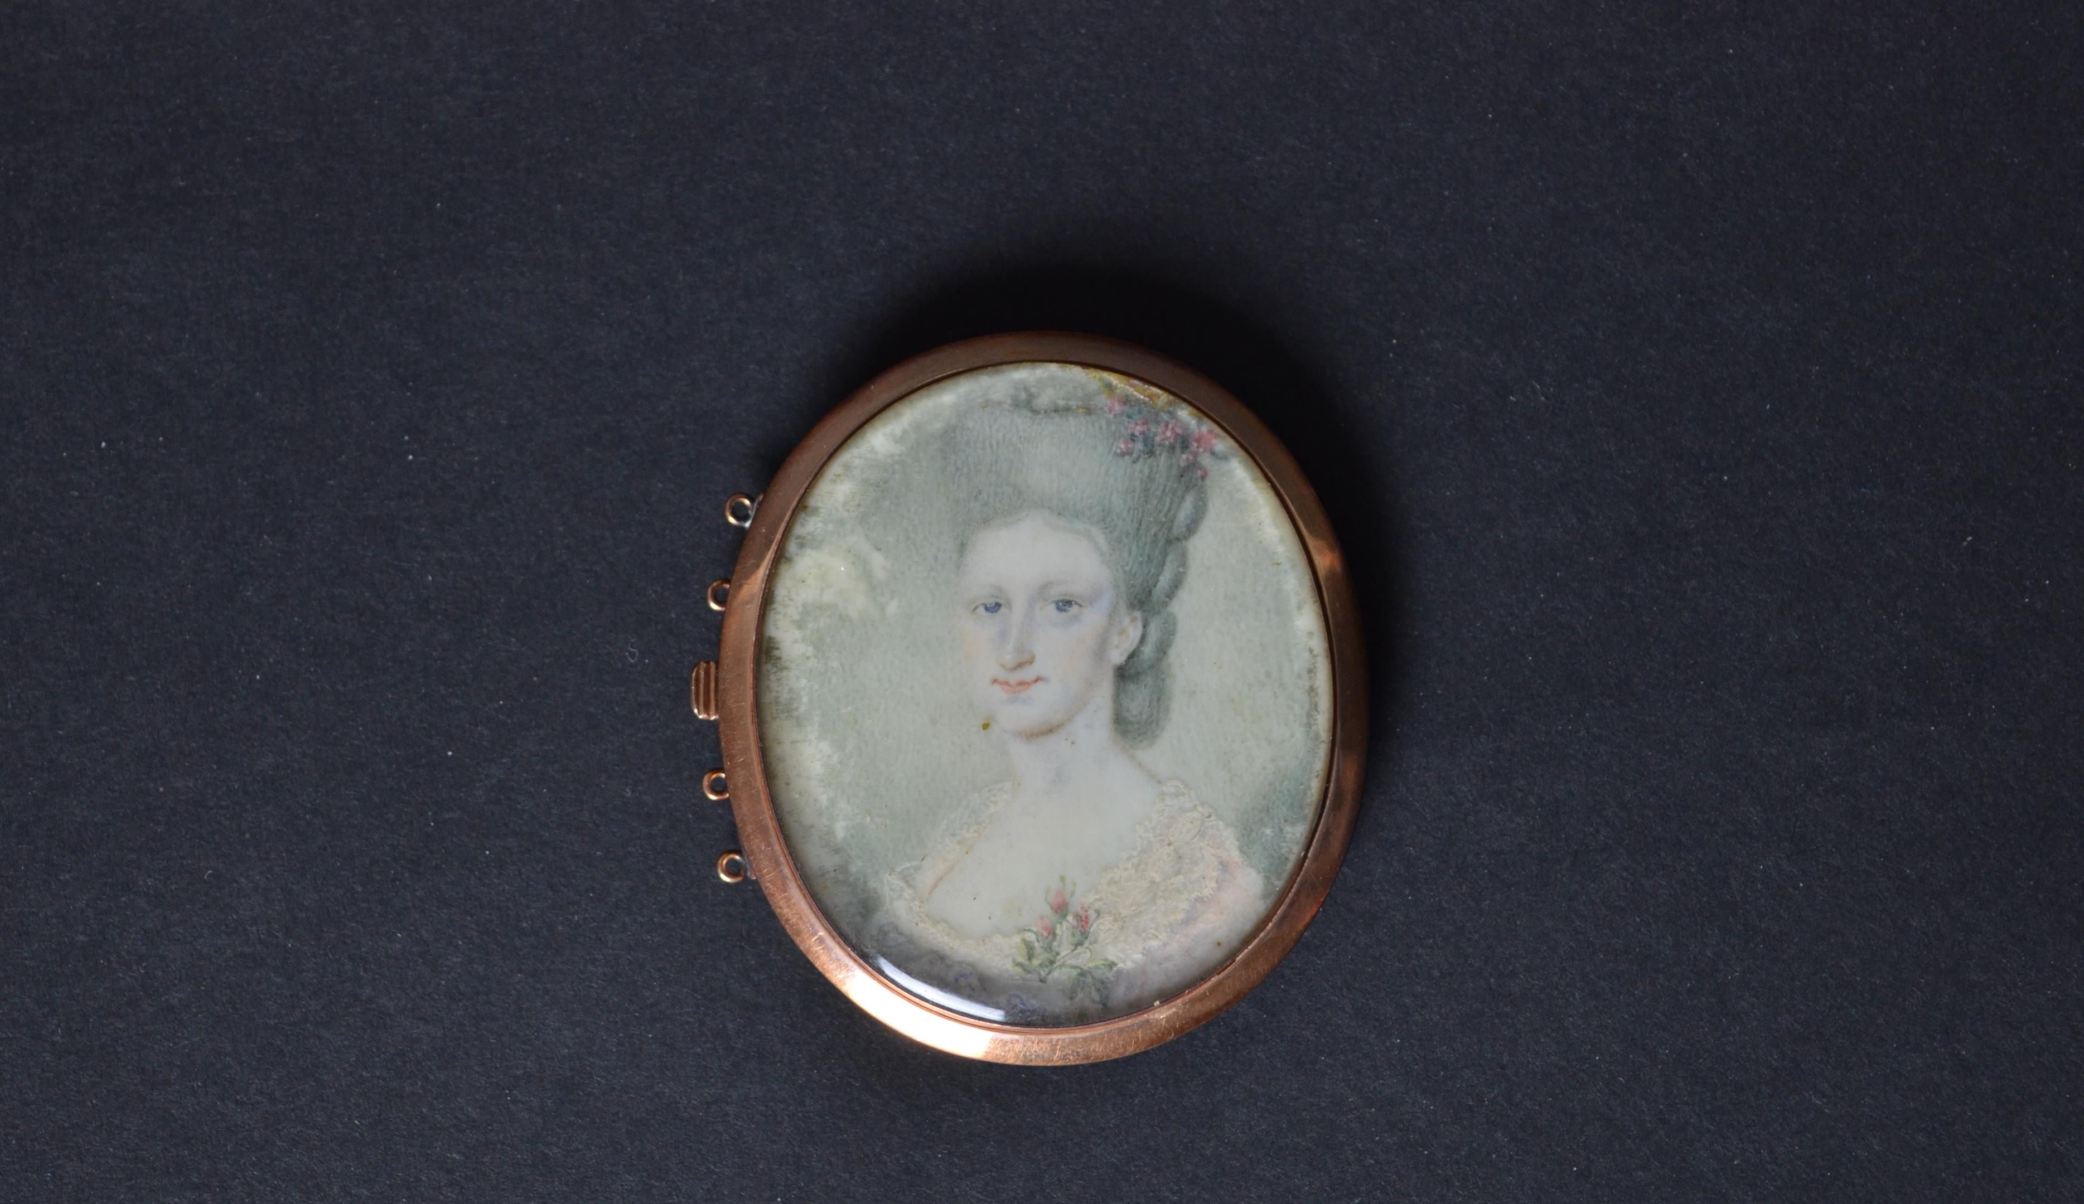
Sarah Jay née Sarah Van Brugh Livingston (1756–1802) c. 1784 Watercolor on ivory Att. William Verstille (1757–1803) JJ.1984.189
Throughout a miniature’s existence, the sentiment attached to it was ever changing. Lovers often exchanged miniatures as a courtship turned to betrothal or as a wedding gift to one another. This miniature was likely made in the early years of Sarah’s marriage to John Jay. Sarah and John’s daughter Maria Banyer came into possession of it (very likely after their deaths), changing the casing to include her father’s plaited hair. At this point the miniature changed from a token of romance to one of mourning and remembrance. As the inscription on the back notes, Maria Banyer gave it to her niece Elizabeth Clarkson Jay, who was born many years after the death of her grandmother Sarah.

Slide 5
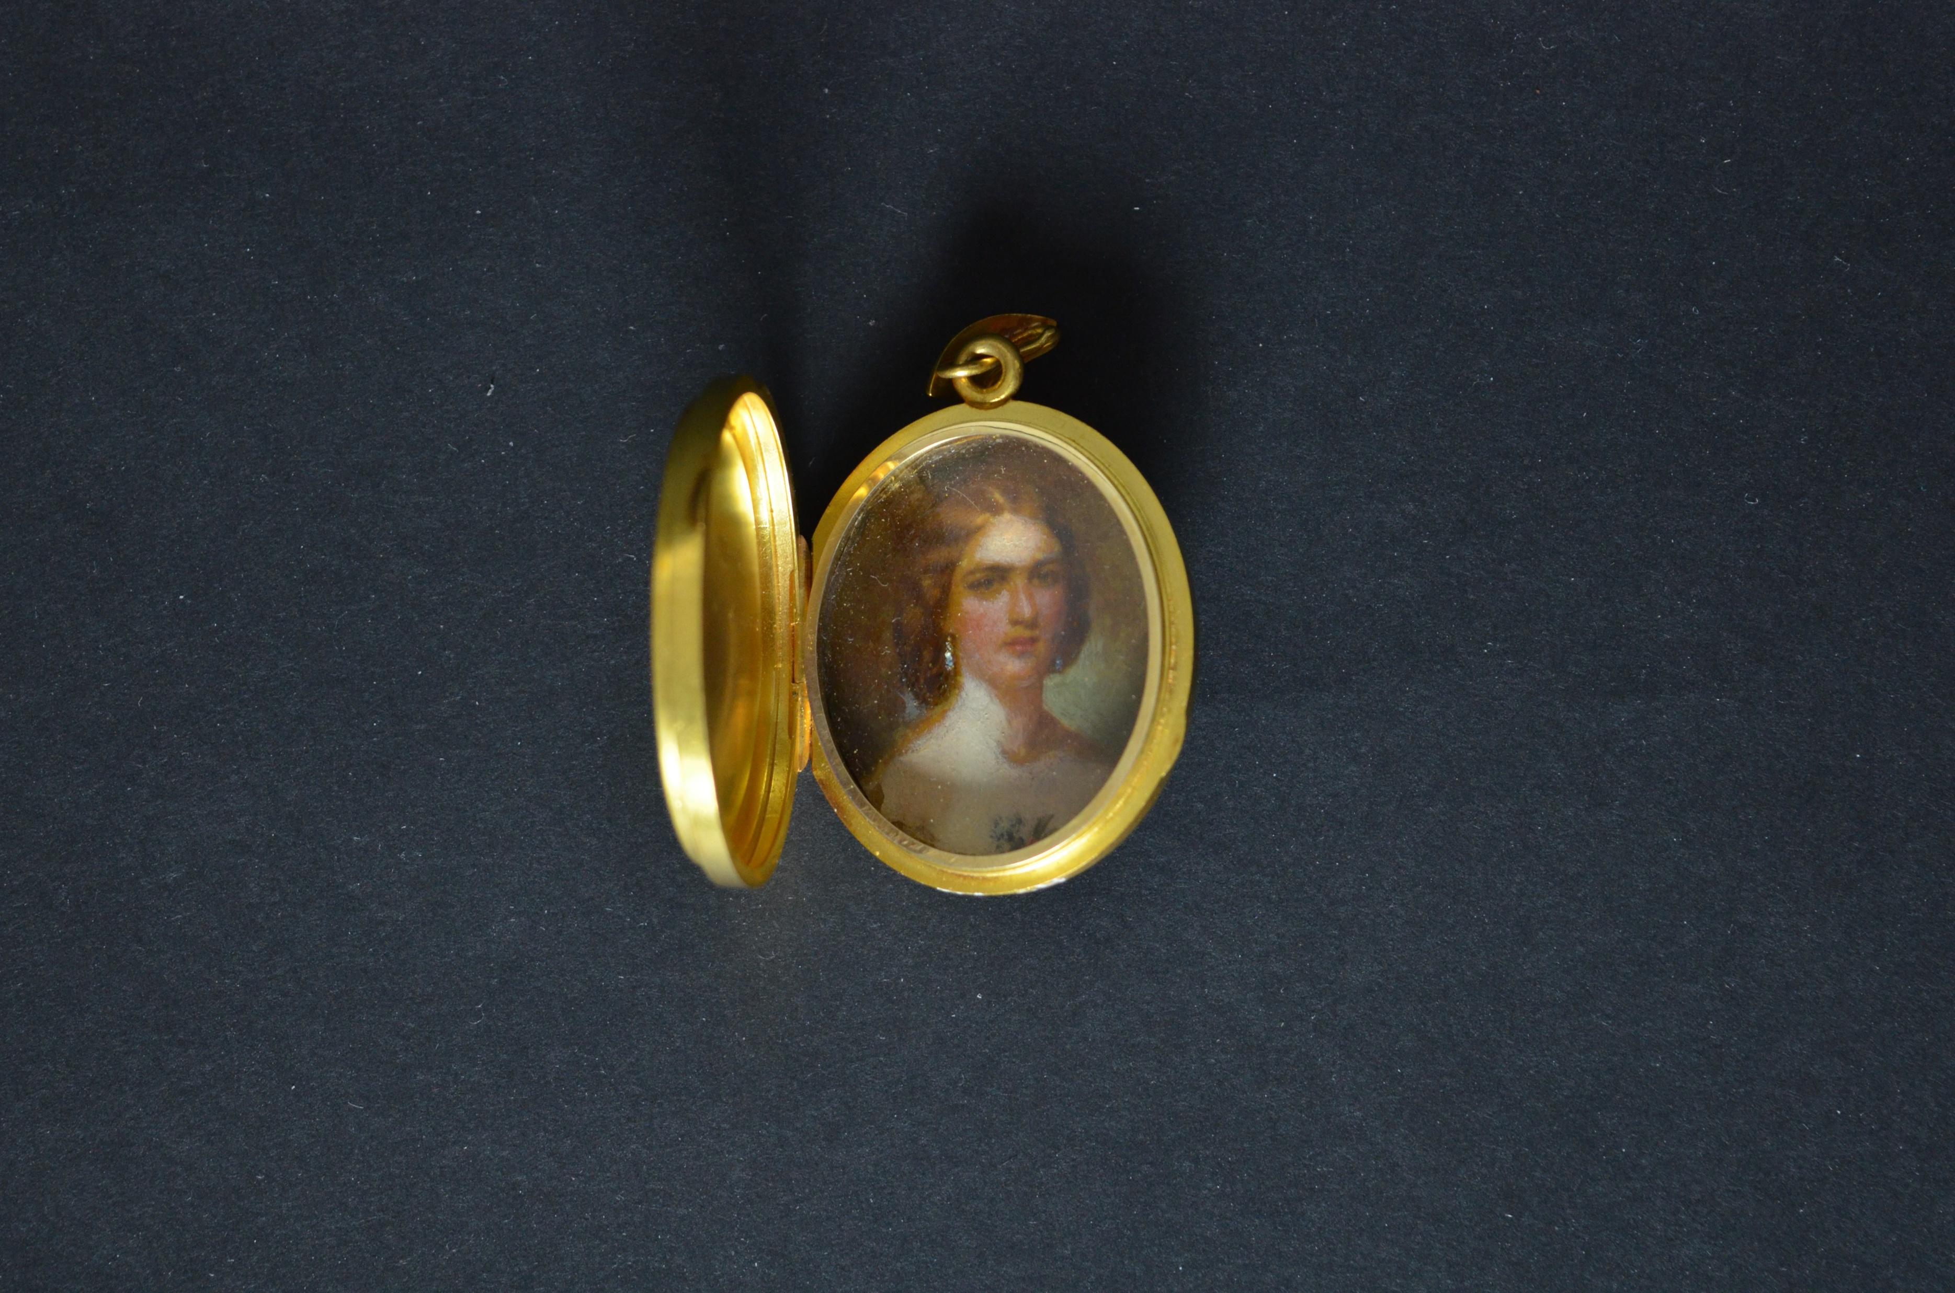
Josephine Pearson Jay (1829–1852) c. 1850 Watercolor on ivory, gold locket Unknown artist JJ.1978.64.A-B
Josephine Pearson Jay was married to Peter Augustus Jay II (1821–1855) in October of 1848. Inscribed on back “AJ from ECJ” and inside “Think of my last words. JJ.” Josephine died at the young age of 23. The inscription on the back of the locket indicates this miniature was painted posthumously. “AJ” is likely Augustus Jay (1850–1919), Josephine & Peter’s only son, and “ECJ” is likely Elizabeth Clarkson Jay (1825–1891), Augustus’ aunt and Josephine’s sister-in-law. The relatively short lives of Peter and Josephine reflect the high mortality rate of the eighteenth and nineteenth centuries. This was no doubt meant to be a wearable memento of a loved one for young Augustus.

Slide 6
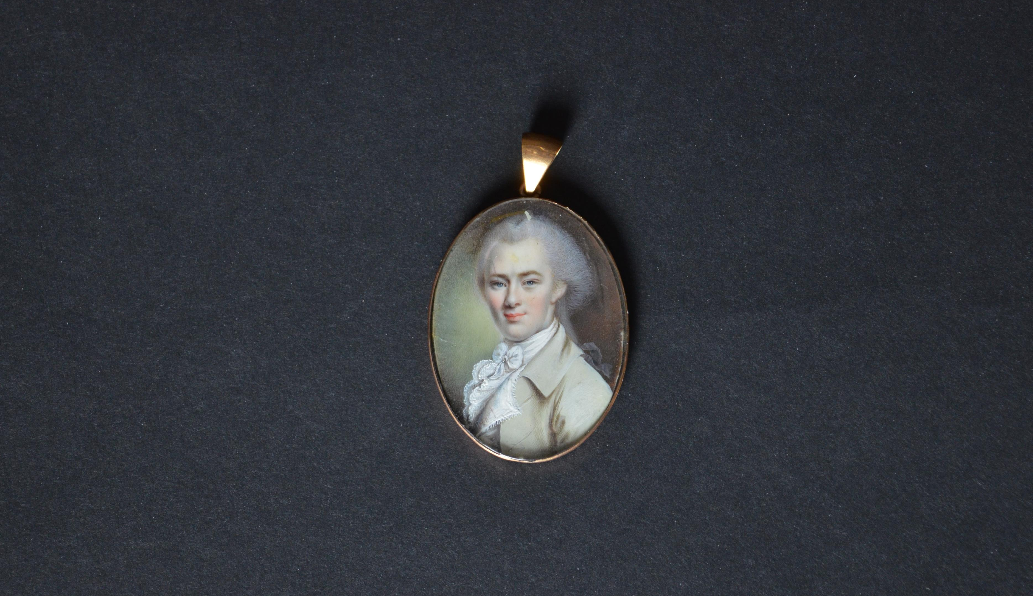
Peter Jay Munro (1767–1833) Late 18th century Watercolor on ivory Att. John Ramage (1762–1802) JJ.1978.65.A-B
Peter Jay Munro had a close relationship with his uncle, John Jay, whom he accompanied to Europe in 1783 as secretary during the Treaty of Paris negotiations.

Slide 7
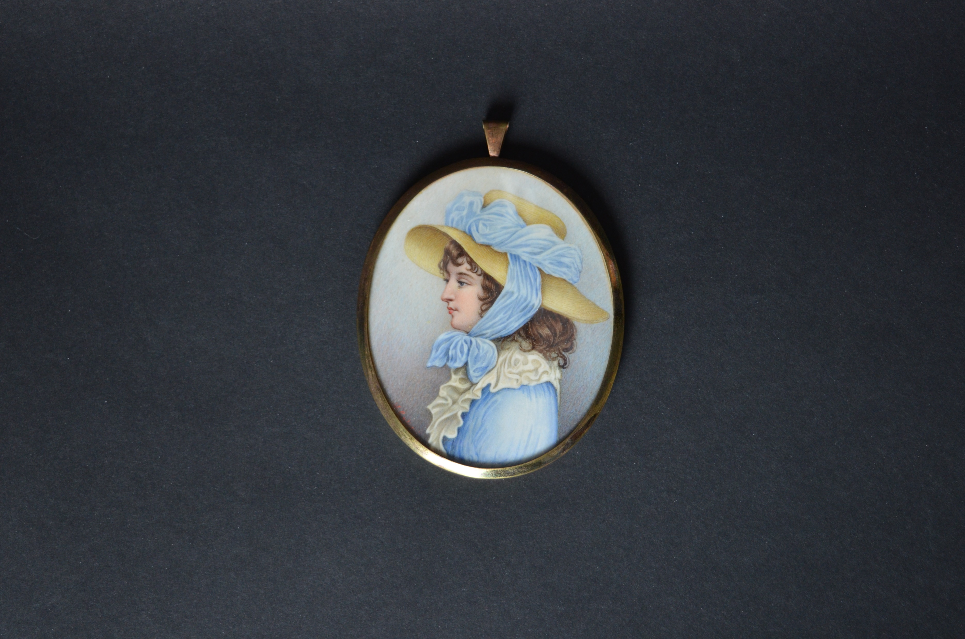
Sarah Jay née Sarah Van Brugh Livingston (1756–1802) c. 1850 Watercolor on ivory, gilt frame S. Calistri (life dates unknown) after a lithograph by James Sharples (1751-1811) JJ.1981.10
Sarah’s likeness in this miniature was taken from James Sharples’s larger pastel Jay family portrait. Produced decades after her death, we do not know who commissioned this memento of the Jay family matriarch. This image captures Sarah’s much celebrated style and elegance, which is evident in the abundance of ruffles around her neck, the vivid blue of her dress and the dramatic ribbons adorning her straw hat.

Slide 8
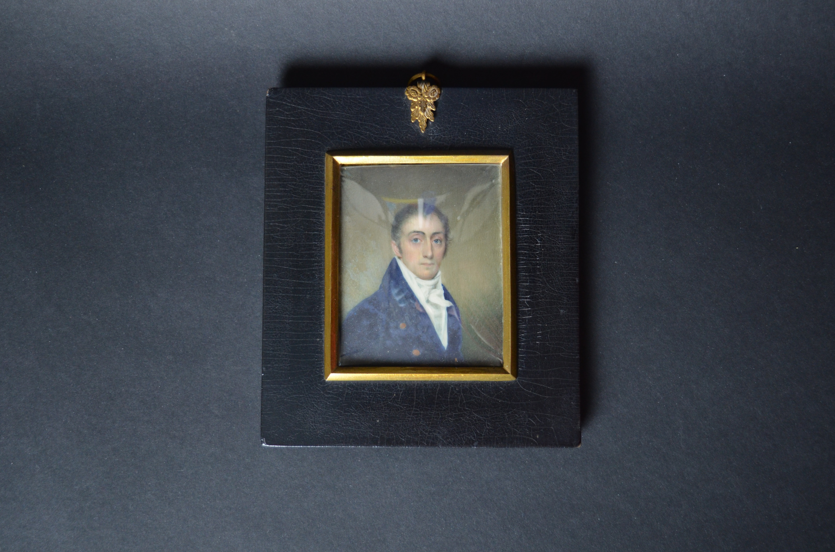
Peter Augustus Jay (1776–1843) 1808 Watercolor on ivory Att. Joseph Wood (1778–1830) JJ.1983.1 A-B
In the spring of 1889, the Washington Centennial Loan Exhibition was held in New York City. To celebrate the 100th anniversary of George Washington’s inauguration, a committee formed to collect and display artifacts from the early years of the republic. The Jay family, like many prominent families of the day, lent their “portraits and relics,” including swords, silver spoons, and six miniatures, this one included. By 1889 the popularity of miniatures had waned thanks to the advent of photography, but these personal tokens, handed down through the generations for almost a century, still held a place of pride within many families.

Slide 9
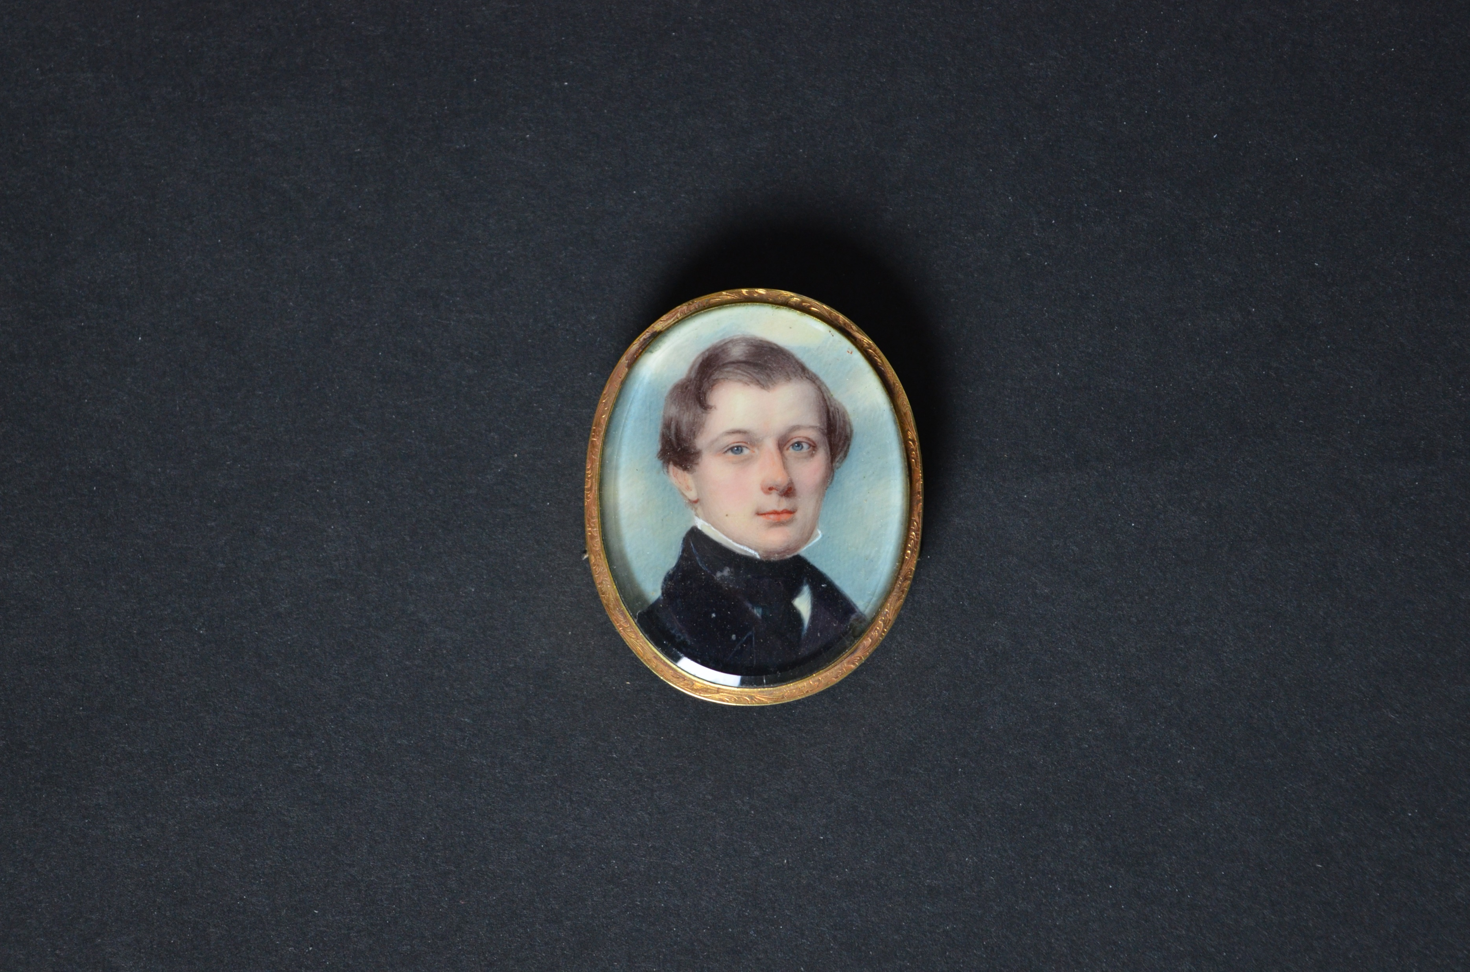
Peter Augustus Jay II (1821–1855) c. 1838 Watercolor on ivory Att. John Wood Dodge (1807–1893) JJ.2006.35
Likely a token of love, this miniature of John Jay’s grandson Peter Augustus has two hinges on either side of its casing, indicating that it was to be worn as a bracelet. This expertly executed miniature by John Wood Dodge, who painted over one thousand miniatures during his long life, showcases Dodge’s talent for capturing a beautiful yet realistic likeness. His portraits often have finely detailed hair and a luminous, porcelain-like complexion.

Slide 10
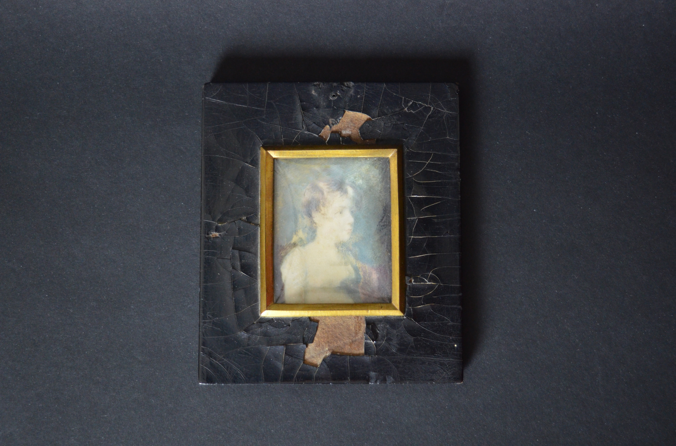
Sarah Louisa Jay (1792–1818) 1808 Watercolor on ivory Anson Dickinson (1779–1852) JJ.1983.2 A-B
According to his meticulously-kept ledger, the artist Anson Dickinson painted over 1500 miniatures throughout his four-decade career, including at least six of the extended Jay family. Despite its poor condition, this miniature of John Jay’s youngest daughter, Sarah Louisa, shows Dickinson’s proficiency. With impressionistic brushstrokes, he captures her calm expression and heavy-lidded, intent gaze. The shawl thrown hastily over her left shoulder is perhaps a nod to her youth. In his ledger, Dickinson notes painting Sarah’s older sisters Maria Banyer and Nancy, as well as her brother in the same year.

Slide 11
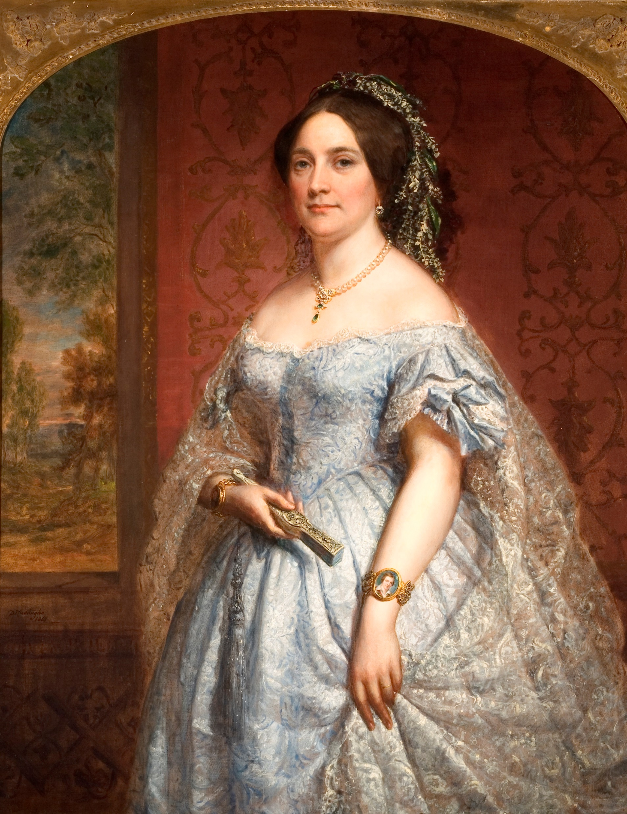
Eleanor “Ella” Kingsland Field Jay (1819–1909) 1860 Oil on canvas Daniel Huntington (1816–1906) JJ.1958.417
In this elaborately staged portrait, Ella proudly wears her finery—intricate lace cape, flowing flowered headdress, delicate silk gown, and gold jewelry, including a bracelet adorned with a miniature of her teenaged son, William Jay II. She uses her closed, carved fan to proudly point directly to the small portrait, as if to make sure the viewer does not miss it. While miniatures are often thought of as personal mementos, this portrait illustrates how they were often worn as a public expression of love.

